Slide 1
SUMMER SEMINARS 2026
“Recovering the Supernatural Christian Faith”
Tuesday, June 2 “The Rise of Anti-Supernaturalism”
Tuesday, June 16 “Dead Ends”
Tuesday, June 30 “The Road to Recovery”
All seminars begin at 7:00 p.m.

Slide 2
RECOVERING the
Supernatural Christian Faith
Seminar 3: “THE ROAD TO RECOVERY”

Slide 3



Slide 4
REVIEW
My thesis has been that the relentless drumbeat of secularism or atheism has largely captured the culture.
The centers of academia and the intellectual world have dismissed any notion of God, and with it have forfeited, ruled out, excluded any reference to the supernatural: the soul, heaven and hell, an afterlife and judgment day, angels, spirits, etc.
There is only machine. The entire universe is only a complex machine that came from nowhere, serves no ultimate purpose, grants no meaning to our existence, and will collapse into irrelevance. Humans are only part of that utterly meaningless machine.
Any human sense of love, truth, beauty, morality, or higher purpose is an illusion that may or may not bring comfort to some, but remains an unreal illusion, nonetheless.

Slide 5
REVIEW
Since this bleak, empty view has captured the minds of the elites and completely dominates virtually all forms of popular media, Christians, whose religion is inherrently supernatural, have been adversely affected by osmosis mainly, but also by the constant, subtle, active coercion of the culture.
It’s an example of what my favorite living theologian described in his definition of “worldliness” in his book Losing Our Virtue: “Worldliness is that system of values, in any given age, which has at its center our fallen human perspective, which displaces God and His truth from the world, and which makes sin look normal and righteousness seem strange. It thus gives great plausibility to what is morally wrong and, for that reason, makes what is wrong seem normal.”
Worldliness “makes sin look normal and righteousness seem strange.” And the strident pressure by the anti-supernaturalists makes the biblical faith seem strange as well.

Slide 6
REVIEW
I’m not going to do a lengthy review of the previous lectures as I did last time. You can review them online. But I will give you just enough to refresh the memory and bring you up to speed.
The heavyweight, Roman theologian Thomas Aquinas first distinguished between “nature and grace.” He suggested that, while grace or spiritual matters could only be known by Scripture, nature, the natural or physical world could rightly be known and understood through observation and reason.
He also made the fatal mistake of arguing that the human reason was unfallen, unaffected by sin, and could be trusted.
GRACE
NATURE

Slide 7
REVIEW
Over the next several centuries, this division developed further so that the supernatural world was dismissed as unknowable and irrelevant (unscientific, and so unreal) and only the natural world was accepted as knowable, and so, relevant.
All was machine, humans included.
And, I argued that this has left us orphaned in the universe, marooned in a bleak, cold, useless existence with no meaning, ironically, irrelevant!
God was declared irrelevant, and eventually we realized that we were irrelevant!
Despite the protests of leaders in this movement, this conclusion is logically required by the anti-supernaturalist worldview. It’s inescapable.

Slide 8
REVIEW
This perspective captured the intellectual world during the time of the enlightenment (~1650-1850) promising liberation from the constraints of (biblical) morality. But the tradeoff required the forfeiture of any ultimate hope, not to mention any foundation for human worth or dignity.
It’s no wonder then that atheism has led to the murders of 170 million people in the last century alone.
That also explains how the most significant factors of our human existence,
God made us,
sin ruined us,
Christ redeems us,
the Holy Spirit restores us,
and Christ is coming again to rescue us
were suddenly declared absolutely irrelevant and off limits to serious thinkers.

Slide 9
REVIEW
One segment of the “church” completely capitulated to this perspective and totally redefined itself.
In Theological Liberalism, God was reduced to an impersonal feeling, a comforting perception, a mere psychological balm.
But this “religious” view is just as anti-supernaturalist as atheism.
A later branch of this movement was honest enough to call itself “Christian Atheism.”

Slide 10


Slide 11
REVIEW
I must repeat a quotation from an earlier critic of modern anti-supernaturalism, Francis Schaeffer, in order to illustrate the distinction between these two views:

Slide 12
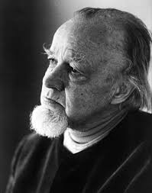


Slide 13
REVIEW
“According to the biblical view, there really are two parts to reality: the natural world—that which we see normally—and the supernatural part. When we use the word ‘supernatural,’ however, we must be careful. The supernatural is really no more unusual in the universe from the biblical viewport, than what we normally call the natural. The only reason why we call it the supernatural part is that we usually cannot see it. That is all. From the biblical view—the Judeo-Christian view—reality has two halves, like the two halves of an orange. You do not have the whole orange unless you have both parts. One part is normally seen, and the other is normally unseen.

Slide 14
REVIEW
“I would suggest that this may be illustrated by two chairs. The men who sin in these chairs look at the universe in two different ways. We are all sitting in one or the other of these chairs at every single moment of our lives. The first man sits in his chair and he sees the total reality of the universe, the seen part and the normally unseen part, and consistently sees truth against the background. The Christian is a man who has said, ‘I sit in this chair.’ The unbeliever, however, is the man who sits in the other chair, intellectually. He sees only the natural part of the universe, and interprets truth against this background.

Slide 15
REVIEW
“Let us see that these two positions cannot both be true. One is true: one is false. If indeed there is only the natural portion of the universe, with a uniformity of natural causes in a closed system, then to sit in the other chair is to delude oneself. If, however, there are the two halves of reality, then to sit in the naturalist’s chair is to be extremely naïve and to misunderstand the universe completely. From the Christian viewpoint, no man has ever been so naïve, nor so ignorant of the universe, as twentieth-century man.” (Or every anti-supernaturalist in the world, which is a rising number every year.) (Schaeffer, True Spirituality, 56-7).

Slide 16
REVIEW
But as we saw last time, some have attempted in recent decades, to try to restore some sense of the supernatural. I described three false starts in this regard.

Slide 17
REVIEW
One was emotionalism, using various techniques to attempt to appeal to the feelings: mood music and lighting, humor and gripping stories, in a word, “entertainment” that seeks to enflame the emotions, with notable success.
It’s obviously true that emotions can be stoked through various natural means.
And I do think that many people want to feel something, especially to feel something in worship. I have heard people pray that they would “sense God’s presence in worship.” I’m not exactly sure what they mean by that, but it does seem to imply that they was to feel something, to be emotionally moved. We will address the place of affections later on.
And yet, as is evident, there is nothing really supernatural about stirring up emotions. Any group, secular or religious, can do so using the proper techniques.

Slide 18
REVIEW
Another attempt at interjecting something supernatural back into the Christian life is called “re-enchantment.”
This is the view of Eastern Orthodoxy. It argues that the Protestant Reformation along with later modernism drained the spiritual from the material world.
Eastern Orthodoxy has gained a following among former Evangelicals, mostly for the appearance of restored supernaturalism.
Through the rites and rituals, the “smells and bells” of Orthodoxy, this view argues that it can re-capture the spiritual, “learning to open our eyes to the reality of the world of spirit and how it interacts with matter.”
This view clearly falls prey to the charge of mysticism and seems to cast a longing eye toward pantheism: all is God or God is in all things.

Slide 19
REVIEW
A more noticeable attempt at this quest at retrieving the supernatural is what J.I. Packer has called “super-supernaturalism.”
It is the insistence on the need for contemporary miracles, signs, and wonders. The Pentecostal/Charismatic movement has been on the forefront of this attempt for over a century.
A dangerous spin-off of Pentecostalism is the more recent “New Apostolic Reformation.” In just the last few decades, they argue, we have now entered into the “last days.”
And God has restored to the church the offices of prophet and even apostle to convey new revelation the church will need to weather the storm as we approach the Second Coming.
You can find my critique of this silly nonsense in the previous lecture, and an extended critique in a Summer Seminar I gave in 2023 ( hosperspca.org ).

Slide 20
INTRODUCTION
Let me give you an example of this problem of the loss of the supernatural in the Christian faith that crossed my desk a few months ago.
It was an unsolicited offer to provide counseling services to the members of our church (for a fee, of course).

Slide 21
INTRODUCTION
“My name is ______, and I’m a Licensed Social Worker with ______ in ____. In a small community, churches often walk closely with people through some of life’s hardest moments. I deeply respect that role and the care you provide.
“I offer therapy for children, teens, and adults, with a focus on anxiety, trauma, attachment, and emotional regulation. My approach is attachment-informed and trauma-focused, and I’m trained in EMDR (including with children). I also integrate play therapy and creative approaches, along with family therapy when it’s helpful.”

Slide 22
INTRODUCTION
Now here’s the more revealing part:
“For those who desire it, I am comfortable incorporating faith into the counseling process—whether that’s through prayer, Scripture, or simply honoring how spiritual beliefs are part of someone’s story. I also respect each person’s preferences and meet them where they are.”

Slide 23
INTRODUCTION
I have argued that the most significant factors of our human existence are:
God made us,
sin ruined us,
Christ redeems us,
the Holy Spirit restores us,
and Christ is coming again to rescue us.
But this therapist is quite sure that she can fix broken people while totally ignoring those five most significant factors of our human existence:
“For those who desire it….”
So, people can be made more “well-adjusted” and “high functioning” without any attention to the supernatural, the spiritual. Why?
Because people are machines.
Whatever she believes and practices in her private life, this therapist has been completely co-opted by anti-supernaturalism.

Slide 24
INTRODUCTION
So now, at last, we come to the important, practical matter of “Recovering the Supernatural Christian Faith: The Road to Recovery.”
We have diagnosed the problem and dismissed false remedies. So what really is the answer?
If there is both a physical world which we can apprehend with our senses, and a spiritual world which we cannot see, but is no less real or relevant, then how do we, in the view of Francis Schaeffer, “keep the two halves of the orange together”?
You are probably not going to like what I suggest as the first step in the remedy, in the first necessary modification in recovering the supernatural Christian faith.
That first, essential component is:
WITHDRAWAL.

Slide 25
I. WITHDRAWAL
Simply stated, a steady diet of atheistic, anti-supernaturalist indoctrination is unhealthy. False worldviews can be “caught” as well as “taught.”
We cannot laugh at or drink deeply from the manipulative propaganda of the flat world and be not be caught up in the artificial, unreality by their cunning stories and dramas that preach anti-supernaturalism in the popular culture.

Slide 26
I. WITHDRAWAL
I watch TV. I watch movies. Probably too much. I often crave the distraction of entertainment.
So, I have noticed some trends.
One is that religion in general, and biblical Christianity in particular, is either totally absent in popular entertainment media, or is despised and lampooned.
Think of popular dramas in which the hero is an outspoken atheist. There are two in particular that stand out to my mind.

Slide 27
I. WITHDRAWAL
One is “House,” and the character of the same name, the brilliant, atheist doctor and diagnostician. The other is “The Mentalist,” with the title character depicted as the brilliant, atheist, crime-fighting, former “psychic” who admitted that he was a fraud.
I only watched some episodes of House but thoroughly devoured all seasons The Mentalist.
Admittedly, the writing was quite skilled, and the dramas were engaging.
And the heroes were anti-supernaturalists.
In the world created by the writers (not the real world), the atheists were the heroes, the smartest, wisest, and most noble and righteous of all, while the other characters played only supporting roles, some even mildly religious.

Slide 28
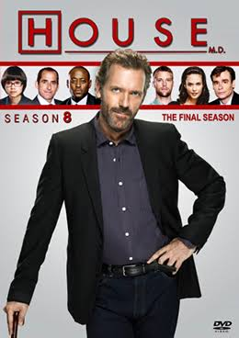


Slide 29
I. WITHDRAWAL
What the writers did not point out, perhaps because they didn’t understand the reality, is that both Dr. House and the Mentalist were inconsistent hypocrites.
Dr. House sought to alleviate human suffering.
Why? As an atheist, he would have to admit that all humans are mere bodies, chemical processes, mere machines who are part of the machine of the universe. Human suffering, as with truth, love, and beauty are an illusion.
What do we do with a broken part in a machine? We discard it and replace it.
The show was totally irrational. Any notion of human worth or dignity must be borrowed from the God that Dr. House has rejected and dismissed.
So, no matter the dramatic stories or the entertainment value, a rational person would necessarily dismiss the premise of the show as inconsistent, irrational nonsense.

Slide 30
I. WITHDRAWAL
And the Mentalist was supposedly a champion for “justice.”
Oops. How can an atheist be concerned about justice?
From the atheistic viewpoint, justice is an illusion. There can be no right or wrong, only preferences.
Justice, fairness, um, morality itself must presuppose a God who is just. Otherwise, the Mentalist’s sense of justice would only be an imposition of his truth upon others (which would be “unjust”?).
I know this all sounds absurd, but I’m only reading from the atheist’s script and playing by their rules.

Slide 31
I. WITHDRAWAL
I don’t know if the writers of these popular dramas just did not understand this or were trying to make some point.
Either way, the writers were banking on the viewers still holding to a sense of rightness and fairness so that they would find satisfaction in the Mentalist’s success in catching murderers. If the viewers were thinking atheists like the Mentalist himself, they would have scoffed at the absurdity of it all.

Slide 32
I. WITHDRAWAL
Even more hostile to biblical Christianity was the entertaining, truly hilarious sit-com, “The Office.”

Slide 33
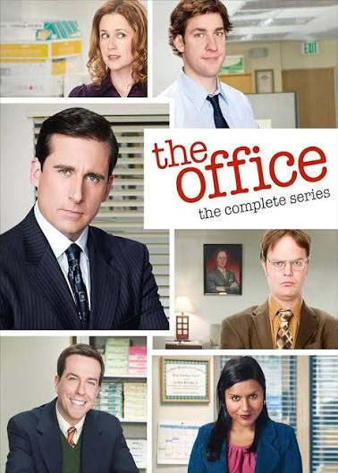
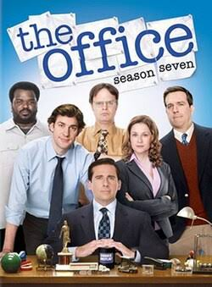

Slide 34
I. WITHDRAWAL
The only committed, religious, regular character in the show was the reprehensible, bigoted, judgmental “Christian” sourpuss and hypocrite.
Everyone else found religion irrelevant at best, even though, in the one religion episode, several characters named their religion or Christian denomination.
In this well-written comedy, the underlying premise showed several characters seeking happiness in life in various ways.
According to the writers, the road to true happiness was love, marriage, family, and children. But even then, religion was at best irrelevant, or even evil and hypocritical.

Slide 35
I. WITHDRAWAL
I’m not trying to whet your appetite for re-runs.
My caution is to remind you that popular culture, especially movies and television, creates alternate realities and is far more “preachy” than anything you will find on Sunday morning.
And aside from the sappy “Touched by an Angel” or the nostalgic “Little House on the Prairie” and similar franchises, virtually everything in film and television will be, in part or in the whole, indoctrination into anti-supernaturalist atheism (that includes Hallmark).
This is because the creators, writers, producers, and actors are almost exclusively anti-supernaturalists themselves (or they would be canceled if they were not).

Slide 36
I. WITHDRAWAL
So, part of the solution is withdrawal from the relentless propaganda/ brainwashing of the spiritually hostile popular media.
The other, larger part, is…
IMMERSION.

Slide 37
II. IMMERSION
I read a lot. I find great comfort and intellectual stimulation in books. I wish I had more time to read.
And in everything I have read from various authors, I have found that there is only one author who consistently keeps the two halves of the orange together, who always honors God with the central place he deserves in every discussion.
And that author is the Holy Spirit speaking in the Scriptures.
There can be no substitute for regular, daily immersion into the world where God matters most of all, where every word is true and trustworthy, and where there is no false dichotomy between “nature” and “grace,” the “natural” and the “supernatural.”
This world is accessed only through reading and pondering God’s Word, the sacred Scriptures.

Slide 38
II. IMMERSION
One of the things we said we were trying to recover was, in Francis Schaeffer’s words, “the reality.”
Here, in Scripture, is the real world as it is, as it actually exists and as it should be understood. It is the world free from spin, free from the expectations and interpretations that we sinners so constantly apply to whatever we perceive.
Our natural proclivity is to place ourselves in the exact center of the universe, when the universe already has a Center.
Another way of describing what we said we wanted to recover was, in Matthew Bingham’s words, “God-consciousness.”
And where else can we find true and accurate “God consciousness” if not in the book authored by the Spirit of God himself?

Slide 39
II. IMMERSION
If we had remained attentive to the biblical doctrines we say we believe, there would have been be no loss of “reality” or “God-consciousness,” of the “supernatural.”
Every doctrine in Scripture demands the “two halves of the orange.” Every biblical doctrine is supernatural. Let’s just run through the list.

Slide 40
II. IMMERSION
CREATION
God made all things out of nothing by the word of his power. Have you looked around you lately? Have you? God’s creation is astounding!
We recently received an inch of well-needed and well-appreciated rain.
I asked AI how many gallons of rainwater an inch of rain would drop on one square mile.
That’s over seventeen million gallons!
And where does all that water come from? Mainly from the ocean. Evaporation raises billions of tons of water from the ocean, forming clouds and storms that drop the purest, distilled water on our thirsty fields and forests.
Stop and smell the roses and examine all the other flowers close up. Ponder the vastness of the universe God created. My grandmother would pluck a flower from her garden, show it to me and say, “And some people say there is no God!”

Slide 41
II. IMMERSION
PROVIDENCE
The God who made all things keeps his hand on the helm.
Whatever happens is simply God outworking his perfect plan.
So we can truly say that all things that touch our lives are part of God’s decretive will. God does work through second causes, seemingly “natural” events, of course. But even then, he is accomplishing his supernatural plan, and doing so supernaturally.
(What we should avoid, though, is the common mistake of seeing “providence” as “direction,” that through circumstances God is trying to tell us something, helping us make decisions according to “God’s will.” That’s something I covered in a Summer Seminar from 2016. hosperspca.org )

Slide 42
II. IMMERSION
REGENERATION
Regeneration, being born again or born from above, is the supernatural work of God, ordinarily accomplished through the preaching of the gospel.
In this work of grace, spiritually dead people who are hostile to God are made new and made willing to trust Christ for salvation. This is nothing less than the supernatural resurrection of a dead soul.
So the natural, the ordinary, the preaching of the gospel renders supernatural results when the Holy Spirit raises a dead soul to life.

Slide 43
II. IMMERSION
JUSTIFICATION
In justification, a supernatural transaction is accomplished. God now counts the sinner as righteous for the sake of faith in Jesus Christ.
It is completely invisible, but this work will necessarily result in visible changes in the character and outlook of the justified (not to mention the eternal disposition of the believer!).

Slide 44
II. IMMERSION
ADOPTION
The same is true in the adoption of the new believer.
A seismic change takes place when a former rebel and child of the devil is supernaturally adopted as God’s own dear “son” (a legal status applied to both male and female believers), with all the rights and privileges of sons and heirs.
This is no small matter! It doesn’t involve pulling a rabbit out of a hat or a spooky ritual in a dark cathedral. But it is a real change of status bearing an eternal impact.

Slide 45
II. IMMERSION
SANCTIFICATION
Through God’s implanting his Holy Spirit within every believer, a supernatural work, that believer is then made willing to lay aside sin and put on Christ, to obey God’s commands and grow in the graces of Christ’s character, bearing (supernaturally) the “fruit of the Spirit”: “love, joy peace, patience, kindness, goodness, faithfulness, gentleness, and self-control.” (Galatians 5:22-23)
We must understand these new graces as supernatural in origin, impossible for any unbeliever to produce, and distinct from mere, self-directed and self-empowered moral improvements.

Slide 46
II. IMMERSION
GLORIFICATION
Upon death, the believer is made perfect in holiness (a supernatural work), is ushered into the immediate presence of God, and awaits the resurrection (a supernatural work), to dwell forever in the house of the Lord (a supernatural work).

Slide 47
II. IMMERSION
What we find is that every single aspect of the Christian religion keeps both halves of the orange together.
Every facet of our faith is supernatural.
It seems odd to say that we must “recover” the supernatural, except that we, through the constant drumbeat of the secular, anti-supernatural world around us have been lulled into forgetting, or perhaps depreciating, the obvious truth.

Slide 48
II. IMMERSION
It may be that we have been missing the fullness of saving faith. Faith in Christ involves the complete commitment of the whole person, the heart.
I am convinced that the three powers of the heart, the inner person, include the mind, the affections, and the will; the intellectual, the affectional, and the volitional.
When these become separated or even placed in conflict with one another, the result can only be a partial commitment to Christ.

Slide 49
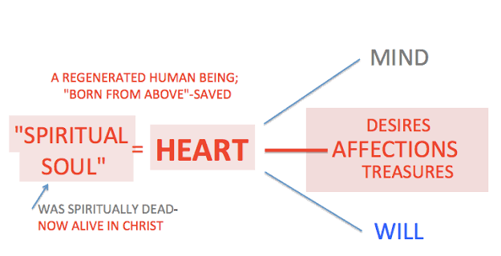

Slide 50
II. IMMERSION
It has been common to point out that in the Christian life, the “imperative” must be preceded by the “indicative.”
This means that the will’s obeying God’s commands, must be based the truth of God’s great acts on our behalf, and not simply on “will power.”
God’s appeal is to the mind first, and then to the will through the mind.
The book of Romans, for example, has been divided by the word “Therefore” in 12:1.
In view of the great “mercies” of God (delineated in Romans 1-11), “therefore,” we must present our bodies as a living sacrifice, etc.
So, the imperatives we find in Romans 12-16 are based on the indicative we find in Romans 1-11.

Slide 51
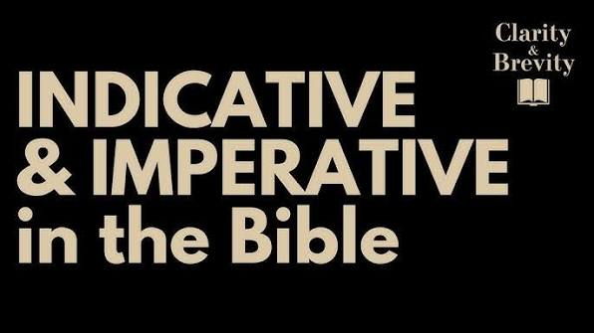

Slide 52
II. IMMERSION
But notice that this way of thinking involves the mind and the will, but skips over the affections.
Jonathan Edwards in his book The Religious Affections has noted that “True religion, in great part, consists in holy affections.” He wrote: “Holy Scriptures do everywhere place religion very much in the affections; such as fear, hope, love, hatred, desire, joy, sorrow, gratitude, compassion and zeal,” and “hence we may learn, what great cause we have to be ashamed and confounded before God, that we are not more affected with the great things of religion. It appears…that this arises from our having so little true religion.”

Slide 53
II. IMMERSION
And interestingly, what’s often missed is that the affections are addressed just before that consequential “therefore” in Romans 12. At the end of Romans 11, Paul is caught up in the wonder of God’s wisdom and grace and expresses his delighted praise:
“33 Oh, the depth of the riches and wisdom and knowledge of God! How unsearchable are his judgments and how inscrutable his ways! 34 “For who has known the mind of the Lord, or who has been his counselor?” 35 “Or who has given a gift to him that he might be repaid?” 36 For from him and through him and to him are all things. To him be glory forever. Amen.”

Slide 54
II. IMMERSION
So, there it is: the affections, the joyful response. Sandwiched between the “indicative” and the “imperative,” we must place the exclamatory, or the “ignition” in keeping with the alliteration.
And this involves and includes the whole person.
It begins with truth, with the renewing of the mind. Might we say, with the “withdrawal” from worldly thinking and the “immersion” into biblical thinking?
Here’s how I have described the process:
“God’s truth engages the mind,
which enflames the affections,
which empowers the will for obedience, love, and service.”

Slide 55
II. IMMERSION
And the Protestant reformers understood this to be the situation.
They defined true and saving faith not as mere intellectualism, nor worked-up emotionalism, nor an act of the will as in moralism.
Rather, they said that faith included three elements: knowledge (notitia), agreement (assensus), and trust (fiducia).
And there we find the three powers of the heart on display: knowledge of the gospel (the mind), hearty agreement with the gospel (the affections), and trusting Christ, entrusting oneself to Christ (the will).

Slide 56


Slide 57
II. IMMERSION
After the break, I want to demonstrate how this is revealed in the Scriptures, one place from the Old Testament and one from the new.
Once you are attuned to this dynamic you will find yourself discovering this all over the Bible, this constant God-consciousness and the practice of vital reality in the Christian walk and life.

Slide 58
SUMMER SEMINARS 2026
“Recovering the Supernatural Christian Faith”
Tuesday, June 2 “The Rise of Anti-Supernaturalism”
Tuesday, June 16 “Dead Ends”
Tuesday, June 30 “The Road to Recovery”
All seminars begin at 7:00 p.m.

Slide 60
III. BIBLICAL EXAMPLES
You may have already anticipated where I’m going, and I hope you have. In the book of 2 Kings, we find an example of a man who desperately needed to recover the supernatural faith.
The dividing line between the historical books of First and Second Kings comes at the transition between the ministries of those two wonder-working prophets, Elijah and Elisha (you can also remember who came first historically because their names are in alphabetical order).
This is from 2 Kings 6:8-17:

Slide 61
III. BIBLICAL EXAMPLES
“8 Once when the king of Syria was warring against Israel, he took counsel with his servants, saying, “At such and such a place shall be my camp.” 9 But the man of God sent word to the king of Israel, “Beware that you do not pass this place, for the Syrians are going down there.” 10 And the king of Israel sent to the place about which the man of God told him. Thus he used to warn him, so that he saved himself there more than once or twice.
“11 And the mind of the king of Syria was greatly troubled because of this thing, and he called his servants and said to them, “Will you not show me who of us is for the king of Israel?” 12 And one of his servants said, “None, my lord, O king; but Elisha, the prophet who is in Israel, tells the king of Israel the words that you speak in your bedroom.” 13 And he said, “Go and see where he is, that I may send and seize him.” It was told him, “Behold, he is in Dothan.” 14 So he sent there horses and chariots and a great army, and they came by night and surrounded the city.

Slide 62
III. BIBLICAL EXAMPLES
“15 When the servant of the man of God rose early in the morning and went out, behold, an army with horses and chariots was all around the city. And the servant said, “Alas, my master! What shall we do?” 16 He said, “Do not be afraid, for those who are with us are more than those who are with them.” 17 Then Elisha prayed and said, “O Lord, please open his eyes that he may see.” So the Lord opened the eyes of the young man, and he saw, and behold, the mountain was full of horses and chariots of fire all around Elisha.”

Slide 63
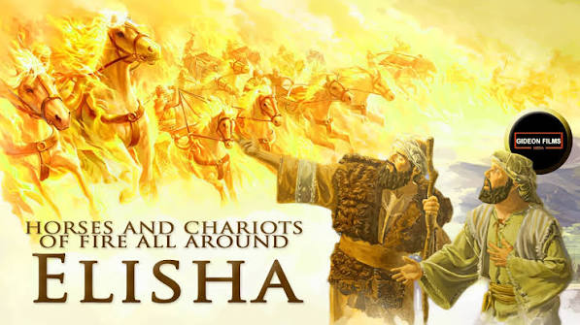

Slide 64
III. BIBLICAL EXAMPLES
So, what was this?
Was it a mere hallucination?
Was it, as theological liberalism would say, a mere legend or fanciful way of describing the feeling of assurance that the writer found in a time of adversity?
No, it was Elisha, who was able to keep the two halves of the orange together, enabling, with God’s help, his servant to perceive the invisible half of reality.
This is the half of reality that the anti-supernaturalists deny. This denial is both naïve and simplistic.

Slide 65
III. BIBLICAL EXAMPLES
What if we took Psalm 34:7 literally?
“The angel of the Lord encamps around those who fear him, and delivers them.”
Isn’t that precisely what Elisha knew and revealed to his servant?
We should not simply think that this is an inspiring, comforting story. That’s the view of theological liberalism, just a feeling.
I also fear the Lord; I think many of you do as well.
So, if God’s Word is true (and it is), then right now, at this moment, as we speak, in real time and space, the angel of the Lord is encamped around us. And he will deliver us. We cannot see this reality. But God has declared it. And by faith we then believe God’s Word with hearty agreement and then act accordingly.
We keep the two halves of the orange together.

Slide 66
III. BIBLICAL EXAMPLES
Right after this incident, we find another story of trouble involving Elisha. I want to quote it in full:

Slide 67
III. BIBLICAL EXAMPLES
“24 Afterward Ben-hadad king of Syria mustered his entire army and went up and besieged Samaria. 25 And there was a great famine in Samaria, as they besieged it, until a donkey’s head was sold for eighty shekels of silver, and the fourth part of a kab of dove’s dung for five shekels of silver. 26 Now as the king of Israel was passing by on the wall, a woman cried out to him, saying, “Help, my lord, O king!” 27 And he said, “If the Lord will not help you, how shall I help you? From the threshing floor, or from the winepress?” 28 And the king asked her, “What is your trouble?” She answered, “This woman said to me, ‘Give your son, that we may eat him today, and we will eat my son tomorrow.’ 29 So we boiled my son and ate him. And on the next day I said to her, ‘Give your son, that we may eat him.’ But she has hidden her son.”

Slide 68
III. BIBLICAL EXAMPLES
30 When the king heard the words of the woman, he tore his clothes—now he was passing by on the wall—and the people looked, and behold, he had sackcloth beneath on his body— 31 and he said, “May God do so to me and more also, if the head of Elisha the son of Shaphat remains on his shoulders today.”

Slide 69
III. BIBLICAL EXAMPLES
32 Elisha was sitting in his house, and the elders were sitting with him. Now the king had dispatched a man from his presence, but before the messenger arrived Elisha said to the elders, “Do you see how this murderer has sent to take off my head? Look, when the messenger comes, shut the door and hold the door fast against him. Is not the sound of his master’s feet behind him?” 33 And while he was still speaking with them, the messenger came down to him and said, “This trouble is from the Lord! Why should I wait for the Lord any longer?”

Slide 70
III. BIBLICAL EXAMPLES
7 But Elisha said, “Hear the word of the Lord: thus says the Lord, Tomorrow about this time a seah of fine flour shall be sold for a shekel, and two seahs of barley for a shekel, at the gate of Samaria.” 2 Then the captain on whose hand the king leaned said to the man of God, “If the Lord himself should make windows in heaven, could this thing be?” But he said, “You shall see it with your own eyes, but you shall not eat of it.”

Slide 71
III. BIBLICAL EXAMPLES
“3 Now there were four men who were lepers at the entrance to the gate. And they said to one another, “Why are we sitting here until we die? 4 If we say, ‘Let us enter the city,’ the famine is in the city, and we shall die there. And if we sit here, we die also. So now come, let us go over to the camp of the Syrians. If they spare our lives we shall live, and if they kill us we shall but die.” 5 So they arose at twilight to go to the camp of the Syrians. But when they came to the edge of the camp of the Syrians, behold, there was no one there. 6 For the Lord had made the army of the Syrians hear the sound of chariots and of horses, the sound of a great army, so that they said to one another, “Behold, the king of Israel has hired against us the kings of the Hittites and the kings of Egypt to come against us.”

Slide 72
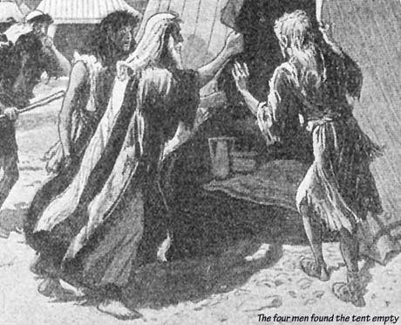

Slide 73
III. BIBLICAL EXAMPLES
I’ll let you finish this account on your own. But I want to point out one detail.
In the previous episode, Elisha’s servant was granted to “see” the spiritual reality.
But what was happening here? Were the Syrians merely hearing things? Was this a “paracusias,” an auditory counterpart of an hallucination? Do you see the point?
The army of angels, the chariots and horses never left! Elisha’s servant was granted to “see” the spiritual reality while the hostile, Syrian troops were granted to “hear” that reality.

Slide 74
III. BIBLICAL EXAMPLES
Now here’s how faith operates, how faith is the lynch pin that holds the two halves of the orange together.
“God’s truth engages the mind, which enflames the affections, which empowers the will for obedience, love, and service.”
So, Psalm 34:7 reports that “The angel of the Lord encamps around those who fear him, and delivers them.”
1. This knowledge addresses the mind.
2. By faith, we heartily accept this report as true. We take great assurance and comfort from it (the affections).
3. And so we act upon this truth (the will) by living in confidence and boldly obeying God’s commands.

Slide 75
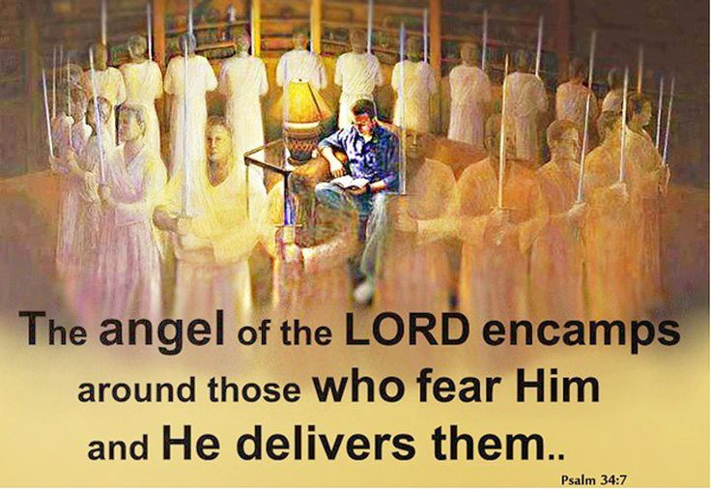

Slide 76
III. BIBLICAL EXAMPLES
Faith involves the whole person.
And once you see this and internalize this, it will revolutionize your reading and study of God’s Word.
For these promises and warnings are all over the Bible. We also find multiplied examples of those who heard these promises and either heeded them or rejected them, and the outcome of their choices.

Slide 77
III. BIBLICAL EXAMPLES
So, there is no need for EMOTIONALISM, trying to ramp up the emotions artificially. My dear friend, if you carefully read God’s Word and meditate on its every truth, you will discover an emotional overload!
And there is no need for RE-ENCHANTMENT, some imaginary reconnection between the material and the spiritual. Rod Dreher in his awful book on re-enchantment whines about his perception that the Protestant reformers “exil[ed] the numinous from the collective consciousness of Western Christianity.”
He quoted Charles Taylor’s charge that “they drained the spiritual energies, both divine and demonic, from the material world and granted them entirely to the Holy Spirit.”
I would say that they actually, thankfully lifted God’s people out of rank superstition and brought them into a more biblical view of reality.

Slide 78
III. BIBLICAL EXAMPLES
And there is no need for SUPER-SUPERNATUALISM, for the bogus claims of contemporary miracles, signs, and wonders.
There is no biblical warrant for asking us to trust present-day, so-called “miracles,” many of which have been discredited.
Our faith is in Jesus, the Christ of God, and in his Word, the Bible, which has been fully authenticated by the miracles and proofs recorded there, requiring no further authentication!

Slide 79
III. BIBLICAL EXAMPLES
Let me turn to a New Testament text quite instructive on the nature of true faith and providing several examples of keeping the two halves of Schaeffer’s “orange” together.
It is Hebrews 11, the great “hall of faith.” We will not cover the whole chapter, just enough to show the pattern.

Slide 80
III. BIBLICAL EXAMPLES
It begins with as close as we get in the Bible to a definition of faith:
“Now faith is the assurance of things hoped for, the conviction of things not seen.”
The emphasis here is on the “hearty agreement” or “assensus” aspect of biblical faith. This faith, of course, receives knowledge (the mind) and acts upon it (the will). But the focus is on the affections, “assurance” and “conviction.”
“2 For by it the people of old received their commendation.” God accepts and commends this faith that honors him by believing and trusting what he has said.
And then there is the contrast between the natural, what is seen, and the supernatural, what is not seen: “3 By faith we understand that the universe was created by the word of God, so that what is seen was not made out of things that are visible.”

Slide 81
III. BIBLICAL EXAMPLES
The first man of faith the writer describes was Adam’s son, Abel:
“4 By faith Abel offered to God a more acceptable sacrifice than Cain, through which he was commended as righteous, God commending him by accepting his gifts. And through his faith, though he died, he still speaks.”
He heard God’s call to approach in worship, and obeyed, unlike Cain, who then murdered him.
And next we find a further aspect of faith, trusting in God though he is unseen, and in his promise, which is by definition, not yet.

Slide 82
III. BIBLICAL EXAMPLES
“5 By faith Enoch was taken up so that he should not see death, and he was not found, because God had taken him. Now before he was taken he was commended as having pleased God. 6 And without faith it is impossible to please him, for whoever would draw near to God must believe that he exists and that he rewards those who seek him.”
Faith is not the same as sight. If we could already see God and see the spiritual rewards in their fullness there would be no need for faith.

Slide 83
III. BIBLICAL EXAMPLES
“7 By faith Noah, being warned by God concerning events as yet unseen, in reverent fear constructed an ark for the saving of his household. [He did not simply say, “Well, that’s interesting. We should form a study committee to explore this!] By this he condemned the world and became an heir of the righteousness that comes by faith.”
This reveals an important point. Christians are hated because, like Noah, we “condemn the world.” Our faith in Christ exposes and shames the sinful unbelief of those who choose to live for self instead.

Slide 84
III. BIBLICAL EXAMPLES
An important dynamic that we must come to terms with is that the biblical faith is decidedly “otherworldly.”
It is not devoted to this world and this life alone, but keeps its steady focus on the promises of God, many, perhaps most of which only come into their fullness in the life and age to come.

Slide 85
III. BIBLICAL EXAMPLES
Next the writer speaks of the man of faith, who trusted God, and whose faith is regaled in both testaments. The following text is powerful. I will simply read it.
“8 By faith Abraham obeyed when he was called to go out to a place that he was to receive as an inheritance. And he went out, not knowing where he was going. 9 By faith he went to live in the land of promise, as in a foreign land, living in tents with Isaac and Jacob, heirs with him of the same promise. 10 For he was looking forward to the city that has foundations, whose designer and builder is God. 11 By faith Sarah herself received power to conceive, even when she was past the age, since she considered him faithful who had promised. 12 Therefore from one man, and him as good as dead, were born descendants as many as the stars of heaven and as many as the innumerable grains of sand by the seashore.

Slide 86
III. BIBLICAL EXAMPLES
13 These all died in faith, not having received the things promised, but having seen them and greeted them from afar, and having acknowledged that they were strangers and exiles on the earth. 14 For people who speak thus make it clear that they are seeking a homeland. 15 If they had been thinking of that land from which they had gone out, they would have had opportunity to return. 16 But as it is, they desire a better country, that is, a heavenly one. Therefore God is not ashamed to be called their God, for he has prepared for them a city.

Slide 87
III. BIBLICAL EXAMPLES
17 By faith Abraham, when he was tested, offered up Isaac, and he who had received the promises was in the act of offering up his only son, 18 of whom it was said, “Through Isaac shall your offspring be named.” 19 He considered that God was able even to raise him from the dead, from which, figuratively speaking, he did receive him back. 20 By faith Isaac invoked future blessings on Jacob and Esau. 21 By faith Jacob, when dying, blessed each of the sons of Joseph, bowing in worship over the head of his staff. 22 By faith Joseph, at the end of his life, made mention of the exodus of the Israelites and gave directions concerning his bones.

Slide 88
III. BIBLICAL EXAMPLES
As you can see, this faith, secure in the promises of God, is future-oriented, otherworldly. The usual complaint against an “otherworldly” faith and Christian life is that such a person is “so heavenly-minded that they are of no earthly good.”
But, when have you heard that charge leveled against anyone lately? Much, much, much of Christianity today gives little thought to the other world, and this is largely the fruit of the pervasive anti-supernaturalism that saturates our daily life.
The only time I hear anything otherworldly is when someone dies. And what is customarily said?
“They are in a better place.”
I hear this statement applied universally to everyone who has died.
So, I have some questions.

Slide 89


Slide 90
III. BIBLICAL EXAMPLES
First, are they really in a better place? Only those who have trusted Christ are in a better place. All the rest are in a place of unimaginable horror, pain, and shame…forever.
And second, is it “a better place?” What makes it “better”? What makes it better is that we will finally and forever keep the two halves of the orange together. Our eyes will be opened at last to both worlds. Best of all, we will see our Savior face to face.
And a third question: If it really is a better place, then why do we never, ever, ever think about it in this life? I can name very few people who appear to be otherworldly.

Slide 91
III. BIBLICAL EXAMPLES
The vast majority of professing Christians are far more “this-worldly.” For most we could abbreviate that to just “worldly.” (How deeply the anti-supernaturalists have infiltrated the whole world, the church, our hearts!)
I see practically no one who is “so heavenly-minded that they are of no earthly good.” Instead, most are simply “so worldly-minded that they are of no use to heaven.”

Slide 92
III. BIBLICAL EXAMPLES
“23 By faith Moses, when he was born, was hidden for three months by his parents, because they saw that the child was beautiful, and they were not afraid of the king’s edict. 24 By faith Moses, when he was grown up, refused to be called the son of Pharaoh’s daughter, 25 choosing rather to be mistreated with the people of God than to enjoy the fleeting pleasures of sin. 26 He considered the reproach of Christ greater wealth than the treasures of Egypt, for he was looking to the reward.”

Slide 93
III. BIBLICAL EXAMPLES
Sounds to me like Moses was rather “other-worldly.” He kept the two halves of the orange together.
And he did the most possible good for this world as well.
“6 And without faith it is impossible to please him, for whoever would draw near to God must believe that he exists and that he rewards those who seek him.”

Slide 94
CONCLUSION
“Recovery” today often speaks of one who has been led off the right path by an addiction, a strong, compulsory enticement that most often starts rather mildly with an initial sampling of the intoxicant. I think it applies well here.
The Bible is so completely supernatural, and compellingly so. And God is at the absolute center of his Word.

Slide 95
CONCLUSION
And that has been the enduring problem that has come to a head.
I get the sense that many who have embraced anti-supernaturalism would dearly love to keep the more welcome aspects of Christianity.
Even the most strident atheist, Richard Dawkins, has recently declared himself to be a “cultural Christian.” He likes the life, the world that the biblical faith creates: its harmony, kindness, generosity, and safety.
What he does not like is God.
It’s almost as though he would want others to believe in and obey God so that he himself could live off the benefits of the world such belief creates.

Slide 96
CONCLUSION
But, of course, one cannot have it both ways. One cannot enjoy the fruits of the Christian faith while, at the same time, denying its substance and even mocking its followers.
I wonder if Dawkins or other atheists, anti-supernaturalists like him have ever wondered WHY the biblical faith and its followers create a better world.
They have no positive evidence that God does not exist. It’s simply a philosophical choice on their part.
But, perhaps, the fruitful benefits that faith in Jesus the Christ provides are also an indicator of its truthfulness.
“And without faith it is impossible to please him, for whoever would draw near to God must believe that he exists and that he rewards those who seek him.”

Slide 97
QUESTIONS?

Slide 98
SUMMER SEMINARS 2026
“Recovering the Supernatural Christian Faith”
Tuesday, June 2 “The Rise of Anti-Supernaturalism”
Tuesday, June 16 “Dead Ends”
Tuesday, June 30 “The Road to Recovery”
All seminars begin at 7:00 p.m.

