Slide 1
RESTORING the
Supernatural Christian Faith
Seminar 1: “THE RISE OF ANTI-SUPERNATURALISM”

Slide 2
INTRODUCTION
Among the early pioneers in the anti-supernatural movement was the religious (or political) group in Israel known as the Sadducees.

Slide 3
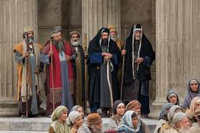

Slide 4
INTRODUCTION
The word “Sadducees” appears fourteen times in the gospels and the book of Acts.
In the gospels, Jesus often warned against their teaching. Also in the gospels and Acts, the two most prominent features describing them was that they did not believe in the resurrection and that they were prominent in the government in Jerusalem at the time.
Yet little is really known about them for the simple fact that they left no writings. Even the origin of their name, the “Sadducees” is uncertain, possibly traced to “Zadok,” the high priest of the days of Solomon, about a thousand years before Christ, or perhaps associated with the Hebrew term “saddiq” meaning “righteous.”

Slide 5
INTRODUCTION
A possible reason why they left no writings was because they believed so very little: there was not much to write about. They probably saw no need to defend their minimal beliefs.
Other, outside sources report that they could be called religious “conservatives,” denying what they considered newer “innovations” in the faith.
So, they rejected the validity and authority of all Scripture except the Pentateuch, the first five books of the Old Testament (the Hebrew Bible). They largely denied anything supernatural, anything more than meets the eye or that extends beyond this life, including the soul, the afterlife, the resurrection, rewards and punishments in any age to come, and the existence of angels and demons.
They rejected God’s sovereignty or intervention in life, and considered one’s prosperity or adversity to be the outcome of one’s own course of action.

Slide 6
INTRODUCTION
In other words, they lived for this life alone and were confident in their own abilities. They were, in fact, among the wealthy elites of the day.
They were living the good life, so they assumed, and did not want to be bothered with any life to come, certainly not any future calling to account represented by a Day of Judgment.
So, they gave no thought to any future life or existence, and felt no alarm at the same. They especially balked at any talk of a resurrection because they desperately did not want there to be any resurrection.
And if that does not sound familiar to you, then you haven’t been paying attention to what’s been going on around us.

Slide 7
INTRODUCTION
We have been living in an anti-supernatural world for some time now.
The spirit of the Sadducees has captivated most of our society, including much of the church, certainly all of the mainline denominations, but to an increasing degree formerly evangelical churches as well.
I would not hesitate to suggest that you and I have been deeply impacted by the anti-supernaturalism of the Sadducee religion, the reigning philosophy of our day, and so we mainly live in a flat, purely naturalistic world.
There is little difference, practically speaking, between our hopes and expectations and those of the most strident atheists who scoff at all religious belief, especially biblical Christianity.

Slide 8
INTRODUCTION
My hope and aim in this series of three seminars is
1) to expose the problem, beginning with its roots,
2) to point out some proposed solutions that are perhaps well-intentioned, but, in the end, mostly distracting and unhelpful (I refer to them as “Dead Ends”), and then
3) to remind us all of the truly supernatural basis of virtually every article of the biblical faith.

Slide 9
INTRODUCTION
The Sadducees were anti-supernaturalists because they desperately wanted this life to be the only life.
They enjoyed power, prestige, and possessions, leading to a pleasurable, mostly pleasant life in the here and now.
They had no real philosophical or religious justification for their views, but instead made their religion serve their selfish desires.

Slide 10
INTRODUCTION
The contemporary experiment of whole cultures devoted to anti-supernaturalism, as in Western civilization of our day (and much more so in other parts of the world), demonstrates the costly, harsh, vicious downside of this flat, futureless worldview.
We have been languishing in the throes of its bleak hopelessness for several decades.

Slide 11
I. THE DIVORCE BETWEEN NATURE AND GRACE
In his short book, Escape from Reason, Christian thinker Francis A. Schaeffer locates the origin of this anti-supernaturalist development in the teachings of the most prominent theologian of the Roman Church, Thomas Aquinas (1222-1274).

Slide 12
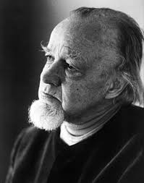


Slide 13
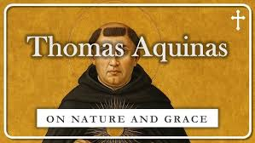

Slide 14
I. THE DIVORCE BETWEEN NATURE AND GRACE
Aquinas drew a sharp distinction between “nature” and “grace.”
In Aquinas’ view, “grace” included “religious” matters like “God the Creator, heaven and heavenly things, the unseen and its influence on the earth, the human soul, and unity in God’s creation and design.”
These matters could only be known from Scripture and were considered “the higher.”

Slide 15
I. THE DIVORCE BETWEEN NATURE AND GRACE
“Nature,” on the other hand, included the created: earth and earthly things, the visible and what nature and man does on the earth, man’s body, and diversity. And this was placed in the realm of “the lower.” The result was a dichotomy between grace and nature:
GRACE: God the Creator, heaven and heavenly things, the unseen and its influence on the earth, the human soul, and unity in God’s creation and design
____________________________________________________________________
NATURE: the created, earth and earthly things, the visible and what nature and man does on the earth, man’s body, and diversity

Slide 16
I. THE DIVORCE BETWEEN NATURE AND GRACE
And here’s the important point: while the “higher” could only be known through Scripture (special revelation), the “lower” could truly be known through the intellect by way of observation and reason, without the aid of grace (or the Bible).
In Aquinas’ view, the human will was fallen in sin, but the human intellect remained unfallen.
So, the intellect was considered “autonomous”: unbiased, independent, and absolutely sovereign over its own realm or jurisdiction, which was the natural.

Slide 17
I. THE DIVORCE BETWEEN NATURE AND GRACE
And so, over time, the distinction became an unbreachable division.
When it came to “religious matters,” one would consult the Bible.
But when it came to “real matters,” the Bible was at first considered unnecessary, and in the end, was eventually dismissed as incompetent and irrelevant.
The unfallen, unaided, autonomous reason alone could rightly assess nature or “real matters.”

Slide 18
I. THE DIVORCE BETWEEN NATURE AND GRACE
From the time of Aquinas on, the discipline of philosophy determined to work exclusively from the lower level, combining observation (the visible, non-spiritual world of “facts”) interpreted by the intellect or reason, (remember, the intellect or reason was considered unfallen, unbiased, independent, and autonomous).
The matters in the upper level, “grace,” the religious, the Bible’s teaching, were considered off-limits for true, unbiased philosophy and science. Religious teachings may or may not be true, but, from the lower level, from the standpoint of observation and reason of the autonomous, independent intellect, all of that was unknowable.
And, over time, “unknowable” shifted to “irrelevant” and eventually to “untrue.”
(In a much later development, in a post-modern era any absolute truth claim was interpreted as an attempt to exploit others. So, nothing could be accepted as truly true. “Truth” was only “personal truth,” i.e.: “Live YOUR truth.”)

Slide 19
I. THE DIVORCE BETWEEN NATURE AND GRACE
Now, a truly unfallen intellect, unbiased in any way (dare we say “open-minded”?) would still have argued, “But, yes, there is still good, plausible reason to assume that the upper level is real and should always be taken into account.”
But, as with the Sadducees, the upper-level stuff interfered with the pursuit of “the good life” of self-seeking. God as Lawgiver and Judge, his moral law, Judgment Day, heaven and hell, were all seen as inconvenient to the autonomous self.
The intellect, the self was not so unbiased or unfallen after all, but was deeply impacted by sin and devoted to the self.
The intractably-biased self is always angling to secure itself on the throne of all things.

Slide 20
I. THE DIVORCE BETWEEN NATURE AND GRACE
Hedonists (those who live for pleasure) work hard at trying to deny that God is there.
Oh, they know the truth. The creation itself continually witnesses to the necessity of a Creator. God’s law is written on each heart, and all people realize that they have broken God’s law and that there is a Day of Judgment coming.
Many do not want this to be true, and so develop alternative explanations in order to dismiss God’s claim over their lives.
The noted atheist, Aldous Huxley (1894-1963), admitted that this was his own situation.

Slide 21
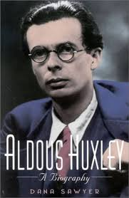
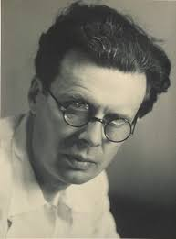

Slide 22
I. THE DIVORCE BETWEEN NATURE AND GRACE
“I had motives for not wanting the world to have meaning; consequently I assumed that it had none, and was able without any difficulty to find satisfying reasons for this assumption….For myself, as no doubt for most of my contemporaries, the philosophy of meaninglessness was essentially an instrument of liberation. The liberation we desired was…liberation from a certain system of morality. We objected to the morality because it interfered with our sexual freedom.”

Slide 23
I. THE DIVORCE BETWEEN NATURE AND GRACE
This view was further developed and pushed to the extreme during the time of the Enlightenment in Western Europe (~1650-1850 A.D.) which enshrined the devotion to the autonomy of the human intellect among elites.
A good example of this entrenchment was offered by the French philosopher Auguste Comte (1798-1857) who founded the philosophical school known as “Positivism.”

Slide 24
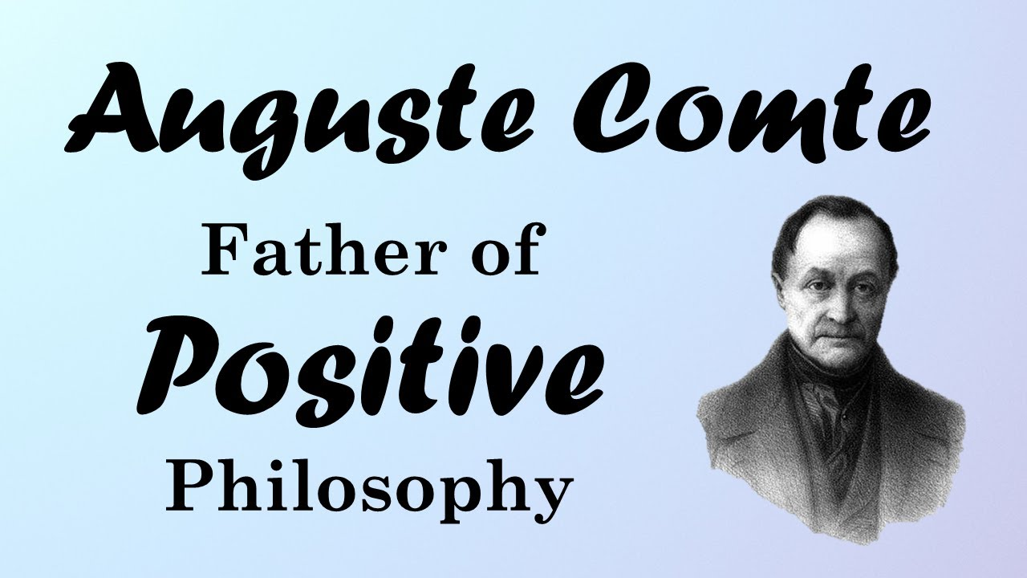

Slide 25
I. THE DIVORCE BETWEEN NATURE AND GRACE
The most basic tenet of his Positive philosophical system was that “human knowledge is restricted to the observable.”
In other words, we can accept as true only that which we can detect with our senses (or our measuring instruments).
Do you see the obvious flaw in this assertion?

Slide 26
I. THE DIVORCE BETWEEN NATURE AND GRACE
The fundamental principle of Comte’s Positivism cannot be detected by our senses!
His bedrock principle was: “human knowledge is restricted to the observable.” But is that statement “observable?” How could you measure the truthfulness of that grand claim?
By its own definition, we cannot accept Positivism as true!
This is only one of many ways that unsupported philosophical opinions masquerade as “science.” It is irrational, and self-defeating.
And yet it is accepted widely as the most basic principle for all modern intellectual pursuits including science, psychology, and history.

Slide 27
I. THE DIVORCE BETWEEN NATURE AND GRACE
For example, I have enjoyed reading many books by the conservative, British historian, Paul Johnson, himself a professing Christian.
And yet on the first page of his book Heroes he defers to Comte’s irrational demand: “Yet history has no miracles, only causes and consequences.”
In other words, a true historian can permit nothing miraculous (“upper level”), but must always look for a purely natural (“lower level”) explanation.
Anti-supernaturalism has virtually captured the academy.
In the late 1980s and 90s one of my seminary classmates went to study history (church history) at a secular university. He said his professor staunchly resisted any “assimilation” on my friend’s part.
In other words, he could study church history, but only from a purely secular, anti-supernaturalist perspective. And he could not permit his personal faith in Christ to intrude into his studies in any way.

Slide 28
RESTORING the
Supernatural Christian Faith
Seminar 1: “THE RISE OF ANTI-SUPERNATURALISM”

Slide 29
4

Slide 30
3

Slide 31
2

Slide 32
1

Slide 33
REVIEW
For the past few hundred years, intellectuals have been constantly excising anything supernatural from the realm of possibility, dismissing it as mere irrational, unprovable, unscientific superstition. Any suggestion of some cause that was not purely natural was dismissed out of hand.
This “anti-supernaturalism” has impacted all people. Even professing Christians have been influenced, and increasingly live in a world where God, the soul, and the afterlife have been banished to the fringe, to the realm of ghosts and goblins, witches and fairies, and so forth.
We traced the origin of this from the time of the Enlightenment in Western Europe, spreading to the US (~1650-1850 A.D.).

Slide 34
II. EIGHT WORDS THAT CHANGED THE WORLD
To this discussion, Christian theologian Francis Schaeffer (1912-1984) adds eight words, eight words that have deeply impacted and governed the modern world: “uniformity of natural causes in a closed system.”

Slide 35
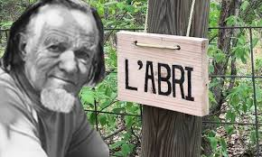

Slide 36
II. EIGHT WORDS THAT CHANGED THE WORLD
I want to explore this idea thoroughly since it greatly illumines our present domination by this iron-fisted, unrelenting anti-supernaturalism.

Slide 37
II. EIGHT WORDS THAT CHANGED THE WORLD
Premodernism (325 A.D. – 1700s A.D.)
In the pre-modern, Western view, God was the source of all truth, mediated through the world he made (nature) and the Scriptures. Humanity could know objective truth through these means.
Revelation and reason lead to the knowledge of God and his world.
GOD
|
TRUTH
/ \
NATURE SCRIPTURE
\ /
HUMANITY

Slide 38
II. EIGHT WORDS THAT CHANGED THE WORLD
Modernism (1650s A.D. – 1960s A.D.)
In the modern, Enlightenment view, the God hypothesis is no longer necessary. Objective truth is still available, but is discovered only through observation and reason (shades of Comte’s Positivism).
GOD
|
TRUTH
/ \
NATURE SCRIPTURE
\ /
HUMANITY

Slide 39
II. EIGHT WORDS THAT CHANGED THE WORLD
Modernism (1650s A.D. – 1960s A.D.)
Modernism thought that this universally recognized truth would lead to unity, peace, and progress for all. Modernism was cheerfully optimistic about the future.
And it was based upon what Schaeffer calls, the “uniformity of natural causes in a closed system.”

Slide 40
II. EIGHT WORDS THAT CHANGED THE WORLD
A. “UNIFORMITY OF NATURAL CAUSES.”
Most of the benefits that we enjoy today and take for granted (and some that are not so beneficial) are the result of this simple concept: “uniformity of natural causes.”
When you add a teaspoon of salt to a quart of water, what happens?
(the salt dissolves and produces salt water)
How often will that happen?
Answer: every time you do it!
We do not expect that sometimes it turns into salt water and sometimes it turns into sulfuric acid or chocolate pudding. This is the “uniformity of natural causes.”

Slide 41
A. “UNIFORMITY OF NATURAL CAUSES.”
This is true of more complex matters. When you get into your car and turn the key (or push the button), what happens? (It turns on.)
Turning the key causes the starter to rotate the crankshaft in the engine which causes the pistons to fire and the engine starts functioning. It’s not that we expect that sometimes the engine turns on, other times it causes the car to melt like water, and other times it causes the car to float off into space.
Pour water onto a campfire: what happens? (The fire sputters and steams but eventually stops burning.) The chemical process of burning is interrupted and the fire goes out. It’s not that sometimes that happens and sometimes the fire gets hotter or that other times the water immediately turns to ice or that the water causes the fire to explode.
This is the uniformity of natural causes. One hundred times out of one hundred times that will happen.

Slide 42
A. “UNIFORMITY OF NATURAL CAUSES.”
Why can we rely on the uniformity of natural causes? That’s a key question.
The earliest Western scientists were premodern (Christian). They practiced their scientific pursuits because they assumed they could rely upon the uniformity of natural causes.
And they assumed that to be the case not simply because it fit their everyday experience, but because they believed that God was there, that God made the world, that he did so in a rational way, and that God upheld fixed “laws of nature.”
The world was reasonable. It made sense. And the natural world operated under laws that God himself created and personally enforced. That’s why salt always dissolves into water and produces a salt water solution, and not sulfuric acid or chocolate pudding. These Christian scientists knew they could depend upon this constant reality, this uniformity of natural causes, and could build on it.

Slide 43
A. “UNIFORMITY OF NATURAL CAUSES.”
This happens so regularly that we can use salt water to make pickles, to boil vegetables, and medical staff can even run salt water, a sterile saline solution into our veins when we are low on fluids!
What if we could not count on that happening? What if salt put into water sometimes became acid or pudding or sand?
(There could be no technology or scientific progress.)
But we literally, regularly stake our lives on the uniformity of natural causes: that salt placed into water becomes a harmless, salt water solution.

Slide 44
A. “UNIFORMITY OF NATURAL CAUSES.”
The earliest scientists also understood that God encouraged us to explore the good world he had made and to use its goodness to develop that which was beneficial to us.
One of the early Christian scientists, Francis Bacon (1561-1626) put it this way: “Man by the Fall fell at the same time from his state of innocence and from his dominion over nature. Both of these loses, however, can even in this life be in some part repaired; the former by religion and faith, the latter by the arts and sciences.”
Sin had severely damaged us spiritually and physically, but God gave religion and science to repair much of that damage.

Slide 45
A. “UNIFORMITY OF NATURAL CAUSES.”
Most historians will agree that all of our great scientific knowledge and achievements came about because the first western scientists believed in the God-given, God-guaranteed uniformity of natural causes.
What’s interesting is that the Eastern world of Asia and India did not develop with this understanding, and neither did science there develop in the same way or with the same speed.
In the East they made discoveries such as the invention of gunpowder in China, but these were purely random discoveries.
They could not really invent and develop scientifically as the West did because they did not have the expectation of the uniformity of natural causes or the belief that God was calling them to explore and harness the benefits of his good world.
So those four words have literally changed the world, and virtually every scientific, technological, or medical development has depended upon this consistent principle.

Slide 46
B. “IN A CLOSED SYSTEM.”
The next four words have also changed the world, but not for the better, in my opinion. The next four words have multiplied misery in a way that cannot be fully appreciated.
The next four words were added to the first four: “in a closed system.” So the full statement is “uniformity of natural causes in a closed system.”
What is a closed system? It is a system in which everything that exists is locked inside. In fact, there is nothing at all outside of it: it encompasses everything.
Or, if there is anything outside of it, the system is completely cut off and isolated from anything that may be beyond the closed system.
There is no possible way to know about or to communicate with anything that may be outside of the closed system. So, anything outside of the closed system may be a matter of speculation, but must also be considered completely impractical and irrelevant.

Slide 47
B. “IN A CLOSED SYSTEM.”
In this closed system, by definition, everything is “natural.”
That is, there is nothing “supernatural.”
(So the closed system is, by definition, “anti-supernatural.”)
Again, the supernatural may exist. But if it is a closed system, then it is completely cut off from anything outside of it.
The supernatural cannot impact the natural, and the natural cannot reach, know about, or communicate with the supernatural.
Hence, it must be considered irrelevant.
That’s how the most significant factors of our human existence, God made us, sin ruined us, Christ redeems us, the Holy Spirit restores us, and Christ is coming again to rescue us were suddenly declared absolutely irrelevant to the intellectual world.

Slide 48
B. “IN A CLOSED SYSTEM.”
Suppose you are in one soundproof room with no doors or windows, and I am in another soundproof room with no doors or windows. And we have both always been in those rooms.

Slide 49
YOU
ME

Slide 50
B. “IN A CLOSED SYSTEM.”
What would we know about the outside world?
Nothing. We could only know about what’s inside the room, and about the room itself.
There could, in fact, be a whole world outside the room, but we could not know anything about it, not even of its existence.
And we could not know about each other. We could never communicate with each other or have any kind of knowledge of one another.
For all we know, there might be something outside the room or there might be nothing outside the room. But the bottom line is that we could not know or communicate with anything outside of the room.
Each of us would be living in a “closed system.”

Slide 51
???
???
???
YOU
ME

Slide 52
B. “IN A CLOSED SYSTEM.”
As we said, the first Western scientists were Christians who believed in the uniformity of natural causes precisely because the Bible taught this truth.
A rational God made a rational world that we can understand and explore, and the same God ensures that this rational world faithfully and uniformly operates according to cause and effect, fixed laws that he himself ensures are always kept.
In other words, they both assumed and operated on the confidence of the uniformity of natural causes.
But for these early Christian scientists the world was not a closed system, only a limited system (Schaeffer calls it a “semi-permeable” system).
So chemicals and plants and animals all react according to cause and effect. We could liken all of that to a machine which always works the same way. Push this button and this happens; pull that lever and that happens, always.

Slide 53
B. “IN A CLOSED SYSTEM.”
But for these early Christian scientists, the world was not a closed system, only a limited system. And the exceptions were
1) God and
2) humans.
God sometimes suspended his laws and acted differently. This is the proper definition of a “miracle.”
Normally a solid human being cannot walk on the top of a liquid sea. But it has happened, according to the Bible (Mark 6:45 ff.).
Normally, a handful of bread and fish can only feed one or two people. But God can suspend that law and cause the substance of the bread and fish to be expanded to feed thousands (Mark 6:30 ff.).
Normally, a body that was dead in the tomb for four days stays dead and decomposes. But God can suspend that law and reverse death and cause that body to rise (Lazarus—John 11:44).

Slide 54
B. “IN A CLOSED SYSTEM.”
And humans have free will: we can reason and assess and choose and interrupt the normal flow of natural causes.
Because humans have free will, we are IN the machine of this world, and we are SUBJECT TO the uniformity of natural causes, but we are not ONLY machine. We can influence what happens with the machine and impact the outcome by our choices.
For example, lightning strikes and ignites a home as a part of purely natural forces that have something to do with wind and friction electrically charging the clouds and then discharging this electrical charge on the most attractive target.
According to the uniformity of natural causes, the fire would continue to burn until all of the fuel (the house) was consumed.
But humans can change the natural outcome by calling the fire department and dousing the fire before the home is completely destroyed.

Slide 55
B. “IN A CLOSED SYSTEM.”
During the time known as the “Enlightenment,” (~1650 A.D. – 1850 A.D.) some scientists and philosophers suggested that God was no longer necessary.
They imagined a universe that was all machine that operated on purely natural principles. People were only a part of the machine, purely natural, only bodies, complex bio-chemical interactions. Even our seemingly free choices were determined by the natural chemical processes of the brain.
According to this view, everything is automatically subject to and absolutely determined by the uniformity of natural causes.

Slide 56
B. “IN A CLOSED SYSTEM.”
They closed the system.
No “God” was needed to enforce these laws of physics.
They tried to operate from a perspective of naturalism. No longer was there a rational God who made the world and ordered it by uniform, rational principles that we could learn and apply in development of that which would benefit us.
Rather, they determined to begin only with themselves and their observations of the world. Everything was drawn into the soundproof room with no doors or windows. All was nature. There was only nature. It was a closed system: the “uniformity of natural causes in a closed system.”

Slide 57
“UNIFORMITY OF NATURAL CAUSES IN A CLOSED SYSTEM”
“UNIFORMITY OF NATURAL CAUSES”
We can rely upon the regular, natural “laws” of physics and logic. All scientific, medical, and technological advances depend upon the “uniformity of natural causes.”
“IN A CLOSED SYSTEM”
The empirical universe (only what we can apprehend with our five senses) is the only thing we can possibly know about (echoes of Comte’s Positivism). There may be something beyond the physical world, but we cannot know it. The physical world is a completely closed system.
But a closed system necessarily excludes some things we might miss!

Slide 58
God?
Purpose?
Meaning?
Afterlife?
Soul?
Truth?
Beauty?
Love?
Morality?
Reality?
The closed system, completely isolated from anything outside.
Only that which is “natural” is within.
There is no “supernatural” (that we can possibly know of).
There is no outside, objective standard for morality, right and wrong.
There can be no ultimate meaning or purpose to our lives.

Slide 59
B. “IN A CLOSED SYSTEM.”
To condense a few hundred years of philosophical inquiry, this is what they concluded.
After looking under every rock and thinking every thought, after chasing down every line of inquiry to the very end of its destination, this is what they found.
1) There is no meaning to life.
2) We came into being for no purpose.
3) Our present lives are completely meaningless now.
4) And we soon will face not simply death but complete, personal extinction.
From within our closed system, from within our soundproof room with no doors or windows, we cannot make any ultimate sense of or discover any ultimate meaning of or purpose in life.

Slide 60
B. “IN A CLOSED SYSTEM.”
The Sadducees formally disappeared from the scene after the destruction of Jerusalem in 70 A.D.
But their philosophy is the dominant view in the world today.

Slide 61
III. THE MODERN, ANTI-SUPERNATURALIST “CHURCH”?
Where was the church in all of this upheaval of knowing?
What was the church doing during the time of the Enlightenment (~1650 A.D. – 1850 A.D.) and beyond?
That’s a great question!
The plain answer is that a significant segment of the organized church began following lock-step with the developments of the anti-supernationalists.

Slide 62
III. THE MODERN, ANTI-SUPERNATURALIST “CHURCH”?
Enter “Theological Liberalism.”
This innovation was created by intellectual elites in religion who wanted to remain in the good graces of unbelieving, anti-supernaturalist intellectuals.
They became convinced that no rational person could continue to believe in the miracles of the Bible, so they reimagined the biblical faith in a way they thought would appeal to those who had already rejected the biblical faith.

Slide 63
III. THE MODERN, ANTI-SUPERNATURALIST “CHURCH”?
Now, make no mistake.
Those who originated Protestant Liberalism AGREED with the Anti-supernaturalists. They became embarrassed by the Bible’s reports of creation, miracles, the unique incarnation of Jesus as the God-man, of his Virgin Birth and Resurrection. So, they reinterpreted all of that as attempts by pre-scientific people to describe their religious feelings.

Slide 64
III. THE MODERN, ANTI-SUPERNATURALIST “CHURCH”?
Friedrich Schleiermacher (1768-1834) is often called "the father of modern theology.” That is, the father of modern liberal theology.

Slide 65
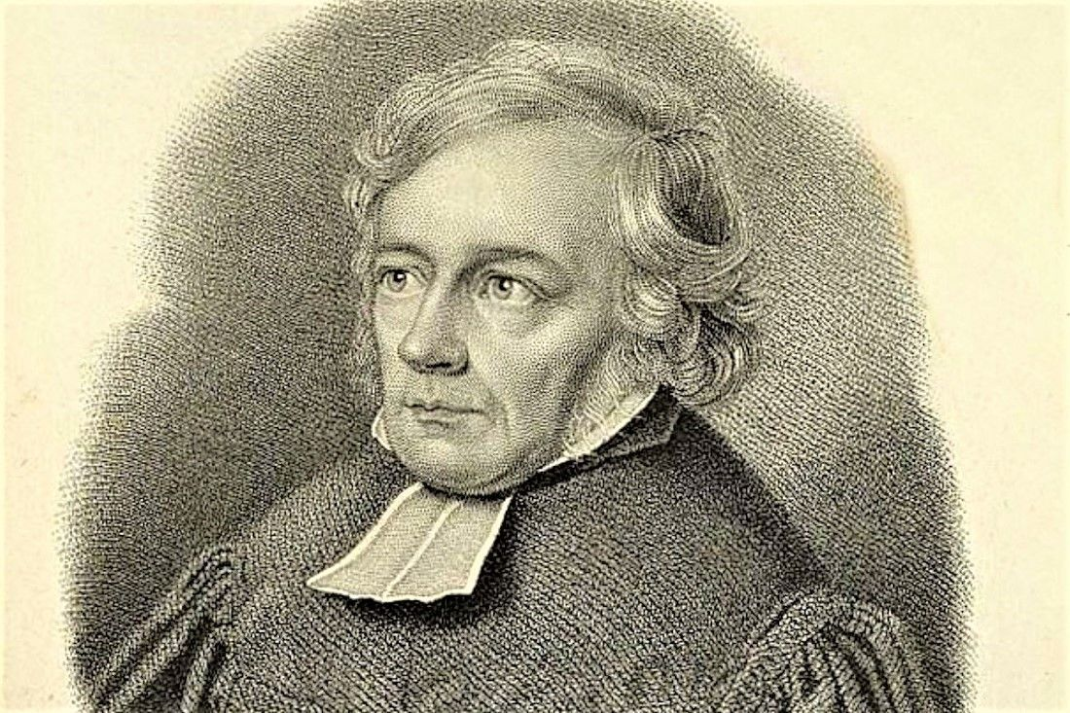

Slide 66
III. THE MODERN, ANTI-SUPERNATURALIST “CHURCH”?
Christian theologian John Frame (b. 1939) defines theological liberalism: “any kind of theology that does not submit to the infallible authority of Scripture.”
The “authority” in theological liberalism is not the Bible, of course, but our old nemesis, the supposedly unfallen, independent intellect or “rational autonomy,” my reason, my determination holding the final authority in my life.

Slide 67
III. THE MODERN, ANTI-SUPERNATURALIST “CHURCH”?
In 1796, Schleiermacher moved to Berlin and became friends with well-known literary figures (the popular crowd) of the romantic movement, all of whom had rejected and abandoned the Christian faith.
Schleiermacher appealed to them trying to answer their objections in his famous book Speeches on Religion to Its Cultured Despisers (1799).

Slide 68
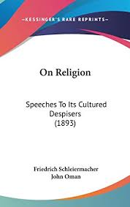
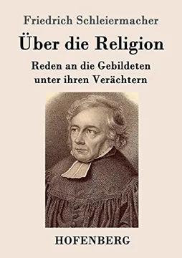

Slide 69
III. THE MODERN, ANTI-SUPERNATURALIST “CHURCH”?
Schleiermacher was trying to make Christianity sound reasonable or attractive to those who had rejected it and had abandoned the biblical worldview.
And if these romantics were all about “feelings” and only accepted the authority of “feelings,” then Schleiermacher rediscovered that the Christian faith is all about feelings as well!
“In this book [Speeches On Religion], Schleiermacher begins to develop his theory that the essence of religion is a ‘feeling of absolute dependence’ rather than any particular doctrinal convictions.”

Slide 70
III. THE MODERN, ANTI-SUPERNATURALIST “CHURCH”?
And that explains how many professing Christians today can espouse beliefs and practices that are the complete opposite of clear biblical teaching and commands.
It comes from a particular view of Scripture.

Slide 71
III. THE MODERN, ANTI-SUPERNATURALIST “CHURCH”?
For Schleiermacher, “Christian doctrines are accounts of Christian religious affections set forth in speech.”
And that explains everything.
What we really need to discover, then, what is the true “essence” of Christianity.
What becomes the de facto authority in the Christian faith cannot be the words on the pages of the Bible, but the original “feelings” that the authors, perhaps clumsily, certainly fallibly, tried to express through those words and stories and doctrines.
“What they REALLY meant or were describing was (fill in the blank).”

Slide 72
III. THE MODERN, ANTI-SUPERNATURALIST “CHURCH”?
That’s how you can play fast and loose with the biblical text and still claim that you are being faithful to the Christian faith.
In fact, you claim to be MORE faithful to the faith than those who pay close attention to the words.
Those who insist on focusing on the objective meaning of the words and sentences of the Bible, they say, are utterly missing the point, the point being the religious feeling that prompted those words.
Do you see how clever, how diabolical this is? Do you see how this is not allowed in any other realm?
All religion was reduced to psychology and morality. And there was nothing at all SUPERNATURAL about any of this, because they had decided (not discovered) from the beginning that there was no supernatural.

Slide 73
III. THE MODERN, ANTI-SUPERNATURALIST “CHURCH”?
Explain to the patrolman that what the real feeling behind the speed limit sign was that you drive in a way that feels authentic to you. (“Sign here, please.”)
Have your teenager explain to you that when you told him to clean up his room, you were only expressing your feeling that he should be happy in a way that was genuine to his experience.
This is often described as the typical, evangelical Bible study, sitting in a circle and asking each person in sequence, “What does this verse mean to you?”
In trying to placate the unbelieving anti-supernaturalists, the liberal church created an irrational religion that no one can take seriously.

Slide 74
IV. THE TWO CHAIRS
Francis Schaeffer offers a simple illustration of the difference:
“According to the biblical view, there really are two parts to reality: the natural world—that which we see normally—and the supernatural part. When we use the word ‘supernatural,’ however, we must be careful. The supernatural is really no more unusual in the universe from the biblical viewport, than what we normally call the natural. The only reason why we call it the supernatural part is that we usually cannot see it. That is all. From the biblical view—the Judeo-Christian view—reality has two halves, like the two halves of an orange. You do not have the whole orange unless you have both parts. One part is normally seen, and the other is normally unseen.

Slide 75
IV. THE TWO CHAIRS
“I would suggest that this may be illustrated by two chairs. The men who sit in these chairs look at the universe in two different ways. We are all sitting in one or the other of these chairs at every single moment of our lives. The first man sits in his chair and he sees the total reality of the universe, the seen part and the normally unseen part, and consistently sees truth against the background. The Christian is a man who has said, ‘I sit in this chair.’ The unbeliever, however, is the man who sits in the other chair, intellectually. He sees only the natural part of the universe, and interprets truth against this background.

Slide 76
IV. THE TWO CHAIRS
“Let us see that these two positions cannot both be true. One is true: one is false. If indeed there is only the natural portion of the universe, with a uniformity of natural causes in a closed system, then to sit in the other chair is to delude oneself. If, however, there are the two halves of reality, then to sit in the naturalist’s chair is to be extremely naïve and to misunderstand the universe completely. From the Christian viewpoint, no man has ever been so naïve, nor so ignorant of the universe, as twentieth-century man.” (Or every anti-supernaturalist in the world, which is a rising number every year.) (Schaeffer, True Spirituality, 56-7)

Slide 77
IV. THE TWO CHAIRS
This is the world we live in.
Virtually all of the leaders in the media and social media speak from this chair of unfaith/anti-supernaturalism, and are woefully naïve, simplistic, and ignorant with no real understanding of the universe.
And increasingly, in the public square, the other view is almost exclusively excised and forbidden (except for the Islamic view, interestingly).

Slide 78
IV. THE TWO CHAIRS
Let’s be honest, we spend hours each day sitting at the feet of the naïve and ignorant who only pontificate in their podcasts or other media forms from the chair that only sees the smaller half of reality.
The speaker, director, producer, writer, actor, AI assistant: these are all sitting in the anti-supernatural chair, and they are teaching and instructing us, molding and shaping our thought patterns, desires, likes and dislikes, moral categories, our outlook on the future, and what we love most of all.
We cannot help but be swayed, deeply impacted by this literally godless and hopeless, false, simple-minded, and gullible perspective.
Proverbs 15:14 states: “The heart of him who has understanding seeks knowledge, but the mouths of fools feed on folly.”

Slide 79
IV. THE TWO CHAIRS
And sadly, to a great degree, we have all become Sadducees! We tend to live for this life alone.
We are practical anti-supernaturalists who seek to enhance and improve the 60-90 or so years we have here with little thought for the everlasting, never-ending life to come or the other half of reality we foolishly ignore.

Slide 80
IV. THE TWO CHAIRS
The book of James highlights a couple of problems that arise when professing believers adopt and try to live from the chair of unbelief. I’ll take them out of order. One serious failure is that of arrogance:
“13 Come now, you who say, “Today or tomorrow we will go into such and such a town and spend a year there and trade and make a profit”— 14 yet you do not know what tomorrow will bring. What is your life? For you are a mist that appears for a little time and then vanishes. 15 Instead you ought to say, “If the Lord wills, we will live and do this or that.” 16 As it is, you boast in your arrogance. All such boasting is evil. 17 So whoever knows the right thing to do and fails to do it, for him it is sin.” (4:13-17)
We have forgotten utterly the sovereignty of God, and we act as though we ourselves are the sovereigns of the earth.

Slide 81
IV. THE TWO CHAIRS
The other is a serious drawback that is common in the church. We have no place for suffering, except to be surprised, outraged, angry, and depressed.
“2 Count it all joy, my brothers, when you meet trials of various kinds, 3 for you know that the testing of your faith produces steadfastness. 4 And let steadfastness have its full effect, that you may be perfect and complete, lacking in nothing.
“5 If any of you lacks wisdom, let him ask God, who gives generously to all without reproach, and it will be given him. 6 But let him ask in faith, with no doubting, for the one who doubts is like a wave of the sea that is driven and tossed by the wind. 7 For that person must not suppose that he will receive anything from the Lord; 8 he is a double-minded man, unstable in all his ways.” (1:2-8)

Slide 82
IV. THE TWO CHAIRS
The “double-minded man” is apparently splitting his time sitting in the faith chair on Sundays and glued to the chair of unbelief the other six days.

Slide 83
V. SITTING IN THE CHAIR OF UNFAITH
Here are some other disheartening, debilitating effects of sitting in the anti-supernaturalist chair that I have noticed.
1. Lowered expectations.
The Sadducees thought the life of wealth and privilege here was the “good life,” “Your Best Life Now.” But we were made for everlasting glory! And so we live dull and dissatisfied here: “Our hearts are restless until they rest in Thee.”

Slide 84
V. SITTING IN THE CHAIR OF UNFAITH
2. Misdirected wonder.
We spend inordinate time amazed by what man has wrought by re-arranging what God has created (using the incredible minds that God has made), and we completely miss the compelling wonder of what God has done.
True science is “thinking God’s thoughts after him!” (More on this in the third seminar.)

Slide 85
V. SITTING IN THE CHAIR OF UNFAITH
3. Diminished desire for holiness.
Every ethicist worth his or her salt will tell you that in the anti-supernatural world, there is no ultimate basis for ethics.
If God is not there, if there is no ultimate Lawgiver and Judge, then do as you please, for it doesn’t matter in the end and you will never, ever answer for it.

Slide 86
V. SITTING IN THE CHAIR OF UNFAITH
Mother Teresa spent her life selflessly serving the poor. She died at the age of 86.
Chairman Mao Zedong presided over the murders of 70 million of his countrymen and women in the so-called “cultural revolution” in Communist China. He died at the similar age of 82.
She helped thousands, he murdered millions.
And in the end, both share the same fate—nothing. Nothing happened after they died. One was not rewarded, and the other was not punished, or even made to admit his wrongdoing.
Both shared the same fate. They both lived into their eighties, and then fed the worms. That’s all.
And when we drink deeply from the fountain of the lawless, defiant anti-supernaturalists, we cannot help but to find our moral sensibilities trampled, hardened, eventually silenced.

Slide 87
V. SITTING IN THE CHAIR OF UNFAITH
4. Misplaced confidence.
Our pontificating teachers indoctrinating us from their chair of unfaith know there is no ultimate hope (if they are rational, consistent, and honest).
So all they can do is prop up false hopes: in technology, in AI, in medical advances, in transhumanism, in cryogenics, in populating the moon on our way to other planets. Naïve, simpleminded, with no real understanding of the universe.

Slide 88
V. SITTING IN THE CHAIR OF UNFAITH
5. Compromised complacency.
When the Romans wanted to placate the increasingly restless populace in the city, they turned to distractions, to “panem et circenses,” “bread and circuses,” handing out free grain and sponsoring chariot races and gladiator fights.
Today it’s “affluence (or handouts) and streaming services.”
But you know that the most enduring and truly exciting enterprise in the history of the human race is recorded in the Bible, the spread of the kingdom of God and perfection of the saints.

Slide 89
V. SITTING IN THE CHAIR OF UNFAITH
6. Muted urgency.
What can we say? If there is no future, no meaning or purpose, no Judgment Day, heaven or hell, then, honestly, what really matters? Why get up in the morning?
And, it seems, many agree with this bleak, depressing worldview.
MAID (Medical Assistance in Dying) in Canada is the fifth leading cause of death in that land! Many of these are terminally ill, but some are just tired of living, including some young people.
Well, if we came from nowhere, exist for no purpose, and are headed toward complete extinction, why wait any longer? It doesn’t matter.
Nothing matters…if the anti-supernaturalists are right.

Slide 90
V. SITTING IN THE CHAIR OF UNFAITH
Years ago several men in a college fraternity in the Northeast hired a trawler to take them on tour out to sea. After they had gone many miles from shore, a storm blew in, and the worried captain swiftly turned back for safe harbor. The college men began to mock him: “You’re afraid! Look at us, we’re not afraid.”
And he simply said, “You are too ignorant not to be afraid.”

