Slide 1
The three false religions
Part Three: More than a feeling

Slide 2
2025 SUMMER SEMINARS HOSPERS PCA
“THE THREE FALSE RELIGIONS”
Ju ne 17 “A Tale of Two Explanations”
July 15 “Am I Good Enough?”
July 29 “More than a Feeling”
August 12 “Abracadabra”

Slide 3
The three false religions
Part Three: More than a feeling

Slide 4
INTRODUCTION
Several years ago, I had placed on the wall of my study a poster sent out by the organizers of a local Christian conference, advertising their yearly theme and schedule.
I kept it for the picture.
It featured a barefoot, young woman dressed in blue jeans and a sleeveless, white top. Her shoulder-length brown hair was windblown. She was apparently standing on the top of some peak or cliff with a cloudy sky in the background.
Her head was poised slightly upward, eyes closed, with her arms at her side, a little away from her body, her open palms facing forwards.
She appeared to be in a dreamy trance or some kind of altered state of consciousness.

Slide 5


Slide 6
INTRODUCTION
If the captions from the poster were removed so that the picture alone remained, one could imagine numerous scenarios.
She might be a jilted girlfriend trying to muster the courage to jump off the cliff and end her misery.
She might be intoxicated by hallucinogenic drugs, in danger of unwittingly falling to her death.
She could perhaps be the practitioner of some eastern religion, up on the mountaintop under her guru’s guidance in a self-induced trance communing with the cosmos.
Or she could simply be enjoying the sunrise.

Slide 7
INTRODUCTION
But, in fact, this was an advertisement for a Christian conference because this is the ideal for much of what passes for Christianity today.
She was apparently in a state of ecstasy. She had somehow achieved an altered state of consciousness that was quite pleasurable.
She was able to tune out her problems and enjoy some solitary, deeply moving event.
Apparently this conference was in the business of providing extraordinary, mystical, perhaps even out-of-the-body experiences.
This was the proposed goal, the ideal Christian life: a high that is produced without medication or mantra, but a high nonetheless.

Slide 8
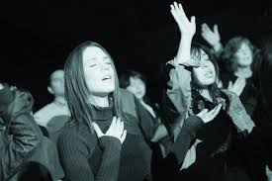

Slide 9
INTRODUCTION
And this is a telling representation of one of the three false religions. Along with the religions of moralism (seeking pride) and magic (seeking power) is the false religion of mysticism (seeking pleasure).
Many churches today seem to be in the business of providing this spiritual ecstasy, this mystical, altered state of consciousness that represents a pleasurable sense of escape from the mundane, not unlike to the effect of hallucinogens or other mood-altering chemicals or meditative practices so common among eastern religions.

Slide 10


Slide 11
MY THESIS
Here’s my thesis:
God created us in his own image vesting us with three wonderful powers by which we might know him and others and the world we live in.
He gave us minds, by which we can think and reason and understand; affections, by which we can feel joy and affection and compassion but also hatred of that which is wicked and evil; and he gave us wills by which we can choose and act on our choosing.

Slide 12
MY THESIS
But when we broke faith with God through our seeking autonomy, to be free from God, to be our own gods, we fell, hard.
These three great powers were not erased or destroyed, but they were deeply warped and reduced to pathetic shadows of their former goodness.
We ourselves were degraded from the joyful, God-centered, happy creatures of our good Creator into the utterly sin-enslaved SELF. We chose that bed, so then we had to lie in it.

Slide 13
MY THESIS
We became self-obsessed and self-absorbed. We wanted to become like God, so we became our own little gods.
These wonderful powers were repurposed and redeployed from the service of our Maker to the service of the self.
The mind became our shady lawyer who always defended and excused the self, usually by blaming others. The will was utterly devoted to self-glorification and self-gratification, to self-promotion, self-pleasing, and self-preservation.

Slide 14
MY THESIS
And the affections, our subject for this evening, degenerated into mere sinful passions that demanded satisfaction. Hedonism, the love of pleasure for its own sake, used to be a negative judgment we would pronounce upon the disgusting, reprehensible few.
Now, everybody is a hedonist. It’s not only mainstream and normal, it is considered the highest good.
You are doing wrong if you are not seeking “self-esteem” and “self-actualization.” It is your moral duty now to think of yourself much and to think much of yourself. You have a moral obligation to explore the wonder of you and to display that wonderful you for the adoration and applause of others.
But, of course, nobody is applauding because they are all too busy adoring themselves.

Slide 15


Slide 16
MY THESIS
This is what sin has done to us.

Slide 17
MY THESIS
We were also created with the impulse to worship, to adore and praise that which is adorable and praiseworthy.
All peoples of the earth have this innate, religious sense that God is there, that he deserve our love and thanks, that he has imposed his moral will, and that he will call us to account.
But worshiping God and giving him the honor and allegiance that he is due is something of which the sinful self is utterly incapable. So the sinful self has created false religion.
And this false religion has been geared to meeting certain felt needs that correspond to the three great God-given powers, now bent and perverted, deformed and degraded to the service of the self.

Slide 18
MY THESIS
As we saw last time, the will seeks PRIDE through MORALISM. Moralism holds that God is somehow offended by our immoral actions. That explains the pervasive problems of life, along with its universal misery and dissatisfaction. By its imaginary superior moral actions, the self through the will seeks to prove that it is good enough for God, certainly better than others, satisfying the need for pride.
This is to the heart of the self-esteem religion that has captured our culture today, excusing bad behavior largely through blaming others (usually the parents). This self-esteem seeking, therapeutic movement was lampooned by the Saturday Night Live character Stuart Smalley, and his silly tag line,
“I’m good enough, I’m smart enough, and dog gone it, people like me!”

Slide 19


Slide 20
MY THESIS
This sinful “pride” has been enabled for rebellious sinners through rejecting biblical morality and replacing it with the only currently-permitted virtue of “tolerance” which has made way for the LGBTQ+, (wait for it…)
“PRIDE” movement and the self-flattering lawn signs that proclaim “Hate has no home here.”
Such a prideful display has been called “virtue signaling.” Virtue signaling costs nothing and helps no one else.
It is only intended to announce: “We are good people, certainly better than you are.” The sign could also read “Humility has no home here.” Or “PRIDE definitely has a home here.”

Slide 21


Slide 22
MY THESIS
The false religion of MAGIC, which we will consider in two weeks, corresponds to the mind, and seeks POWER. Magic assumes that God is aloof, hard to reach, and must be summoned or bribed, or even coerced and controlled by discovering and using the right formula.
You know the common expression “knowledge is power,” and that applies to this particular false religion as well. It takes several forms, from the crude “casting of spells” or “calling on spirits” to the forms of religion which pretend to have discovered three keys or six steps or seven principles for “personal success,” for “influence over others,” or for “tapping into the power of the mind or the universe or the Word or something like that.”

Slide 23
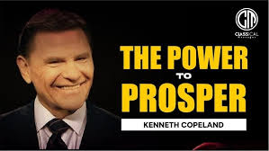

Slide 24
MY THESIS
MYSTICISM, which again, is our subject for this evening, is the religion of PLEASURE. It’s the religion of the dreamy-faced woman on the cliff, breeze blowing through her hair, hands open to (something), who is either contemplating suicide, in the grip of an intoxicant, following the counsel of her guru, or is an evangelical Christian enjoying a mountaintop experience.

Slide 26
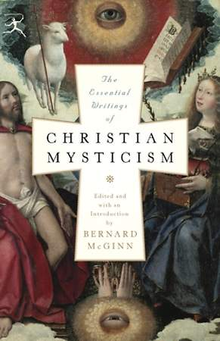

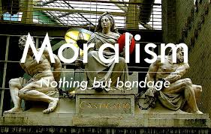
“CHRISTIAN” MYSTICISM?
My main concern in all of this is not to criticize or to call out the moralism of the Muslim or the magic of the shaman or the mysticism of the Buddhist monk.
It is to expose aberrant versions of the Christian faith that purport to be the genuine thing, but are really expressions of one or more of the three false religions.

Slide 27
“CHRISTIAN” MYSTICISM?
The Christian faith is really faith in the Christ of God, Jesus.
He is the true Prophet who informs the mind. He is the Priest who heals and restores our true affections. And he is the King who first subdues our rebellious hearts and then enables us to re-order our lives according to his will.
This is his sanctifying work.
And his work follows a regular pattern, beginning with his mind, running on to the affections, and then to the will. And his design ordinarily operates in this way:

Slide 28
“CHRISTIAN” MYSTICISM?
“God’s truth engages the mind,
which enflames the affections,
which empowers the will for love, obedience, and service.”

Slide 29

“CHRISTIAN” MYSTICISM?
If we try to start with THE WILL we will only find an unsustainable MORALISM which will stoke our sinful PRIDE.
If we start with THE AFFECTIONS, just getting emotionally whipped up, we will only find a fleeting MYSTICISM which will provide a temporary buzz of pleasure that has little to do with Christ or the kingdom of God.

Slide 30
“CHRISTIAN” MYSTICISM?
If we start but also end with only THE MIND, we will only be practicing MAGIC, seeking POWER. We will assume that God is pleased that we got all the words right and in the correct order, and that we will then enjoy “blessing,” meaning good luck or personal power.
But the Lord Jesus Christ wants all of us, our whole person, mind, affections, and will. He deserves all of us. He is the true Prophet, Priest, and King.
And if we try to separate these, mind, affections, or will, if we seek to embrace only one or another of these, we will find ourselves at best with a warped version of the faith, or falling into no true faith at all, but only one or another of the three false religions: MORALISM, MYSTICISM, or MAGIC.

Slide 31
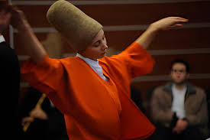

THE FALSE RELIGION OF MYSTICISM
Mystical religion abounds today, beyond, but also within the Christian fold.
Virtually every organized religion has its subgroup or sect that is devoted to mysticism more than to the organized religion itself. As we pointed out last time Islam has a mystical sect known as Sufism and Judaism has its version, Kabbala.
If you were to pair up people from these two sects, you would probably find that they are more compatible with each other than with other members of their own religion. (That’s because mysticism is their true religion.)

Slide 32
THE FALSE RELIGION OF MYSTICISM
Some religions like Hinduism and Buddhism are mostly devoted to mysticism, though Buddhism has within its fold a sect known as Zen which is a purer expression of mysticism.
The Christian faith also has its mystics.
Pietism and Pentecostalism lean in this direction, as do the Praise and Worship enthusiasts. Various figures from the Roman Church of the middle ages were mystics, and even Martin Luther had some mystic influence in his spiritual background.
Again, mysticism seeks pleasure, feeling good, mainly through achieving an altered state of consciousness. Mood-altering chemicals and hallucinogens will get you there quicker and more reliably.

Slide 33

THE CURSILLO MOVEMENT
I first became aware of the false religion of mysticism and its inroads into the Christian faith through my research into the Cursillo Movement.
I didn’t know much about it, only that it was both impactful to some and secretive (which is one dynamic leading to its impact).
A young couple who attended our church for a time had gone on a Cursillo weekend and had a lot of questions. They reported that they could not tell me any of the details and then proceeded to tell me all of the details.

Slide 34
THE CURSILLO MOVEMENT
And it all sounded very familiar.
When I was a high school student our church participated in a mainline church renewal movement known as a Lay Witness Mission. Lay people came from all around and spent a weekend at our church trying to pump us up. By employing numerous emotionally manipulative techniques, they managed to precipitate a cathartic experience in many of us, a very pleasurable and bonding experience that was a bit spooky and surreal. We were assured that what we felt was the Holy Spirit. The buzz it gave our church lasted for a couple of months, and then things went back to business as usual.
But I was hooked and signed up to become one of those lay witnesses I so admired and appreciated. I also learned to play guitar which made me even more valuable as a youth team member.

Slide 35
THE CURSILLO MOVEMENT
After attending several weekends I began to notice two things.
First, I noted that that the weekends all ran according to a particular pattern that anticipated a certain response: Saturday night crying and weeping, followed by a bonding sense of dreamy euphoria that lasted for a couple of weeks or at most, a couple of months.
The other thing I noticed was that the weekends had less and less of an impact on me, and eventually produced no euphoria, not even a minor buzz. And I wondered where the Holy Spirit had gone.

Slide 36
THE CURSILLO MOVEMENT
So when I listened to this couple describe their Cursillo weekend experience, it sounded very familiar. (It also sounded a lot like numerous “retreats” I had attended and summer camps I had led, with the final night concluding with the crying and the bonding euphoria.)
But as I further researched the movement I learned how the Cursillo leaders had refined and intensified the emotionally manipulative techniques to produce an even greater impact. Sometimes, according to their own reports, the impact was too great leading to psychotic breaks among some of the candidates.
The techniques they were well known among other researchers, and were also used by most destructive cults. And, here’s the giveaway: the techniques could be used by any group, religious or non-religious, and they would achieve the same effects. The Holy Spirit seemed optional, but the techniques were essential. (All of this and more is spelled out in my book.)

Slide 37
THE CURSILLO MOVEMENT
What the Lay Witness and Cursillo leaders had unwittingly stumbled onto were the techniques.
They combined these powerful tools with some mild, basic Christian teaching, and the results seemed to be miraculous!
What they were really practicing, though, was mysticism, not Christianity. They were providing a means by which people could slip into an altered state of consciousness through a naturally induced catharsis that felt very good (but was unsustainable).
Oh, I’m sure the graphic testimonies and teachings helped to precipitate the catharsis, but it was the techniques that did all the heavy lifting, especially the disorientation, the sleep deprivation, the guiding social pressure to conform, and the wrenching, rapid shifting of the emotional mood.

Slide 38

THE CURSILLO MOVEMENT
And what I’m suggesting is that milder versions of these emotional manipulations go on all the time in what passes for Christian worship and the Christian life.
It includes the booming music, the emotionally clutching, story-telling preaching, the the rather recent innovation of drama, skits, and showing movie clips in church services, and the social pressure of the altar call, “going forward” at church meetings.

Slide 39
THE CURSILLO MOVEMENT
Haven’t you heard this comparison? “Head knowledge” (bad) vs. “heart knowledge” (good). “Heart knowledge” in this instance refers exclusively to the feelings.
Finish this line: “You ask me how I know he lives….
HE LIVES WITHIN MY HEART/FEELINGS.”
So “sermons” with little biblical content but overflowing with emotional stories produce “heart knowledge” (good), while faithful biblical exposition with application can only produce “head knowledge” (bad).
And remember “people do not care what you know until they know that you care.”
(Unless, that is if the person in view is your surgeon or the pilot of your 737. Oh, then we care deeply about how much they know about their profession. And ordinarily, we never even meet our pilot.)

Slide 40
THE CURSILLO MOVEMENT
Remember our paradigm of how God sanctifies us:
“God’s truth engages the mind,
which enflames the affections,
which empowers the will for love, obedience and service.”

Slide 41

THE CURSILLO MOVEMENT
When you aim at the affections, bypassing the mind and ignoring the will, you are practicing MYSTICISM and you are on a quest for PLEASURE.
You are NOT seeking the whole Christ as Prophet, Priest, and King.

Slide 42
THE CURSILLO MOVEMENT
What I want to do after the break is to explore some ways that people have mistaken alternate states of the mind (mysticism) for true religion (which they do feel in their heart), and then think about some ways we can beware the enticing draw of the false religion of mysticism.

Slide 43
2025 SUMMER SEMINARS HOSPERS PCA
“THE THREE FALSE RELIGIONS”
Ju ne 17 “A Tale of Two Explanations”
July 15 “Am I Good Enough?”
July 29 “More than a Feeling”
August 12 “Abracadabra”

Slide 44
FORMS OF PSYCHOLOGICALLY-INDUCED RELIGION Baal Worship
An example of this kind of altered-state, mystical religion is most likely preserved in Scripture in the description of Baal worship in 1 Kings 18. The story is familiar.
God instructs Elijah to challenge the prophets of Baal to a “showdown” on Mt. Carmel: which God can answer with fire from heaven?
The 450 prophets of Baal go first, but it is the description of their worship practice that is to the point. After arranging their sacrifice, they began to call on their god.
Following an initial lack of success “they limped around the altar that they had made.” (18:26) Rhythmic dancing, an apparent feature in Baal worship, is one means of inducing catharsis according to psychologist and physician William Sargant. “Emotions can also be discharged by vigorous dancing….Some primitive tribes use dancing for the same purpose.”

Slide 45
FORMS OF PSYCHOLOGICALLY-INDUCED RELIGION Baal Worship
Still finding no success and after being taunted by Elijah, the prophets stepped up their efforts. “And they cried aloud and cut themselves after their custom with swords and lances, until the blood gushed out upon them. And as midday passed, they raved on until the time of the offering of the oblation, but there was no voice. No one answered; no one paid attention.” (18:28-29)
The writer indicates that the common practice of Baal worship included prolonged, rhythmic dancing, self-inflicted blood loss (dehydration), and chanting, all of which can produce trance-like, altered states of consciousness and catharsis.
So it is probable that Baalism really consisted of a methodology for inducing an altered state and associated it with a mythology (devotion to Baal) largely intended to explain their extraordinary experience (which they all felt in their hearts!).

Slide 46
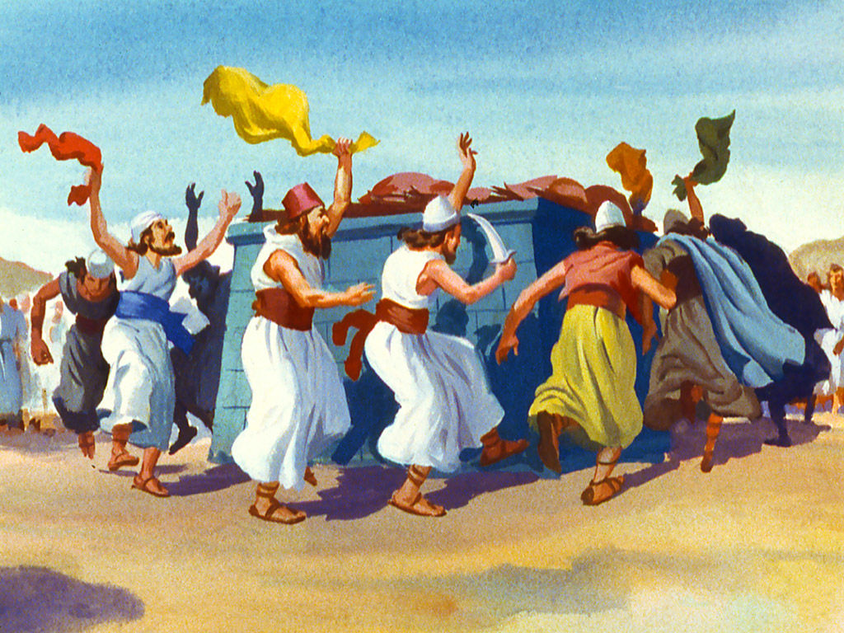

Slide 47
FORMS OF PSYCHOLOGICALLY-INDUCED RELIGION Baal Worship
Note by contrast the simplicity of Elijah’s worship: preparation of the sacrifice according to God’s commandment, and prayer.
Also Elijah’s worship was not simply subjectively felt but also objectively answered as the fire fell (c.f. 1 Kings 18:30-39).
And note that God severely punished Baalism (mystical idolatry): the 450 prophets of Baal were all put to death.
Examples of altered-state, mystical religions abound. (These are all from my book on Cursillo.)

Slide 48
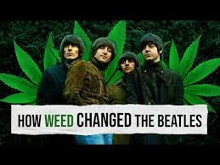
FORMS OF PSYCHOLOGICALLY-INDUCED RELIGION Alcohol Religions
Ringo Starr sang McCartney and Lennon’s lyric, “I get by/high with a little help from my friends,” in reference to chemical “friends.”
Others have decided that they can “get religion with a little help from” their “friends.” There are several versions of drug-induced altered states of consciousness which are interpreted as religious experiences.

Slide 49
FORMS OF PSYCHOLOGICALLY-INDUCED RELIGION Alcohol Religions
According to John Ferguson’s Encyclopedia of Mysticism and Mystery Religions, alcohol “is the commonest of all drugs” acting “as a depressant on the brain.” It is ubiquitous to all cultures dating back to the earliest civilizations. Since it was impossible to keep fruit juices and other liquids containing sugar or starch from fermenting, the resultant alcoholic drink was widely available. Its relaxing and consciousness-altering properties (including the creation of illusions) also gave it apparent religious qualities.
Numerous cultures attributed spiritual significance to alcohol (spirits) as in the mystery religion of Dionysius, for example. These properties were heightened by the discovery of the process of distillation. “The Hindu Soma, and Persian Haoma were ritual libations of fermented juice. The god Indra drank great quantities of Soma and said, ‘I have drunk Soma, I have become immortal.’” In a curious twist of the Alcoholics Anonymous’ terminology, alcohol itself is the “higher power.”

Slide 50
FORMS OF PSYCHOLOGICALLY-INDUCED RELIGION The Oracle of Delphi
Long-thought discredited, the ancient Greek historian Plutarch had spoken of a spring which emitted “fragrance and breeze” into the temple of the Oracle at Delphi, creating a frenzy and trance for the virgin priestesses resulting in their delivery of supposed prophetic messages from an ecstatic state.
Researchers in the 19th and 20th centuries had found no such springs or gases, and so Plutarch was dismissed.

Slide 51
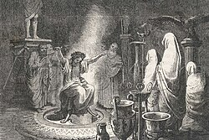

Slide 52
FORMS OF PSYCHOLOGICALLY-INDUCED RELIGION The Oracle of Delphi
But more recent discoveries have led to a revision of the revision. Archaeologist John Hale and geologist Jelle de Boer discovered two intersecting fault lines at the base of the ancient temple, fault lines which could indeed emit gases from deep in the earth.
“De Boer posited that limestone deposits buried deep beneath the ground might have released hydrocarbon gases—specifically, methane, ethane, and ethylene—into the air.” Ethylene was of greater interest since it bears a sweet aroma (it makes fruits smell sweet), according with Plutarch’s observation of “fragrance.”
Ethylene also produces mental confusion and in low doses can create trance-like symptoms. According to Hale, “Early-20th-century researchers found that ethylene could produce an anesthetic state twice as fast as nitrous oxide” (so-called “laughing gas”).
Water samples from natural springs discovered at the faults indeed detected low levels of ethylene along with other gases.

Slide 53
FORMS OF PSYCHOLOGICALLY-INDUCED RELIGION The Oracle of Delphi
Though scholars continue to debate the precise nature of the gas—an Italian team published a paper arguing that methane-induced oxygen deprivation was the culprit—Hale says the bigger point is that the debate is happening at all.
“People were responding to a very specific phenomenon in the Earth’s surface,” he says. “Modern science confirms the validity of those ancient observations, and this is a great way of looking at ancient religion.”
Once more we find an example of a drug-induced altered state of consciousness confused with a religious or mystical experience.

Slide 54
FORMS OF PSYCHOLOGICALLY-INDUCED RELIGION Peyotism
A more telling and evident example of pharmacological mysticism is found in Peyotism, called “the most widespread contemporary religion among (native Americans) in the United States.”
Peyotism is a syncretistic blend of Christian teachings, ethics, and eschatology with Native American culture. Originating about 1885, it has spread to many tribes and boasts a congregation of some 300,000.
In this religious practice, an all-night ceremony (sleep deprivation) of symbolic ritualism centers on consuming the peyote buttons, which come from a spineless cactus and contain the active hallucinogenic agent mescaline.

Slide 55
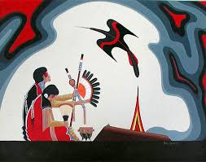

Slide 56
FORMS OF PSYCHOLOGICALLY-INDUCED RELIGION Peyotism
The resulting trance-like state is thought to convey healing powers and spiritual wisdom through heightened awareness, visions, and mystical experiences.
Proponents claim that while others only talk about Jesus, they talk to Jesus.
“And its resources are inexhaustible: ‘You can use the Peyote all your life, but you never get to the end of what there is to be known from Peyote. Peyote is always teaching you something new.”

Slide 57
FORMS OF PSYCHOLOGICALLY-INDUCED RELIGION Psilocybin and the Magic Mushrooms of Marsh Chapel
Another hallucinogenic drug found in a natural source became famous for its purported religion-enhancing properties in a well-known “experiment” on Good Friday 1962, in the basement of Marsh Chapel at Boston University.
A few years earlier, a New York banker and his Russian wife, Richard and Valentina Wasson, with a special interest in mushrooms, traveled to Mexico to track down the fabled mystical mushroom that had been the source of legends in the journals of Spanish conquistadors.
Richard consumed some of the mushrooms, had what he described as a profound mystical experience, and presented his findings at Harvard University.

Slide 58
FORMS OF PSYCHOLOGICALLY-INDUCED RELIGION Psilocybin and the Magic Mushrooms of Marsh Chapel
This happened to coincide with the hippie movement, and the press covered the event widely. Psilocybin mushrooms were readily available in grassy areas of North America.
The Wassons’ discovery heralded the beginning of the recreational/spiritual hallucinogen movement in the United States.

Slide 59
FORMS OF PSYCHOLOGICALLY-INDUCED RELIGION Psilocybin and the Magic Mushrooms of Marsh Chapel
By 1962 many youth were leaving formal churches in search of spiritual reality through hallucinogens. A noted religious philosopher, Huston Smith, sought to discover if psilocybin alone could produce a religious experience. Together with interested staff from Harvard, including the junior lecturer, Timothy (“Tune in. Turn on. Drop out.”) Leary, Smith devised an experiment in which Harvard Divinity School students with no previous drug use were invited to volunteer.
In a blind study, half of the group was given a placebo of nicotinic acid which merely produces a tingling sensation. The other half was given psilocybin.
The experiment took place on Good Friday in the basement of Marsh Chapel as chapel services were being held above. It later became known as “The Good Friday Experiment” or “The Miracle of Marsh Chapel.”

Slide 60
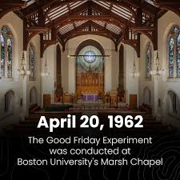

Slide 61
FORMS OF PSYCHOLOGICALLY-INDUCED RELIGION Psilocybin and the Magic Mushrooms of Marsh Chapel
Their findings were that the half which were given the placebo experienced boredom while many in the other half reported the most profound religious experience of their lives, a claim which they reaffirmed when interviewed some 25 years later.
Did these intoxicated divinity school students truly encounter “the ultimate?” Most Christians would dismiss this claim (they got high).

Slide 62
FORMS OF PSYCHOLOGICALLY-INDUCED RELIGION Chanting and Repetitive Singing
Hyperventilation, the common result of vigorous chanting and repetitive singing, has been discussed in chapter three. Clinical psychologist Margaret Singer relates the demonstration of a “Hoo meditation” by a former follower of Rajneesh:
“He stood with his feet wide apart, his arms above his head, and began to bow at the waist, rapidly with stiff arms, blowing out air as sharply, forcefully, and as fast as he could, turning the heavy puffs into the sound ‘hoo’ while bowing. This was done, he said, until most members fell to the mats on the floor.”
The light-headedness experienced during hyperventilation is called “respiratory alkalosis.”

Slide 63
FORMS OF PSYCHOLOGICALLY-INDUCED RELIGION Chanting and Repetitive Singing
Respiratory alkalosis also causes fainting. People often drop to the floor and are briefly unconscious.
While they are unconscious, underbreathing occurs to compensate for the period of overbreathing and to restore the normal acid-base balance of the blood.
People awaken limp, exhausted, and aware that they have been through a dramatic and frightening experience.

Slide 64
FORMS OF PSYCHOLOGICALLY-INDUCED RELIGION Chanting and Repetitive Singing
Cults, quacks, and manipulators have become aware of the predictable outcomes of hyperventilation—the giddiness, the out-of-control feeling, the possible loss of consciousness, the tingling, and the clenching of fingers and toes.
Similarly, they have recognized the impact of immediately reframing the experience. By consciously reframing or relabeling the effects, thus confounding individuals’ gut-level reactions that something unpleasant has happened, leaders turn a frightening state into a supposedly positive one, telling neophytes, for example, that they are “becoming blissed out,…getting or receiving the spirit,…on the path.”

Slide 65
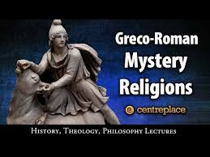
FORMS OF PSYCHOLOGICALLY-INDUCED RELIGION The Mystery Religions
The mystery religions were secret sects of ancient Greece and Rome.
They offered a pathway to spiritual experiences not available in the officially-sanctioned religions. Originating in primitive, tribal ceremonies from various parts of the world, these practices and initiation rites were widely available to individuals on a voluntary basis.
Though their origins are much older, the mystery religions were most popular in the first three centuries after Christ.

Slide 66
FORMS OF PSYCHOLOGICALLY-INDUCED RELIGION The Mystery Religions
Walter Burkhert, a foremost historian of the Greek religion, describes these mystery religions even while recognizing that their secrecy has left many of their mysteries unrevealed. The resemblance of the expected effect of this mystery religions to the goals of the Cursillo is remarkable:
“‘something is bound to happen to the soul,’ so that initial bewilderment is changed into wonder, and acceptance into sense. In religious terms, mysteries provide an immediate encounter with the divine….In psychological terms, there must have been an experience of the ‘other’ in a change of consciousness, moving far beyond what could be found in everyday life.”

Slide 67
FORMS OF PSYCHOLOGICALLY-INDUCED RELIGION The Mystery Religions
The mystery religions sought to create great emotional upheaval.
“The experience is patterned by antithesis, by moving between the extremes of terror and happiness, darkness and light.” Those undergoing initiation should “bear up to the first purifications and unsettling events and hope for something sweet and bright to come out of the present anxiety and confusion.”
Like the Cursillo clausura (or closing ceremonies) “one of the main characteristics of the mysteries is the makarismos, the praise of the blessed status of those who have ‘seen’ the mysteries. As the initiate is accepted and hailed by a chorus of those who have gone through the same peripteries of experience, his feelings of relief will rise to the heights of exultation.”

Slide 68
FORMS OF PSYCHOLOGICALLY-INDUCED RELIGION The Mystery Religions
What techniques were used to create the sense of “something sweet and bright” and “the blessed status of those who have ‘seen’ the mysteries”?
The methods varied, and again, since they were secret, some information is unavailable. But the various initiations included shocking, nighttime practices of candidates being smeared with clay, confronted by priestesses dressed as demons, poisonous snakes, rhythmic dance, shrieks and cries, or being lowered into a pit only to be drenched in the warm blood of a bull agonizing and dying just above.
Emerging from the pit, the candidate would be “‘adored’ by the others, as one who had risen to a superior state, and feelings of liberation and a new life would have been overwhelming by contrast, just because of the horrifying procedure undergone before.”
“The basic idea of an initiation ritual is generally taken to be that of death and rebirth.”

Slide 69
FORMS OF PSYCHOLOGICALLY-INDUCED RELIGION The Mystery Religions
Another possible avenue to enlightenment in the mystery religions was torture. There remains some evidence of mutilation and human sacrifice, though this charge of torture was largely raised by the contemporary opponents of the mystery religions. “Psychological terror, however, is well-attested: ‘all those terrible things, panic and shivering and sweat,’ to quote Plutarch once more.”
Sexuality was another means to achieve the end. Mystery initiations we often filled with sexual symbolism and ritualism, and were often preceded by periods of sexual abstinence.
“This would stimulate expectations and attentiveness to certain signals. Sexuality becomes a means for breaking through to some uncommon experience, rather than an end in itself.”
And drugs likely played their part with suggestions ranging from hallucinogenic drinks, to mushrooms, to a natural form of LSD, and opium. And, of course, wine.

Slide 70
FORMS OF PSYCHOLOGICALLY-INDUCED RELIGION The Mystery Religions
Some ancient witnesses offered their observations regarding the source of these experiences, including:
“a clinical description of ecstasy in the cult of Meter, as seen by a doctor: the galloi “are turned on by flute music and gladness of heart [thymedie], or by drunkenness, or by the instigation of those present”—an interesting observation of the interdependence of performers and onlookers. “This madness is divine possession. When they end the state of madness, they are in good spirits, free of sorrow, as if consecrated by initiation to the god.”
More simple is the account that Aristides Quintilianus, the musicologist, gives of Bacchic initiation. He follows to some extent Aristotle’s concept of katharsis: “This is the purpose of Bacchic initiation, that the depressive anxiety [ptoiesis] of less educated people, produced by their state of life, or some misfortune, be cleared away through the melodies and dances of the ritual in a joyful and playful way.”

Slide 71
FORMS OF PSYCHOLOGICALLY-INDUCED RELIGION The Mystery Religions
This, then, is a form of psychotherapy that would be compatible even with the latest trends of today….Still more deprecating and purportedly realistic is the explanation given by Livy for the ecstasy and miracles experienced at the Bacchanalia: it was just lack of sleep, he writes, and the wine and the musical sounds and cries throughout the night that stunned people.”

Slide 72
FORMS OF PSYCHOLOGICALLY-INDUCED RELIGION The Mystery Religions
Burkhert acknowledges that these means were widely employed, yet he maintains that the mysteries were something more: “This is a collection of stimuli that every rationalist may endorse. But this interpretation closes the door of the secret rather than revealing it.”
He concludes that the mystery religions offered an extraordinary experience, the hope of something beyond a drab life:
“It was enough to know that there were doors to a secret that might open up for those who earnestly sought it. This meant that there was a chance to break out of the enclosed and barren ways of predictable existence. Such hopes were attempts to create a context of sense in a banal, depressing, and often absurd world, providing the experience of a great rhythm in which the resonances of the individual psyche could be integrated through an amazing event of sympatheia.”

Slide 73
FORMS OF PSYCHOLOGICALLY-INDUCED RELIGION The Mystery Religions
Yet what we discover once again is that the employment of psychological and physiological methods produce a predictable breakthrough response which is then supplied with a mythology and reinterpreted as a religion.

Slide 74
FORMS OF PSYCHOLOGICALLY-INDUCED RELIGION Contemporary Christian “Praise and Worship”
We conclude our survey of mystical religions, that is, altered states of consciousness reinterpreted as religion, with one that is commonly practiced among professing, evangelical Christians, namely the “praise and worship” portion of many church services.

Slide 75


Slide 76
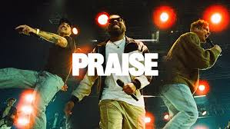

Slide 77


Slide 78


Slide 79
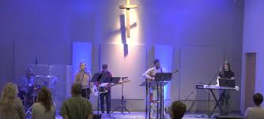

Slide 80
FORMS OF PSYCHOLOGICALLY-INDUCED RELIGION Contemporary Christian “Praise and Worship”
Barry Liesch, Professor of Music at Biola University, both describes and defends the “praise and worship” style in his book, The New Worship.
The model Liesch cites is the five-phased pattern developed by John Wimber and Eddie Espinosa. Espinosa likens this sustained period of singing to “a physical workout. Just as sustained periods of exercise are good for the cardiovascular system, so sustained singing for fifteen to forty minutes is good for worshipers’ spiritual systems,” (a questionable analogy).

Slide 81
FORMS OF PSYCHOLOGICALLY-INDUCED RELIGION Contemporary Christian “Praise and Worship”
The five phases sound innocuous enough: invitation, engagement, exaltation, adoration, and intimacy. Most troubling, though, is the close attention paid to the psychological impact each of the five phases has upon the worshiper.
Liesch offers a chart called “Five-Phase Worship Curve Respects Psychological Dimension,” which graphs the rising and falling emotional state of the participants. The invitation phase is an extended call to worship, seeking to draw people into worship with lyrics that are directed mostly to the people. The key is to attain the psychological response from those gathered,
“Leaders continue the invitation phase until they have made contact with the people and everyone is focused. ‘The skillful leader woos the congregation into worship like the patient lover draws the beloved.’”

Slide 82
FORMS OF PSYCHOLOGICALLY-INDUCED RELIGION Contemporary Christian “Praise and Worship”
The engagement phase follows the invitation “as the people begin to draw near to God.” It is likened to the “engagement period before marriage, for now we are attentive, serious.”
The exaltation phase is next in which “the people sing out to the Lord with power.” The intent is a rising tide of emotional fervor. Note the careful attention to the part the music plays in shaping the emotional response:
“The pitch spans are greater than in the other phases because high notes help bring out a dynamic response and project a sense of God’s greatness. If the people stand throughout the invitation, engagement, and exaltation phases, response will be stronger.”

Slide 83
FORMS OF PSYCHOLOGICALLY-INDUCED RELIGION Contemporary Christian “Praise and Worship”
After the climax of emotional fervor has been reached, it’s time to slow things down and move into the adoration phase.
“In the adoration phase the people can be seated, the dynamics subside, the melodic range may reduce to five or six notes, and the key words may be you and Jesus….Transitions and modulations can be longer and more expressive in the adoration phase. Don’t rush it!”

Slide 84
FORMS OF PSYCHOLOGICALLY-INDUCED RELIGION Contemporary Christian “Praise and Worship”
Then Liesch makes an astonishing statement: “In the exaltation and adoration phases, two sides of God’s character receive expression: his transcendence (majestic greatness) and his immanence (closeness to us). The expression of both together tends to allay contrived emotion.” Up to this point the focus of the five-phase pattern is almost exclusively devoted to “contriving” the emotions of the gathered. The whole purpose of the five-phase pattern from beginning to end is to control and shape the emotional response of those assembled.
The words that are sung are apparently not of greatest importance, only the emotional impact of the music.

Slide 85
FORMS OF PSYCHOLOGICALLY-INDUCED RELIGION Contemporary Christian “Praise and Worship”
The last phase is the intimacy phase, “the quietest and most personal of all.” And how are the gathered maneuvered into this intimacy? Chiefly by shifting the personal pronouns from “we” to “I” and “me.”
Of course, the instrumentation must be likewise modified to create the new mood: “The acoustic guitar could be used to project intimacy. Brushes or no percussion sounds may be most appropriate.” The conclusion of this “worship” is to have people stand for a closeout chorus or hymn.
The purpose of this song is that it “leads out of intimacy and helps everyone adjust to the next event in the service.”
Once again the main focus is on shifting the emotional state of those in attendance.

Slide 86
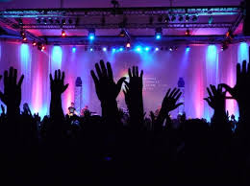

Slide 87
FORMS OF PSYCHOLOGICALLY-INDUCED RELIGION Contemporary Christian “Praise and Worship”
To his credit, Liesch does note that some object to this mood music:
“Some critics believe contemporary worship is guilty of promoting manipulative, self-indulgent worship experiences. They object to the use of music to induce, urge, cause, or empower a worship experience—to push people’s “worship buzzer”—like a conditioned reflex. Some even object to the concept that music can be used to aid, facilitate, or enhance a worship experience.”

Slide 88
FORMS OF PSYCHOLOGICALLY-INDUCED RELIGION Contemporary Christian “Praise and Worship”
One such critic he cites is Harold Best, former dean of Wheaton College’s Conservatory of Music, who declares:
“‘Depending on music to aid, induce, or enhance worship is idolatry dressed up in psycho-aesthetic finery. It confuses the power of music with the presence of God.’” It also places the “worshiper” in the difficult position of experiencing “contrived emotion” and yet falsely thinking it to be a genuine experience of the Divine.

Slide 89
FORMS OF PSYCHOLOGICALLY-INDUCED RELIGION Contemporary Christian “Praise and Worship”
Some time ago I attended a large gathering of evangelicals. The worship leaders distributed a song sheet. One of the songs on the sheet contained the lyrics: “Celebrate Jesus, celebrate.” This phrase was repeated several times along with affirmations of Christ’s resurrection.
But what amazed me was the note at the bottom of this chorus. It read, “Repeat until euphoric” (that is until you are in a happy, giddy mood).
I guess I’ve never seen it stated that obviously before. Here was an instance where large group “praise” music was clearly used to achieve an altered state of consciousness, euphoria, an elevated mood, while at the same time interpreting it as true religion, an encounter with the ultimate.

Slide 90

FORMS OF PSYCHOLOGICALLY-INDUCED RELIGION Contemporary Christian “Praise and Worship”
This startling, candid admission demonstrates that much contemporary, evangelical “praise and worship” is simply another expression of one of the three false religions: mysticism.

Slide 91
CONCLUSION: THE “HEART ON FIRE”
Certainly the most striking aspect of mystical religion is emotion.
And we should become emotionally engaged with our faith.
Jesus said that we should love the Lord with all our heart and soul (Matt. 22:37) which certainly must include our emotions.
Paul commands in Romans 12:11: “Do not be slothful in zeal, be fervent in spirit, serve the Lord.”
In commenting on Hebrews 2:1-4, the Puritan John Owen writes: “The apostle uses the incomparable excellency of the Author of the Gospel as the basis of his argument. He reminds them, and us, in general, that in handling the doctrines of the Gospel about the person and work of Jesus Christ, we should not be satisfied with mere intellectual assent, but should endeavor to have our hearts set on fire by them through faith, love, obedience, and perseverance.”

Slide 92
CONCLUSION: THE “HEART ON FIRE”
Likewise Jonathan Edwards could go so far as to say “True religion, in great part, consists in holy affections.”
He noted that the “Holy Scriptures do everywhere place religion very much in the affections; such as fear, hope, love, hatred, desire, joy, sorrow, gratitude, compassion and zeal,” and “hence we may learn, what great cause we have to be ashamed and confounded before God, that we are not more affected with the great things of religion. It appears…that this arises from our having so little true religion.”

Slide 93
CONCLUSION: THE “HEART ON FIRE”
Here we discover the danger of the so-called “dead orthodoxy” which is content only with the intellectual, giving the right answers, while being unconcerned, even suspicious of the enflamed heart.
We need to seek to become emotionally involved with the truth.
And if we really believed what we profess, how could we help but become emotionally involved?
Who in his right mind would not love a Savior so glorious, or be horrified by the hideousness of sin?
Who would not recoil from the terrors of hell and pour out ardent prayer that all might escape such everlasting torment?
Who would not soar with joy at every hint of the hope of heaven and its eternal glory and delight?

Slide 94
CONCLUSION: THE “HEART ON FIRE”
The goal is “truth on fire,” an earnestness enflamed at the magnitude of what is declared in the Gospel.
This is not emotionalism, which is mere “fire on fire,” nor is it simply getting “pumped up” like a crowd at a basketball game.
Rather, it is a steady, growing blaze feeding on the solid fuel of the glory of God in the Gospel.

Slide 95
CONCLUSION: THE “HEART ON FIRE”
Our great Prophet, Priest, and King came to redeem all of us and deserves all of us: mind, affections, and will. And it begins with truth, with the mind. But it doesn’t end there. Rather…
“God’s truth engages the mind,
which enflames the affections,
which empowers the will for love, obedience and service.”

Slide 96
QUESTIONS?

Slide 97
2025 SUMMER SEMINARS HOSPERS PCA
“THE THREE FALSE RELIGIONS”
June 17 “A Tale of Two Explanations”
July 15 “Am I Good Enough?”
July 29 “More than a Feeling”
August 12 “Abracadabra”
(Audio and PowerPoint slides from all summer seminars can be found at hosperspca.org)

