Slide 1
The three false religions
Part Four: abracadabra

Slide 2
2025 SUMMER SEMINARS HOSPERS PCA
“THE THREE FALSE RELIGIONS”
Ju ne 17 “A Tale of Two Explanations”
July 15 “Am I Good Enough?”
July 29 “More than a Feeling”
August 12 “Abracadabra”

Slide 3
The three false religions
Part Four: abracadabra

Slide 4


Slide 5
INTRODUCTION
Many years ago I went to see my dentist (not my current dentist) for a routine appointment. My dentist was a Christian, so we often discussed theology.
It seemed a little unfair. He would come in, examine my teeth for five minutes. And then for the next ten minutes I would answer his questions on theology. And at the end, he gave me the bill and not the other way around!
That day we were discussing various TV preachers. And the topic was magic religion. I had been reading about it in a book called Power Religion. And I explained that some TV preachers followed a philosophy called “New Thought,” a mystical teaching quite distinct from historic Christianity.
One of its tenets is the belief in “mind over matter,” the idea that our thoughts or words could change our circumstances into something we preferred.

Slide 6
INTRODUCTION
The TV preacher, Robert Schuller, for example, following his guiding star, Norman Vincent Peale (a New Thought proponent), taught that we could change our circumstances through “possibility thinking” (appropriating Peale’s “positive thinking”).

Slide 7
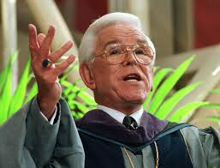
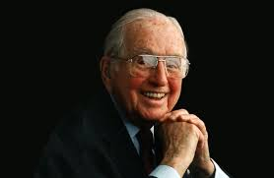

Slide 8
INTRODUCTION
More radical was a TV preacher like Joel Osteen.

Slide 9
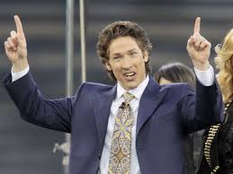

Slide 10

INTRODUCTION
Osteen is a proponent of the practice of “positive confession,” by which, it was claimed, we can actually re-shape our reality by saying the right words, positive words: banishing sickness and problems and creating financial prosperity and success.
This is the “name it, claim it” view.
And this is a clear example of the third of the three false religions. Along with moralism and mysticism, this is the religion of magic.

Slide 11
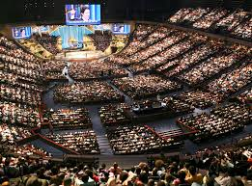
INTRODUCTION
The reason I remember this event was the fact that the hygienist sitting with us had been listening. I knew her to be a member of a local Reformed church.
And at the mention of Joel Osteen, she brightened up: “Oh, Joel Osteen! I love to listen to him!”
She’s not the only church member who does.

Slide 12
THREE FALSE RELIGIONS
What I’ve been arguing all along is that we humans, created in God’s image, are incurably religious.
We instinctively know that God is there and that we have become estranged from him due to our sinful disobedience. We know that we are incomplete, suffering various troubles, and that something far worse is coming after death.
But…because we have rejected God’s rightful claim over our lives, we cannot acknowledge the truth. We cannot apply to God for salvation through Jesus which would involve faith in Christ and repentance from sin and self.
We do not like God’s story, so we attempt to replace it with something more flattering to us: false religion.

Slide 13
THREE FALSE RELIGIONS
And so people have created false religion.
And these false religions have been contrived to meet our three most basic needs which correspond to God’s great gifts of mind, affections, and will.
Because of our fall into sin, these priceless gifts have degenerated to nearly complete ruin. We are alienated from the life of God.
Our mind has been darkened,
our affections have become sinful passions, and
our will is now enslaved to only obey sin and self.

Slide 14
THREE FALSE RELIGIONS
The darkened mind seeks power, the sinful passions seek pleasure, and the enslaved will seeks pride.
And the three false religions correspond to these felt needs.
Pride (the fallen will) seeks the affirmation of MORALISM (I can be good enough if I try hard enough.)
Pleasure (the fallen passions) seeks the ecstasy of MYSTICISM (an enjoyable, altered state of consciousness that thinks it has encountered “god” or the “ultimate”).
And power (the fallen, darkened mind) seeks to discover the secrets and rituals of MAGIC (providing supremacy over negative circumstances, harmful forces, even over an uncooperative God—“knowledge is power!”).

Slide 15
THREE FALSE RELIGIONS
In false religion, “God” or the “Ultimate” is either offended, aloof, or unwilling.
So by moralism, God is placated, by mysticism, God is encountered, or by magic, God is controlled, forced to respond in our favor.
Organized, false religions like Islam, Hinduism, Buddhism, and others are really expressions of or combinations of one or more of these three false religions.
And most all organized religions have factions within them that are more directly devoted to one or another of the three false religions of moralism, mysticism, or magic.

Slide 16
THREE FALSE RELIGIONS IN THE CHURCH
What concerns me most, as I have said, are the various forms of moralism, mysticism, or magical religion that masquerade as Christianity, even as advanced forms of Christianity or as the true, rediscovered, or restored Christian faith.
The bottom line in each of these three false religions maintains the central position of the autonomous self.
Self must be in control. Self must be satisfied. Self must be exalted. It’s about self-preservation and promotion, self-gratification, and self-glorification.

Slide 17



Slide 18
THREE FALSE RELIGIONS IN THE CHURCH
Each of these false religions view the problem and the solution in the wrong light, the exact opposite of the truth.
In the true, biblical religion, the problem is “in here” and the solution is “out there.” In false religion, the problem is “out there” while the solution is “in here.”

Slide 19
THREE FALSE RELIGIONS IN THE CHURCH
In moralism, the perceived problem is that God is offended or disappointed and the solution is trying harder to do better, calling on my inner resources for self-help and self-improvement, making myself good enough for God.
In mysticism, the perceived problem is the tedium and pain of life and the solution is to dive down deep within, to my always-good inner self and to achieve an altered state of consciousness where I can bask in the mystical joy of God (or me, same thing), or merge with the cosmos, etc.
And in magic religion, the problem is with the negative forces of the universe that cause sickness and adversity. If I can learn the secret keys and tap into my inner powers (for I am god), I can take authority over these forces and transform them into what I really want: health and wealth, worldly prosperity.

Slide 20
THREE FALSE RELIGIONS IN THE CHURCH
As with most forms of false religion, the problem is seen to be metaphysical.
There is a flaw in the universe, or something incomplete in our being, or there are some negative forces to overcome.
So we need to gain some special insight or achieve some higher status.
In the true religion, the problem is not metaphysical but moral: our willful defection from God and our chosen devotion to self.
This is a moral problem that we are powerless to overcome.

Slide 21
THREE FALSE RELIGIONS IN THE CHURCH
In biblical Christianity, the problem is sin. We have offended a holy God. That sin has severed us from the life that is in God alone.
As a result, we have devolved into a hideous creature: the proud, imperious, grasping, sinful Lord Self. And in biblical Christianity the answer is “out there.” The answer is Jesus, the God-man, who has atoned for our sin and who will lead us into a new life.

Slide 22
THREE FALSE RELIGIONS IN THE CHURCH
Jesus is precisely what we need.
As the True Prophet, the Word of God, he can restore our darkened mind.
As the True High Priest who has made atonement for our sin by becoming our final sacrifice for sin, he can heal our sinful passions, restoring godly affections.
And as our True King, he can subdue our stubborn will and bring it back into submission to himself.
Our rightful PRIDE is then placed in Jesus, and we boast in him alone. We find true and lasting PLEASURE in Jesus, in his love for us, the joy he brings, and the unquenchable hope we receive. And we find POWER in Jesus through his Holy Spirit, divine power for defeating the sinful self and for transforming us into the holy character of Jesus himself.
This is very different from magic.

Slide 23
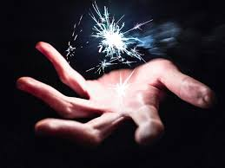

Slide 24
MAGIC CHRISTIANITY
Joel Osteen is the head of the largest “church” in North America, Lakewood Community Church in suburban Houston, with over 40,000 in attendance each weekend.
He doesn’t really refer to his organization as a “church,” more of a “family business.” And he doesn’t like to think of himself as a preacher, more of a motivational speaker.
Osteen, son of the preacher and faith-healer, John Osteen, is a multi-millionaire. Just one of his best-selling books received a $13 million advance.
His 2025 net worth is estimated to be between
$50 and $100 million.

Slide 25


Slide 26

MAGIC CHRISTIANITY
But he’s not a Christian, not by any orthodox standard, and we should beware.
Like his female counterpart, the multi-millionaire Joyce Meyer (2025 net worth $8 million),
Osteen is a follower of a quasi-religious philosophy known as “the Word of Faith” movement, based on the metaphysical “New Thought” teachings of Phineas Quimby.

Slide 27
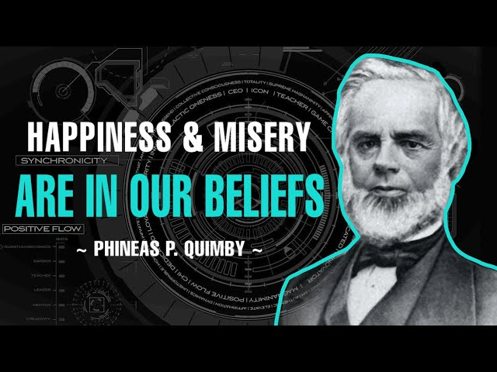

Slide 28
MAGIC CHRISTIANITY
Sometimes this philosophy is referred to as “the prosperity gospel” or “the health and wealth gospel.” If you are old enough, you may remember the names Kenneth Hagin, Kenneth Copeland, Robert Tilton, and Oral Roberts.

Slide 29
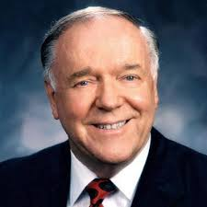
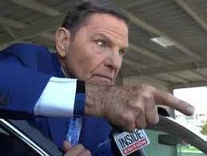
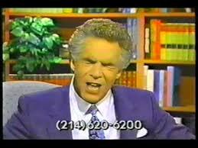
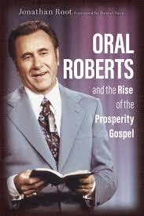

Slide 30
MAGIC CHRISTIANITY
The heart of this false teaching is the supposed power of the “Word of Faith.” Of course, “word” and “faith” are good, biblical terms, but Osteen and his ilk mean something quite different from the biblical message.
In the Bible, the Word is the Son of God, the second person of the Trinity, through whom God made all things. Every act of creation in Genesis 1 is prefaced by the formula, “And God said….” And the Bible also is the written Word of God.
The biblical word “faith” means submission to and trust in the promises of God fulfilled in Jesus Christ, leading to assurance and obedience.

Slide 31
MAGIC CHRISTIANITY
But the Word of Faith teachers like Osteen and Joyce Meyer mean something radically different by these terms.
In their world, you are the center of the universe, and by your faith and your positive words or “positive confession,” you are able to tap into the power of the “Word,” just like God did when he created all things.
They teach that this power is infused through the universe (think “the force” as in Star Wars), and we are able to capture and employ this power, called “the Word,” through our “faith,” our will to believe, which is demonstrated by the positive words we use, which is called “positive confession” (the similarities to the Star Wars cosmology are striking!).
So, to be clear, just as God had to exercise his faith to manipulate the power of the Word to create the universe, so we can exercise our faith to call upon the Word-force to change our situations.

Slide 32


Slide 33
MAGIC CHRISTIANITY
“Salvation,” then, in the Word of Faith scheme, is really success, to be successful, to create circumstances more to your liking, to rebuke and deny sickness and negative experiences, to claim for yourself vast riches in the form of houses and cars, rich clothing and fancy vacations.
That’s why this false teaching is sometimes called “name it and claim it.”

Slide 34
MAGIC CHRISTIANITY
But the real power is you and your positive words and affirmations.
Beware! Negative words have a negative effect. Don’t admit to sickness or financial hardship. Don’t use the word “cancer” or “death.” Take authority over them.
A related form of this false teaching is the “positive thinking” of Norman Vincent Peale and the clearly co-opted message of “possibility thinking” of Robert H. Schuller, though Schuller, at least, remained orthodox on paper.
But these people, Osteen and those like him, take things to another level altogether.

Slide 35
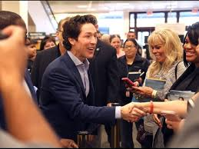
MAGIC CHRISTIANITY
Obviously this teaching is ridiculous nonsense, having nothing in common with biblical Christianity, and no sane person would possibly believe it.
And yet, judging by book sales alone, millions upon millions, many of whom would claim to be professing Christians, do believe this and do seek to practice this magical religion.

Slide 36
MAGIC CHRISTIANITY
Think of how blasphemous this Word of Faith teaching is!
Who is God in their view? God is some kind of spirit being who long ago discovered the real power in the universe, the power of the Word.
And then this God cleverly learned to tap into this great power (obviously a power that was greater than he) so that he could create the universe.
And now God is merely a coach or cheerleader who will help us discover how we also can tap into this great power of the Word for ourselves, like he did. His purpose is to teach us how our own positive confession can create good things in our lives and negate the bad things.
So the real Power/God is the impersonal Word, and the lesser “God” is simply our guide for manipulating the all-powerful Word-force.

Slide 37
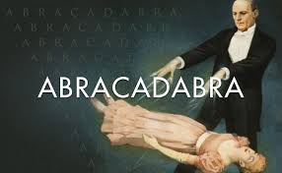
MAGIC CHRISTIANITY
You say, “How is this crazy teaching any different than magic?” That’s a good question.
It is the very definition of magic, sorcery.
Like the Word of Faith teaching, magic holds that by discovering the right words, the “magic words” (“hocus pocus,” “abracadabra”) one can manipulate the forces in the universe, casting spells, or creating circumstances more to your liking.

Slide 38
THE ATTRACTION OF MAGIC RELIGION
The seductive aspect of this message is twofold.
First, it appeals to our sinful lust for power, prestige, and possessions. It is sheer greed, covetousness. It demands that we know best and so have our way.
It would never, ever choose the way of hardship or suffering, the way of the cross.
In fact, this message wickedly declares that Jesus endured the cross so that we would never have to suffer in the least in this life, twisting the meaning of Isaiah 53:5: “and with his wounds we are healed.” The cross (“his wounds”) guarantees “healing,” if we only have enough faith.
This means that if you are not wealthy or if you are sick and suffering, God has no part or purpose in that. Rather, it is entirely your fault because you don’t have enough faith (or don’t know the secrets).

Slide 39
THE ATTRACTION OF MAGIC RELIGION
But secondly, it gives the illusion that we are in charge if we want to be, and that we can do what God did: tap into the power of the Word and create things!
Remember, the first and most seductive temptation that ensnared and ruined our race was precisely that. “You shall be like God,” which THE DEVIL whispered into Eve’s ear, and she believed him. She put her faith in herself and in her own abilities, and as a result doomed all of us to everlasting destruction.
The message of the false teachers like Osteen and Joyce Meyer is not simply unhelpful or distracting—it is a satanic message: it is the serpent’s voice.

Slide 40
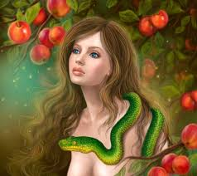

Slide 41
THE ATTRACTION OF MAGIC RELIGION
My wife reports many Facebook posts by otherwise orthodox Christian friends who regularly, approvingly quote Joyce Meyer and Joel Osteen.
But their whisperings are spiritual poison. They would woo you away from the Savior!
They would have you reverse roles: God as your servant-coach, helping you to reach your dreams: “Man’s chief end is to glorify himself, and permit God to enjoy him forever.”
But now, more recently, (2015) Joel Osteen has taken his blasphemy to a whole new level.
And we will find out how at this after our break.

Slide 42
2025 SUMMER SEMINARS HOSPERS PCA
“THE THREE FALSE RELIGIONS”
June 17 “A Tale of Two Explanations”
July 15 “Am I Good Enough?”
July 29 “More than a Feeling”
August 12 “Abracadabra”
(Audio and PowerPoint slides from all summer seminars can be found at hosperspca.org)

Slide 43
(Relevant resources.)

Slide 44
“THE POWER OF I AM”
Joel Osteen’s first popular books merely pandered to self-interest: Your Best Life Now, Become A Better You, and It’s Your Time.

Slide 45
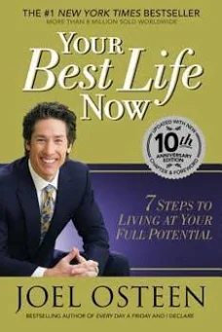
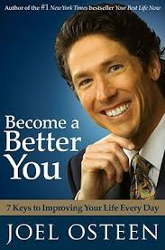
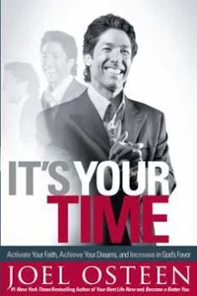

Slide 46
“THE POWER OF I AM”
After hearing these titles, do you have any doubt concerning the object of worship? It is “you.”
Yes, God is occasionally mentioned, but only as a divine cheerleader praising the wonders of you or as a life coach leading you to the promised land of a better self. But it is you, your self, that is truly worthy of praise.

Slide 47
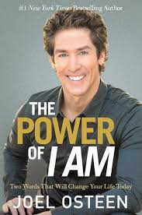
“THE POWER OF I AM”
His more recent book is titled, The Power of I Am (2015).

Slide 48
“THE POWER OF I AM”
Now you may know that “I Am” is the English translation of the covenant name of God, “Yahweh” or “Jehovah.”
In Exodus 3, God called Moses to the awesome task of being the deliverer of his people from slavery and death in Egypt and to lead them to the Promised Land. And Moses was hesitant. One of the questions he asked was this: “If I come to the people of Israel and say to them, ‘The God of your fathers has sent me to you,’ and they ask me, ‘What is his name?’ what shall I say to them?”

Slide 49
“THE POWER OF I AM”
And here is God’s reply: “¹⁴ God said to Moses, “I AM WHO I AM.” And he said, “Say this to the people of Israel, ‘I AM has sent me to you.’”
The Hebrew translated “I AM” is “Yahweh,” the covenant name for God.
“¹⁵ God also said to Moses, “Say this to the people of Israel, ‘The LORD, the God of your fathers, the God of Abraham, the God of Isaac, and the God of Jacob, has sent me to you.’ This is my name forever, and thus I am to be remembered throughout all generations.”

Slide 50
“THE POWER OF I AM”
What does the name of God, “I AM,” mean?
Bible scholars are somewhat divided, but most agree that “I AM” refers to God’s absolutely unique “self-existence,” his “a seity.” God alone exists eternally and independently of himself.
All others merely borrow existence (and life, if they are alive) from God. It is the very highest claim of exclusivity. All other beings only derive their being from the LORD, from the “I AM.” All other “gods” are mere creatures who exist, if they exist, because the self-existent One has called them into being and can unmake them at any time.
The Bible tells us that even Satan must appear before the LORD and ask permission to do his evil works. As Martin Luther observed, “The devil is God’s devil.”

Slide 51
“THE POWER OF I AM”
Why do you exist? You did not create yourself, and yet there was a time when you did not exist. You were created by God.
In fact, you have no being, no existence apart from the “I AM.” So in all of your thoughts and deliberations, you must always consider your existence and purpose in light of and in reference to your self-existent Creator. God alone is independent, all else is absolutely dependent on him.
Why are you alive? You have no life in yourself. All of your life, every second of it, is borrowed, a gift.
Every aspect of your life, thoughts, feelings, motives, and actions, all must be considered in relation to God.

Slide 52
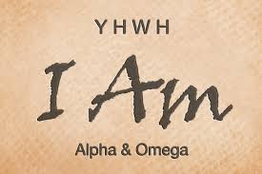
“THE POWER OF I AM”
This makes our first parents’ bid for independence so absurd and irrational. Some have compared it to a Marionette puppet that somehow managed to cut its own strings and then, forever, laid in a useless, impotent heap.
The LORD, Yahweh, I AM is his name. He alone is the self-existent one, as he has revealed himself, and we must know him as he is.

Slide 53
“THE POWER OF I AM”
This covenant name for God, Yahweh, “I AM,” was held in the highest reverence by the Jews. In the first commandment, “You shall have no other gods before me,” the “me” was Yahweh.
Most English versions translate this name of God as “LORD,” with all capital letters.
So in the Old Testament, when you see LORD you know that the term that lies behind it is the sacred, covenant name of God, Yahweh, I AM.

Slide 54
“THE POWER OF I AM”
And God gave another commandment, the third commandment that deals specifically with the absolute respect and reverence we must have for this name of the LORD, Yahweh. “You shall not take the name of the LORD your God in vain, for the LORD will not hold him guiltless who takes his name in vain.”
“LORD” there is in all caps, so it is the covenant name of God, Yahweh or I AM.
The Jews greatly feared the name of God. When Jewish scribes making copies of the Scriptures came to the sacred name of Yahweh in the text, they would rise, rinse their hands from any impurity, and only then write the Name.
Jews were also reluctant to allow any scrap of paper to fall to the ground lest it contain the sacred Name and so would defile the Name.

Slide 55
“THE POWER OF I AM”
And this is what makes Osteen’s use of the title “I Am” in his book so disturbing.
I was hoping that here in this book at last he would come around to talking about God instead of how wonderful you are.
But by “the power of I am,” Osteen is referring to the power you have by declaring who you are. It’s just another expression of “positive confession.”
In Osteen’s view, YOU YOURSELF ARE THE “I AM!”
I cannot recall seeing anything more blasphemous in my lifetime! Atheists declare that the I AM is not anything, nonexistent, and that is bad enough.
But when Osteen declares that the I AM is you, this is incomparably worse. To take up the sacred name of Yahweh, I AM, and declare that you are the self-existent one is the most offensive wickedness I can imagine, a most Satanic message.

Slide 56
“THE POWER OF I AM”
Let me give you just a taste of his sacrilege:
“What kind of ‘I am’s are coming out of your mouth? ‘I am victorious. I am blessed. I am talented. I am anointed.’ When you have the right ‘I am’s,’ you’re inviting the goodness of God. Maybe if you would just change the ‘I am,’ you would rise to a new level. Words have creative power. They can be very helpful, like electricity. Used the right way, electricity powers lights, air-conditioning, and all kinds of good things.

Slide 57
“THE POWER OF I AM”
“But electricity used the wrong way can be very dangerous. It can harm you, even kill you. It’s the same way with our words. Proverbs 18:21 says, ‘Life and death are in the power of the tongue.’ It’s up to you to choose what follows the ‘I am.’ My encouragement is to never say negative things about yourself.”

Slide 58
“THE POWER OF I AM”
And here’s a little more Scripture-twisting from down the page:
“The Scripture says, ‘Let the weak say, “I am strong.”’—not the opposite, ‘I am so tired. I am so run-down.’ That’s calling in the wrong things.
“Let the poor say, ‘I am well off’—not ‘I am broke. I am so in debt.’
“Let the sick say, ‘I am healthy. I am improving. I am getting better and better.’” (p. 7-8)

Slide 59


Slide 60
“THE POWER OF I AM”
There it is: the unvarnished temptation of the health and wealth, mind over matter, name it and claim it, prosperity gospel message. “You need to take charge. Just as the God did in the beginning, so you can use your positive confession to tap into the power of the Word and create good things for your own life. May the force be with you!”
This is magic religion masquerading as Christianity.

Slide 61
ASSUMPTIONS OF FALSE RELIGION
This isn’t just silly. And it isn’t just distracting. This is blasphemy, damnable heresy, a satanic message from the depths of hell. “You shall be like God.” God declares, “I AM.” And the prosperity teacher says, that we also should say, “I am!” Just keep telling yourself over and over, “I am, I am, I am.”
This is all heresy, blasphemy, and nonsense. So what explains the attraction? What’s the hook? Why do 40,000 attend his motivational speeches each weekend? Why do millions eagerly gobble up his books and tune into his teachings?
In the end, it must be the lust for power. It is the false promise that the secrets he and the other prosperity teachers reveal will enable you to take authority over your unwanted circumstances.

Slide 62
ASSUMPTIONS OF FALSE RELIGION
Here are some of the unbiblical lies that undergird this false teaching.
1. “God” is impersonal, a force, or at best, a life-coach/personal assistant.
2. The problem is not moral, you are a good person. The problem is metaphysical. You just haven’t learned the secrets or mastered the techniques or worked up enough faith.
3. Heaven is not future, but now: you just need to claim it by faith.
4. “God” is most interested in your happiness.
5. Suffering is always negative and unhelpful, something Jesus endured for us so that we would not have to undergo any suffering or adversity whatsoever.

Slide 63


Slide 64
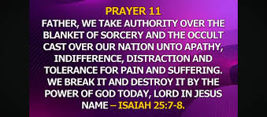

Slide 65
ASSUMPTIONS OF FALSE RELIGION
This is worldliness on display.
These prosperity teachers are promising to provide the very same things that rebellious sinners demand.
Against all biblical evidence, they seem to assume that his is what God wants for us as well.

Slide 66
FOUNDATIONS OF THE BIBLICAL FAITH
The biblical faith obviously says otherwise.
1. God is personal. It is deeply offensive to treat God as a mere force to be utilized or as our servant to do our bidding. It is the fundamental confusion of “means” and “end.” It is to use God as a mere means to achieve the end that we really want, which is clearly something other than God himself.
2. The problem is moral, not metaphysical. Jesus did not come to teach us the secrets of success. Jesus came as the Lamb of God to bear the awful penalty for our sins. True healing, restoration of the image of God in us comes through faith in Christ and continual repentance from sin.

Slide 67
FOUNDATIONS OF THE BIBLICAL FAITH
3. Heaven is mostly future. We have been given the divine down payment of the indwelling Holy Spirit, and we now taste a fraction of the joys to come, but the fullness awaits us.
If heaven is now and if this life in this fallen world could be considered “your best life now” (Osteen, 2004) then heaven above will be supremely disappointing.
The Word of Faith movement suffers from an “overly-realized eschatology.” They imagine that we can “name and claim” heaven on earth if we can only muster up sufficient faith and know the secret words.

Slide 68
FOUNDATIONS OF THE BIBLICAL FAITH
4. God is most interested in our holiness. Christ’s death on the cross, his resurrection from the dead, and his gift of the Holy Spirit are expressly for our salvation, which includes both our justification and our sanctification.
By focusing on happiness and ignoring or redefining holiness, the Word of Faith proponents make a critical error. Ultimately and even proximately there can be no lasting happiness without holiness.

Slide 69
FOUNDATIONS OF THE BIBLICAL FAITH
5. God wisely uses suffering for our sanctification.
And here we find the real drawing power of as well as the fatal flaw of the Word of Faith, prosperity teaching.
Like many professing Christians today, the health and wealth charlatans have no place for suffering in the Christian life.
If you are suffering in any way, if you have failed to make millions, to live in mansions, or to enjoy robust, vibrant health all the time, then something must have gone wrong. This is not how it should be. This cannot be “your best life now” (which God, of course, promises to all.)

Slide 70
GOD’S PURPOSE IN SUFFERING
But think of the many positive purposes the Lord has designed for suffering!
1. Suffering is his corrective discipline for sin.
2. Suffering is God’s positive discipline for godliness. Even the sinless Lord Jesus gained positive discipline through suffering according to Hebrews 2:10: “For it was fitting that he, for whom and by whom all things exist, in bringing many sons to glory, should make the founder of their salvation (Jesus) perfect through suffering.”
3. Suffering often weans us away from worldly false comforts and drives us to seek refuge and rest in Christ (which leads to joy!).

Slide 71
GOD’S PURPOSE IN SUFFERING
Let’s consider some classic New Testament texts on the benefits of suffering.
James 1:2-4: “Resist at all costs any form of suffering. Deny it. Claim authority over it by your word of faith and be free from it.”
(No, that’s the Word of Faith view. Here’s what God says:)
“² Count it all joy, my brothers, when you meet trials of various kinds, ³ for you know that the testing of your faith produces steadfastness. ⁴ And let steadfastness have its full effect, that you may be perfect and complete, lacking in nothing.”

Slide 72
GOD’S PURPOSE IN SUFFERING
Many years ago I preached on this text in a neighboring church. Afterward, an older couple came up to me confused.
They said they had not really experienced many trials in life. So how could they have become “perfect and complete, lacking in nothing” without trials?
The answer is that there is no other way.
Faithfully enduring trials, not avoiding or denying or commanding away trials, is essential to our sanctification.

Slide 73
GOD’S PURPOSE IN SUFFERING
Here’s the Apostle Peter on the necessity of suffering to Christian growth: (1 Peter 1:3-7)
“³ Blessed be the God and Father of our Lord Jesus Christ! According to his great mercy, he has caused us to be born again to a living hope through the resurrection of Jesus Christ from the dead, ⁴ to an inheritance that is imperishable, undefiled, and unfading, kept in heaven for you, ⁵ who by God’s power are being guarded through faith for a salvation ready to be revealed in the last time. ⁶ In this you rejoice, though now for a little while, if necessary, you have been grieved by various trials, ⁷ so that the tested genuineness of your faith—more precious than gold that perishes though it is tested by fire—may be found to result in praise and glory and honor at the revelation of Jesus Christ.”

Slide 74
GOD’S PURPOSE IN SUFFERING
Enduring suffering is not only redemptive and helpful to the sufferer, it becomes the occasion for praise and glory and honor to Christ. Here is another wonderful benefit when the Christian faithfully endures suffering: it honors the Lord we love!
But notice that in the Word of Faith world there is zero focus on Christian maturity or on “praise and glory and honor” to Christ.
In their view, Jesus actually only stands on the sidelines, waiting for us to call him over to serve the imperial Lord Self for our own “praise and glory and honor.”

Slide 75
GOD’S PURPOSE IN SUFFERING
And then there is that wonderful text from 2 Corinthians 12, the “my grace is sufficient for you” passage that has no place in the Word of Faith scheme of things.
This is truly a knockout punch to all of the Word of Faith nonsense, and to all of the worldly hopes of its followers.
“I must go on boasting. Though there is nothing to be gained by it, I will go on to visions and revelations of the Lord. ² I know a man in Christ who fourteen years ago was caught up to the third heaven—whether in the body or out of the body I do not know, God knows. [He’s talking about himself, of course.] ³ And I know that this man was caught up into paradise—whether in the body or out of the body I do not know, God knows— ⁴ and he heard things that cannot be told, which man may not utter.”

Slide 76
GOD’S PURPOSE IN SUFFERING
Up to this point, the Word of Faith folks like this. Some of them have claimed that they also have been caught up to heaven and witnessed these visions.
“⁵ On behalf of this man I will boast, but on my own behalf I will not boast, except of my weaknesses— ⁶ though if I should wish to boast, I would not be a fool, for I would be speaking the truth; but I refrain from it, so that no one may think more of me than he sees in me or hears from me.”
The Word of Faith people do not like that part so much. But it is what follows that gives them the most grief:

Slide 77
GOD’S PURPOSE IN SUFFERING
“⁷ So to keep me from becoming conceited because of the surpassing greatness of the revelations, a thorn was given me in the flesh, a messenger of Satan to harass me, to keep me from becoming conceited. ⁸ Three times I pleaded with the Lord about this, that it should leave me. ⁹ But he said to me, “My grace is sufficient for you, for my power is made perfect in weakness.” Therefore I will boast all the more gladly of my weaknesses, so that the power of Christ may rest upon me. ¹⁰ For the sake of Christ, then, I am content with weaknesses, insults, hardships, persecutions, and calamities. For when I am weak, then I am strong.”
And the Word of Faith crowd says, “NO, NO, NO, NO!”

Slide 78
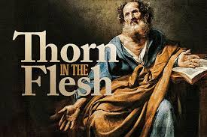

Slide 79
GOD’S PURPOSE IN SUFFERING
What was the “thorn in the flesh” that Paul was referring to? It sounds like some physical (“in the flesh”), bodily ailment. But this is the one thing that the Word of Faith people will never allow.
A friend who had been deeply influenced by the Word of Faith teachers declared to me that this was not any kind of physical sickness or infirmity but only the guilt and shame Paul felt because he had persecuted the church.
So, let me get this straight. We have the power to deny and command away sickness, but the Christian faith is powerless over guilt and shame?
That’s seems to me exactly backwards. If I had to choose between the two, I would want to be spiritually well and physically sick. And that seems much more in line with the New Testament message.

Slide 80
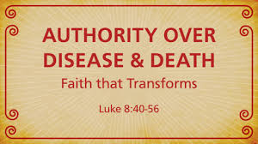
GOD’S PURPOSE IN SUFFERING
The Word of Faith teaching neither counsels nor consoles the suffering. It can only condemn the suffering as lacking faith. Suffering is always unnecessary and is always the fault of the sufferer.

Slide 81
GOD’S PURPOSE IN SUFFERING
It is, I think, this rejection of all suffering that exposes the spiritual bankruptcy of this magical, false religion. It reveals the sheer worldliness of it.
It twists the meaning of many clear texts of Scripture and flatly denies and contradicts others.
And we must beware the shallow and self-seeking promises it makes and reject its offensive denigration of the sovereign God who wisely “works all things (including sickness and poverty) together for our good.”
Please understand, there is no virtue in suffering or poverty for its own sake. But there is even less virtue in rejecting God’s fatherly wisdom when he lead us into these dark valleys or in pretending to be stronger than God is by the positive confession of our own Word of Faith.

Slide 82
AVOIDING THE PITFALLS OF FALSE RELIGION
So how do we avoid the pitfalls of the three false religions?
To answer this in part let me refer back to something I hinted at during a previous seminar: the corresponding “three streams” of the Reformed faith: doctrinalism, pietism, and culturalism or transformationalism (often attributed to historian George Marsden).
The “three streams” of the Reformed faith have departed from each another drifting off in the direction of one or another of these three false religions.

Slide 83
AVOIDING THE PITFALLS OF FALSE RELIGION
Those who valued the supremacy of the will have tended to slide into the moralism of “transformationalism,” assuming the calling of the church was primarily to “transform the culture.”
This has often been to the neglect of concern for doctrine or for the piety of warm love for Christ.

Slide 84
AVOIDING THE PITFALLS OF FALSE RELIGION
Those who placed greatest focus on the affections have tended to drift into mystical quest of pietism, seeking uncanny, numinous, pleasurable feelings of deep emotional (religious?) experiences.
This has often been to the neglect of theological faithfulness or interest in helping and serving others.

Slide 85
AVOIDING THE PITFALLS OF FALSE RELIGION
And those who esteemed the mind and devising exacting doctrinal formulations have tended to fall into the magic of doctrinalism, assuming God is most pleased with and most favorable toward those who can declare theological truth with the greatest accuracy and precision.
This has often been at the cost of joyful devotion to the Christ of their creed or of practical care for neighbor.

Slide 86
AVOIDING THE PITFALLS OF FALSE RELIGION
The way we as believers may avoid the deep ditches of the false religions of moralism, mysticism, and magic is to keep the “three streams” together.
And we do so by embracing Christ in all of his offices as Prophet, Priest, and King.
Jesus said that the greatest commandment is that we “love the Lord our God with all our heart, soul, mind, and strength.”
“Heart” refers to our entire inner being.
“Soul” points to our affections.
“Mind” is what it sounds like, the mind. And
“Strength” is a reference to the will.
So we are to love God by keeping the three powers of the heart: affections, mind, and will together, not separating them. True religion loves God with our whole being.

Slide 87
AVOIDING THE PITFALLS OF FALSE RELIGION
And God’s sanctifying work begins with the Word and the mind:
“God’s truth engages the mind, which
enflames the affections, which
empowers the will for love, obedience, and service.”

Slide 88
AVOIDING THE PITFALLS OF FALSE RELIGION
When it came to the proper use of wealth, the founder of the Methodist Church, John Wesley, summarized three principles: “Earn all you can, save all you can, give all you can.”
When it comes to the biblical faith, and avoiding the errors of the three false religions, the center of our faith is Jesus himself. So stealing a page from Wesley, when it comes to Jesus:
“Learn of Jesus all you can,
love Jesus all you can, and
serve Jesus all you can.”

Slide 89
QUESTIONS?

Slide 90
2025 SUMMER SEMINARS HOSPERS PCA
“THE THREE FALSE RELIGIONS”
June 17 “A Tale of Two Explanations”
July 15 “Am I Good Enough?”
July 29 “More than a Feeling”
August 12 “Abracadabra”
(Audio and PowerPoint slides from all summer seminars can be found at hosperspca.org)

