Slide 1
“Understanding the popular mind”
3. Is the church witnessing a
“new apostolic reformation”?

Slide 2
2023 SUMMER SEMINARS HOSPERS PCA
“Understanding the Popular Mind”
June 20 “Responding to the Social Imaginary”
June 27 “Restoring Biblical Marriage”
July 18 “Is the Church Witnessing a ‘New Apostolic Reformation’?”
Notes:
Now we can be glad that most probably do not cheat or lie or fake their conclusions. In fact, the scientific method has a safeguard built into it from the start. Reliable data can only be gleaned from experiments that can be replicated, repeated with the same results. Anyone should be able to conduct the same experiment under the same conditions and achieve the same outcome. If you perform an experiment a thousand times and get the same results a thousand times, then the data is probably correct, even well established. If you get multiple, conflicting outcomes, then the data is not confirmed and needs more work.

Slide 3
“Understanding the popular mind”
3. Is the church witnessing a
“new apostolic reformation”?

Slide 4
RESOURCES
Here are some resources I turned to in preparation for this seminar:
Counterfeit Kingdom: The Dangers of New Revelation, New Prophets and New Age Practices in the Church by Holly Pivec and R. Douglas Geivett
Interview of these authors on Carl Trueman’s The Mortification of Spin podcast, February 14, 2023
Author Holly Pivec’s website: www.hollypivec.com
Notes:
Now we can be glad that most probably do not cheat or lie or fake their conclusions. In fact, the scientific method has a safeguard built into it from the start. Reliable data can only be gleaned from experiments that can be replicated, repeated with the same results. Anyone should be able to conduct the same experiment under the same conditions and achieve the same outcome. If you perform an experiment a thousand times and get the same results a thousand times, then the data is probably correct, even well established. If you get multiple, conflicting outcomes, then the data is not confirmed and needs more work.

Slide 5
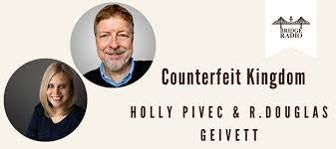
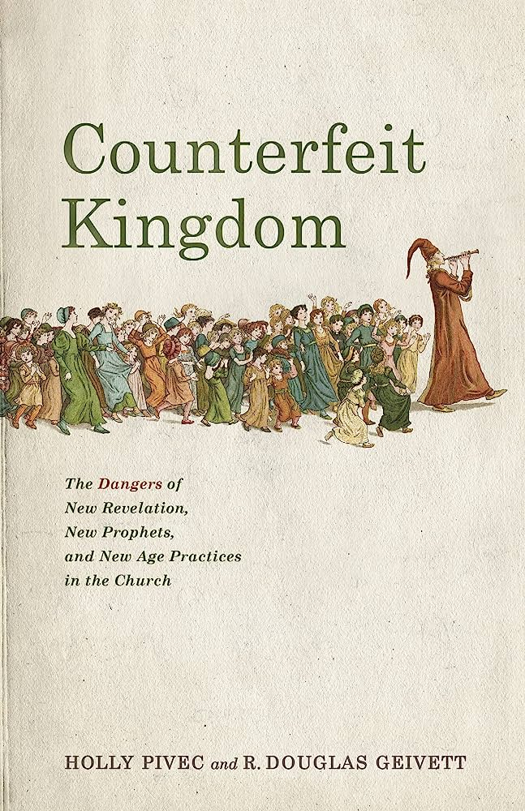

Slide 6
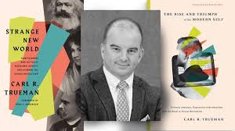
REVIEW
This is the third in a series of three summer seminars given here at the church. The subject this summer has been “Understanding the Popular Mind.”
We began with a summary of Reformed theologian Carl Trueman’s popular books, The Rise and Triumph of the Modern Self (2020) and Strange New World (2022).
Notes:
Now we can be glad that most probably do not cheat or lie or fake their conclusions. In fact, the scientific method has a safeguard built into it from the start. Reliable data can only be gleaned from experiments that can be replicated, repeated with the same results. Anyone should be able to conduct the same experiment under the same conditions and achieve the same outcome. If you perform an experiment a thousand times and get the same results a thousand times, then the data is probably correct, even well established. If you get multiple, conflicting outcomes, then the data is not confirmed and needs more work.

Slide 7
REVIEW
From there we explored the current “social imaginary” or commonly embraced worldview of “expressive individualism.”
Notes:
Now we can be glad that most probably do not cheat or lie or fake their conclusions. In fact, the scientific method has a safeguard built into it from the start. Reliable data can only be gleaned from experiments that can be replicated, repeated with the same results. Anyone should be able to conduct the same experiment under the same conditions and achieve the same outcome. If you perform an experiment a thousand times and get the same results a thousand times, then the data is probably correct, even well established. If you get multiple, conflicting outcomes, then the data is not confirmed and needs more work.

Slide 8
REVIEW
Expressive individualism is that “unique core of feeling and intuition that should unfold or be expressed if individuality is to be realized.”
It is, in the words of Carl Trueman: “the belief that each person must act based on expressing his or her core feelings and intuition.”
It reflects the “culture of authenticity” where “each one of us has his/her own way of realizing our humanity, and that it is important to find and live out one’s own [way], as against surrendering to conformity with a model imposed on us from outside, by society, or the previous generation, or religious or political authority.” (“I gotta be me.”)
Notes:
Now we can be glad that most probably do not cheat or lie or fake their conclusions. In fact, the scientific method has a safeguard built into it from the start. Reliable data can only be gleaned from experiments that can be replicated, repeated with the same results. Anyone should be able to conduct the same experiment under the same conditions and achieve the same outcome. If you perform an experiment a thousand times and get the same results a thousand times, then the data is probably correct, even well established. If you get multiple, conflicting outcomes, then the data is not confirmed and needs more work.

Slide 9
REVIEW
This innovation involves the significant shift of “granting decisive authority” to the inner feelings, rather than to outward reality.
What I see, hear, touch, taste, and smell teaches me nothing.
Reality and truth are now what I feel inside: my reality, my truth (“Live your truth”).
And what we must realize is that, to some extent, we are all products of our times, shaped by the social imaginary of our culture. We are all expressive individualists now.
If you haven’t guessed it, I argued that expressive individualism is not a good thing, not good for the family, the church, the nation, or the soul.
Notes:
Now we can be glad that most probably do not cheat or lie or fake their conclusions. In fact, the scientific method has a safeguard built into it from the start. Reliable data can only be gleaned from experiments that can be replicated, repeated with the same results. Anyone should be able to conduct the same experiment under the same conditions and achieve the same outcome. If you perform an experiment a thousand times and get the same results a thousand times, then the data is probably correct, even well established. If you get multiple, conflicting outcomes, then the data is not confirmed and needs more work.

Slide 10
REVIEW
In the second seminar, we looked into the impact of expressive individualism upon marriage and contrasted the traditional view of marriage with the new revisionist view which Trueman called “a mere sentimental bond.” And I suggested seven neglected hallmarks of biblical marriage including:
1. the priority of children
2. the concern for civilization
3. the goal of sanctification
4. the practice of sacrificial service
5. marriage as witness to the world/evangelism
6. the goodness of marriage leading to worship
7. marriage stoking anticipation of the coming, glorious “marriage supper of the Lamb”
Notes:
Now we can be glad that most probably do not cheat or lie or fake their conclusions. In fact, the scientific method has a safeguard built into it from the start. Reliable data can only be gleaned from experiments that can be replicated, repeated with the same results. Anyone should be able to conduct the same experiment under the same conditions and achieve the same outcome. If you perform an experiment a thousand times and get the same results a thousand times, then the data is probably correct, even well established. If you get multiple, conflicting outcomes, then the data is not confirmed and needs more work.

Slide 11
EXPRESSIVE INDIVIDUALISM AND RELIGION
In this third seminar I want to explore what happens when expressive individualism is applied to religion, to the Christian faith.
If marriage collapses under the temporal self-absorption of expressive individualism, as all difficult and demanding things do, we would expect the Christian faith likewise to be negatively impacted. And we would not be wrong.
Notes:
Now we can be glad that most probably do not cheat or lie or fake their conclusions. In fact, the scientific method has a safeguard built into it from the start. Reliable data can only be gleaned from experiments that can be replicated, repeated with the same results. Anyone should be able to conduct the same experiment under the same conditions and achieve the same outcome. If you perform an experiment a thousand times and get the same results a thousand times, then the data is probably correct, even well established. If you get multiple, conflicting outcomes, then the data is not confirmed and needs more work.

Slide 12
EXPRESSIVE INDIVIDUALISM AND RELIGION
First, the objective, biblical faith becomes internalized, a matter of intuition: my feelings and impressions and personal experiences. In fact, my experience becomes the reigning authority in my life, replacing the Scriptures, the Word of God as our authority.
The old adage holds true: “A man with an experience is never at the mercy of a man with an argument.”
Under expressive individualism, my experience trumps all arguments, but we forget that all of our experiences must be measured by the standard of the Word of God.
In my view, this is the most serious impact of expressive individualism on the church, the rejection of God’s Word as my sole authority.
Notes:
Now we can be glad that most probably do not cheat or lie or fake their conclusions. In fact, the scientific method has a safeguard built into it from the start. Reliable data can only be gleaned from experiments that can be replicated, repeated with the same results. Anyone should be able to conduct the same experiment under the same conditions and achieve the same outcome. If you perform an experiment a thousand times and get the same results a thousand times, then the data is probably correct, even well established. If you get multiple, conflicting outcomes, then the data is not confirmed and needs more work.

Slide 13
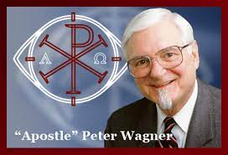
EXPRESSIVE INDIVIDUALISM AND RELIGION
Secondly, the collapse of society, even of civilization itself becomes alarming, suggesting that the church now needs some new, stronger means, some more advanced weaponry to fight for truth, or imagining that God is now supplying some new tools, or perhaps restoring some other instruments to enable the church to prevail.
And these two dynamics converge in what has been labeled by one of its leaders, C. Peter Wagner, a “New Apostolic Reformation.”
Notes:
Now we can be glad that most probably do not cheat or lie or fake their conclusions. In fact, the scientific method has a safeguard built into it from the start. Reliable data can only be gleaned from experiments that can be replicated, repeated with the same results. Anyone should be able to conduct the same experiment under the same conditions and achieve the same outcome. If you perform an experiment a thousand times and get the same results a thousand times, then the data is probably correct, even well established. If you get multiple, conflicting outcomes, then the data is not confirmed and needs more work.

Slide 14
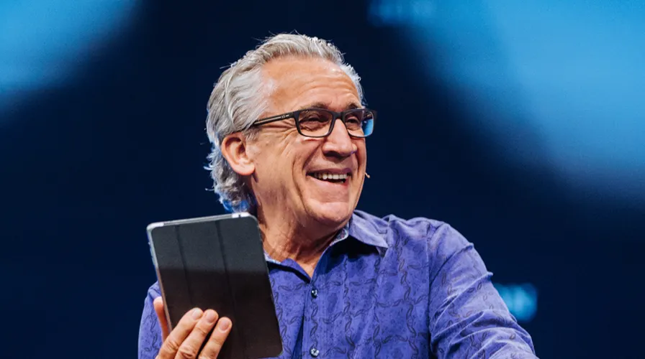
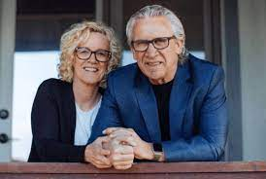
THE HISTORY OF THE NAR MOVEMENT
The recognized epicenter of the New Apostolic Reformation (hereafter NAR) today is Bethel Church in Redding California.
The pastor is Bill Johnson. It boasts of 780,000 Instagram followers and is home of Bethel Music with 1.7 million Instagram followers.
Notes:
Now we can be glad that most probably do not cheat or lie or fake their conclusions. In fact, the scientific method has a safeguard built into it from the start. Reliable data can only be gleaned from experiments that can be replicated, repeated with the same results. Anyone should be able to conduct the same experiment under the same conditions and achieve the same outcome. If you perform an experiment a thousand times and get the same results a thousand times, then the data is probably correct, even well established. If you get multiple, conflicting outcomes, then the data is not confirmed and needs more work.

Slide 15
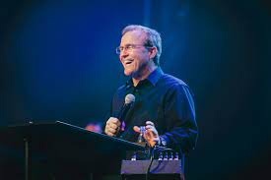
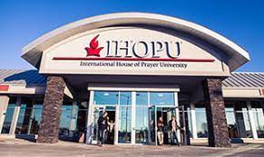
THE HISTORY OF THE NAR MOVEMENT
An affiliate NAR center closer to our area is the International House of Prayer in Kansas City (IHOPKC) led by Mike Bickle.
Notes:
Now we can be glad that most probably do not cheat or lie or fake their conclusions. In fact, the scientific method has a safeguard built into it from the start. Reliable data can only be gleaned from experiments that can be replicated, repeated with the same results. Anyone should be able to conduct the same experiment under the same conditions and achieve the same outcome. If you perform an experiment a thousand times and get the same results a thousand times, then the data is probably correct, even well established. If you get multiple, conflicting outcomes, then the data is not confirmed and needs more work.

Slide 16
THE HISTORY OF THE NAR MOVEMENT
Bickle’s 2016 OneThing conference, at his International House of Prayer (IHOP) in Kansas City, Missouri, featured Bill Johnson as the headliner speaker.
Bickle introduced Johnson this way:
“He's a dear friend. I have such affection and respect for him. ... I have read his books, watched his videos, stole his material shamelessly, been instructed by the Lord through him.”
Notes:
Now we can be glad that most probably do not cheat or lie or fake their conclusions. In fact, the scientific method has a safeguard built into it from the start. Reliable data can only be gleaned from experiments that can be replicated, repeated with the same results. Anyone should be able to conduct the same experiment under the same conditions and achieve the same outcome. If you perform an experiment a thousand times and get the same results a thousand times, then the data is probably correct, even well established. If you get multiple, conflicting outcomes, then the data is not confirmed and needs more work.

Slide 17
THE HISTORY OF THE NAR MOVEMENT
But this is not some limited, regional phenomenon. Rather, local expressions of NAR churches are popping up all over the country and in many parts of the world.
“In the United States alone, more than 3.5 million people attend NAR churches that are governed by modern-day ‘apostles’ and ‘prophets.’” (Counterfeit Kingdom, 13-14)
By way of comparison, this is more than the entire membership of the liberal Evangelical Lutheran Church in America (ELCA), and over three times larger than the liberal Presbyterian Church USA.
My own denomination, the conservative Presbyterian Church in America is the largest conservative Reformed Church in the US and has only 400,000 members, only about one tenth of those who attend NAR churches.
Notes:
Now we can be glad that most probably do not cheat or lie or fake their conclusions. In fact, the scientific method has a safeguard built into it from the start. Reliable data can only be gleaned from experiments that can be replicated, repeated with the same results. Anyone should be able to conduct the same experiment under the same conditions and achieve the same outcome. If you perform an experiment a thousand times and get the same results a thousand times, then the data is probably correct, even well established. If you get multiple, conflicting outcomes, then the data is not confirmed and needs more work.

Slide 18
THE HISTORY OF THE NAR MOVEMENT
But because of intentional misdirection and misleading denials on the part of many of these churches, there may be a NAR church near you and you may not be aware of it. You may even belong to a NAR church without knowing it.
The basic premise that is true of all NAR churches is that we are in the end times and that God has restored certain offices to the church today: the offices of apostles and prophets.
All churches now must be governed by an apostle and informed by prophets. What’s more, all believers ought to be prophesying and performing miracles.
You must believe this in order to accept the NAR agenda, so let me repeat it:
Notes:
Now we can be glad that most probably do not cheat or lie or fake their conclusions. In fact, the scientific method has a safeguard built into it from the start. Reliable data can only be gleaned from experiments that can be replicated, repeated with the same results. Anyone should be able to conduct the same experiment under the same conditions and achieve the same outcome. If you perform an experiment a thousand times and get the same results a thousand times, then the data is probably correct, even well established. If you get multiple, conflicting outcomes, then the data is not confirmed and needs more work.

Slide 19
THE HISTORY OF THE NAR MOVEMENT
“We are in the end times and God has restored certain offices to the church today: the offices of apostles and prophets. All churches now must be governed by an apostle and informed by prophets. What’s more, all believers ought to be prophesying and performing miracles.”
Notes:
Now we can be glad that most probably do not cheat or lie or fake their conclusions. In fact, the scientific method has a safeguard built into it from the start. Reliable data can only be gleaned from experiments that can be replicated, repeated with the same results. Anyone should be able to conduct the same experiment under the same conditions and achieve the same outcome. If you perform an experiment a thousand times and get the same results a thousand times, then the data is probably correct, even well established. If you get multiple, conflicting outcomes, then the data is not confirmed and needs more work.

Slide 20
THE HISTORY OF THE NAR MOVEMENT
Do you accept this as true?
If so, then you are on board with the NAR agenda.
If you do not accept this basic premise as true, then you are not on board with the NAR agenda, and you really must oppose this scheme, for it is fundamentally mistaken at its foundational level.
Notes:
Now we can be glad that most probably do not cheat or lie or fake their conclusions. In fact, the scientific method has a safeguard built into it from the start. Reliable data can only be gleaned from experiments that can be replicated, repeated with the same results. Anyone should be able to conduct the same experiment under the same conditions and achieve the same outcome. If you perform an experiment a thousand times and get the same results a thousand times, then the data is probably correct, even well established. If you get multiple, conflicting outcomes, then the data is not confirmed and needs more work.

Slide 21
THE HISTORY OF THE NAR MOVEMENT
According to the NAR teaching, whatever may have been true in the past, churches now must be governed by these apostles and prophets who will supply new, critical, information from God. (The charismatic Assemblies of God denomination does not accept the offices of apostles and prophets.)
Along with this restoration of apostles and prophets comes the widespread practice of performing miracles.
Every believer now has the ability to prophesy and to perform miracles and are only awaiting the “activation” (a key word) of these gifts through proper instruction and with practice.
Notes:
Now we can be glad that most probably do not cheat or lie or fake their conclusions. In fact, the scientific method has a safeguard built into it from the start. Reliable data can only be gleaned from experiments that can be replicated, repeated with the same results. Anyone should be able to conduct the same experiment under the same conditions and achieve the same outcome. If you perform an experiment a thousand times and get the same results a thousand times, then the data is probably correct, even well established. If you get multiple, conflicting outcomes, then the data is not confirmed and needs more work.

Slide 22
THE HISTORY OF THE NAR MOVEMENT
One of the telltale signs of a NAR church is their insistence on their now being five offices operating in their church: apostles, prophets, evangelists, pastors, and teachers.
Here’s that clear signal of this belief on a NAR church website:
Notes:
Now we can be glad that most probably do not cheat or lie or fake their conclusions. In fact, the scientific method has a safeguard built into it from the start. Reliable data can only be gleaned from experiments that can be replicated, repeated with the same results. Anyone should be able to conduct the same experiment under the same conditions and achieve the same outcome. If you perform an experiment a thousand times and get the same results a thousand times, then the data is probably correct, even well established. If you get multiple, conflicting outcomes, then the data is not confirmed and needs more work.

Slide 24
THE HISTORY OF THE NAR MOVEMENT
In fact, this is a clear indication of a NAR church, despite all denials. No other Protestant church accepts five offices. Most endorse only two: elder and deacon.
Notice, though, the misquotation of Ephesians 4:11, which reads: “And he gave the apostles, the prophets, the evangelists, the shepherds and teachers.”
These were not given to individual churches, but to the whole church. This is a fundamental mistake.
Not every New Testament church had its own apostle or was under the authority of a single apostle, but all churches were under the authority of the apostles (plural).
Notes:
Now we can be glad that most probably do not cheat or lie or fake their conclusions. In fact, the scientific method has a safeguard built into it from the start. Reliable data can only be gleaned from experiments that can be replicated, repeated with the same results. Anyone should be able to conduct the same experiment under the same conditions and achieve the same outcome. If you perform an experiment a thousand times and get the same results a thousand times, then the data is probably correct, even well established. If you get multiple, conflicting outcomes, then the data is not confirmed and needs more work.

Slide 25
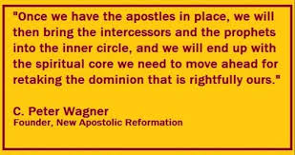
A “NEW” “APOSTOLIC” “REFORMATION”?
As we said, the term “New Apostolic Reformation” was coined by one of the intellectual leaders of the movement, C. Peter Wagner (1930-2006) of Fuller Theological Seminary.
But each of the words in this designation “NEW APOSTOLIC REFORMATION” is suspect.
Notes:
Now we can be glad that most probably do not cheat or lie or fake their conclusions. In fact, the scientific method has a safeguard built into it from the start. Reliable data can only be gleaned from experiments that can be replicated, repeated with the same results. Anyone should be able to conduct the same experiment under the same conditions and achieve the same outcome. If you perform an experiment a thousand times and get the same results a thousand times, then the data is probably correct, even well established. If you get multiple, conflicting outcomes, then the data is not confirmed and needs more work.

Slide 26
A “NEW” “APOSTOLIC” “REFORMATION”?
It is not a “new” movement, relatively speaking.
Every essential element of its teaching had already been claimed by the discredited “Latter Rain” movement that arose shortly after World War II.
Notes:
Now we can be glad that most probably do not cheat or lie or fake their conclusions. In fact, the scientific method has a safeguard built into it from the start. Reliable data can only be gleaned from experiments that can be replicated, repeated with the same results. Anyone should be able to conduct the same experiment under the same conditions and achieve the same outcome. If you perform an experiment a thousand times and get the same results a thousand times, then the data is probably correct, even well established. If you get multiple, conflicting outcomes, then the data is not confirmed and needs more work.

Slide 27
A “NEW” “APOSTOLIC” “REFORMATION”?
Its views (identical with those of the NAR churches today) were so extreme that the movement was formally condemned by the charismatic Assemblies of God denomination in 1949.
Notes:
Now we can be glad that most probably do not cheat or lie or fake their conclusions. In fact, the scientific method has a safeguard built into it from the start. Reliable data can only be gleaned from experiments that can be replicated, repeated with the same results. Anyone should be able to conduct the same experiment under the same conditions and achieve the same outcome. If you perform an experiment a thousand times and get the same results a thousand times, then the data is probably correct, even well established. If you get multiple, conflicting outcomes, then the data is not confirmed and needs more work.

Slide 29
A “NEW” “APOSTOLIC” “REFORMATION”?
The Latter Rain movement dwindled for a time, but reemerged with force in the 1980s and exploded on the scene with the rise of Bethel Church and Bill Johnson.
So the “New Apostolic Reformation” is not “new.”
Notes:
Now we can be glad that most probably do not cheat or lie or fake their conclusions. In fact, the scientific method has a safeguard built into it from the start. Reliable data can only be gleaned from experiments that can be replicated, repeated with the same results. Anyone should be able to conduct the same experiment under the same conditions and achieve the same outcome. If you perform an experiment a thousand times and get the same results a thousand times, then the data is probably correct, even well established. If you get multiple, conflicting outcomes, then the data is not confirmed and needs more work.

Slide 30
A “NEW” “APOSTOLIC” “REFORMATION”?
But is it “apostolic”? Please understand that the NAR movement is claiming the same authority as the biblical apostles. Can you name the apostles?
Peter
James
John
Paul
Thomas
Bartholomew
Bill
Mike
“Bill?” “Mike?”
Notes:
Now we can be glad that most probably do not cheat or lie or fake their conclusions. In fact, the scientific method has a safeguard built into it from the start. Reliable data can only be gleaned from experiments that can be replicated, repeated with the same results. Anyone should be able to conduct the same experiment under the same conditions and achieve the same outcome. If you perform an experiment a thousand times and get the same results a thousand times, then the data is probably correct, even well established. If you get multiple, conflicting outcomes, then the data is not confirmed and needs more work.

Slide 32
A “NEW” “APOSTOLIC” “REFORMATION”?
Yes, “Bill” Johnson of Bethel Church, Redding, California and “Mike” Bickle of the International House of Prayer in Kansas City (IHOPKC), along with many other self-proclaimed “apostles” today.
Did you not know that they too are apostles just like the twelve appointed by Jesus?
The NAR movement claims that God has fully restored the biblical office of apostle and that men living today are apostles as much as were Peter and Paul.
I will argue shortly that this is unbiblical nonsense, practically and spiritually hazardous to the church and to individual believers.
The “New Apostolic Reformation” is neither “new” nor is it “apostolic.”
Notes:
Now we can be glad that most probably do not cheat or lie or fake their conclusions. In fact, the scientific method has a safeguard built into it from the start. Reliable data can only be gleaned from experiments that can be replicated, repeated with the same results. Anyone should be able to conduct the same experiment under the same conditions and achieve the same outcome. If you perform an experiment a thousand times and get the same results a thousand times, then the data is probably correct, even well established. If you get multiple, conflicting outcomes, then the data is not confirmed and needs more work.

Slide 33
A “NEW” “APOSTOLIC” “REFORMATION”?
But is it a “reformation”?
This is highly offensive to anyone who is a spiritual descendant of the real “reformation,” the sixteenth century Protestant Reformation.
Notes:
Now we can be glad that most probably do not cheat or lie or fake their conclusions. In fact, the scientific method has a safeguard built into it from the start. Reliable data can only be gleaned from experiments that can be replicated, repeated with the same results. Anyone should be able to conduct the same experiment under the same conditions and achieve the same outcome. If you perform an experiment a thousand times and get the same results a thousand times, then the data is probably correct, even well established. If you get multiple, conflicting outcomes, then the data is not confirmed and needs more work.

Slide 34
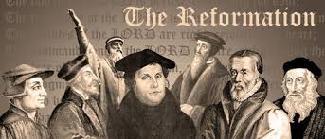

Slide 35
A “NEW” “APOSTOLIC” “REFORMATION”?
And we can be quite sure that the leaders of that Reformation, Martin Luther and John Calvin, would have thoroughly refuted the claims of the NAR churches.
Why? Because they had already refuted the claims of the “NAR” churches of their day, associated with the similar claims of Thomas Muntzer, one of the leaders of the disastrous Peasants’ War (1524-1525).
Notes:
Now we can be glad that most probably do not cheat or lie or fake their conclusions. In fact, the scientific method has a safeguard built into it from the start. Reliable data can only be gleaned from experiments that can be replicated, repeated with the same results. Anyone should be able to conduct the same experiment under the same conditions and achieve the same outcome. If you perform an experiment a thousand times and get the same results a thousand times, then the data is probably correct, even well established. If you get multiple, conflicting outcomes, then the data is not confirmed and needs more work.

Slide 36
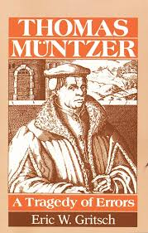
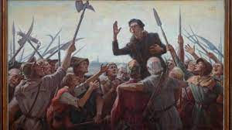

Slide 37
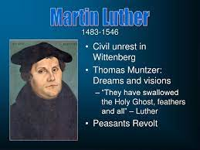
A “NEW” “APOSTOLIC” “REFORMATION”?
Muntzer asserted a personal endowment of the Holy Spirit which made him a prophet bringing new messages from God (sound familiar?).
As a result, he discounted the need for the Bible—God spoke through him directly. Luther condemned him and his views.
Notes:
Now we can be glad that most probably do not cheat or lie or fake their conclusions. In fact, the scientific method has a safeguard built into it from the start. Reliable data can only be gleaned from experiments that can be replicated, repeated with the same results. Anyone should be able to conduct the same experiment under the same conditions and achieve the same outcome. If you perform an experiment a thousand times and get the same results a thousand times, then the data is probably correct, even well established. If you get multiple, conflicting outcomes, then the data is not confirmed and needs more work.

Slide 38
A “NEW” “APOSTOLIC” “REFORMATION”?
Do you know how many “new revelations” Luther and Calvin claimed to bring to the church in the real “Reformation”?
The answer is zero.
They positively denied that any new revelation from God was forthcoming.
Rather, they went back to the Bible, to Scripture. They declared that it was actually the Roman church that had claimed new revelations, bringing new, unbiblical innovations to the church, and they sought to “reform” the woefully “de-formed” church according to the standard of the Word of God—the Bible.
Their watchword was “sola scriptura,” “Scripture alone.”
Notes:
Now we can be glad that most probably do not cheat or lie or fake their conclusions. In fact, the scientific method has a safeguard built into it from the start. Reliable data can only be gleaned from experiments that can be replicated, repeated with the same results. Anyone should be able to conduct the same experiment under the same conditions and achieve the same outcome. If you perform an experiment a thousand times and get the same results a thousand times, then the data is probably correct, even well established. If you get multiple, conflicting outcomes, then the data is not confirmed and needs more work.

Slide 40
A “NEW” “APOSTOLIC” “REFORMATION”?
We can say with all confidence that Luther and Calvin and all the major reformers would have rejected the nonsensical, spurious claims of the NAR leaders without hesitation.
They would have declared that by claiming to be apostles, the NAR leaders were instead establishing many “popes.”
For that is exactly what they said about Muntzer and his cabal.
Notes:
Now we can be glad that most probably do not cheat or lie or fake their conclusions. In fact, the scientific method has a safeguard built into it from the start. Reliable data can only be gleaned from experiments that can be replicated, repeated with the same results. Anyone should be able to conduct the same experiment under the same conditions and achieve the same outcome. If you perform an experiment a thousand times and get the same results a thousand times, then the data is probably correct, even well established. If you get multiple, conflicting outcomes, then the data is not confirmed and needs more work.

Slide 41
RIDICULOUS CLAIMS / STRANGE PRACTICES
We could spend the entire time citing the ridiculous claims and practices of the NAR movement, especially Bethel Church of Redding, California led by Bill Johnson.
In 2019 they “declared” the resurrection of Olive Heiligenthal, the two-year old daughter of one of Bethel’s worship leaders who tragically died in her sleep.
Notes:
Now we can be glad that most probably do not cheat or lie or fake their conclusions. In fact, the scientific method has a safeguard built into it from the start. Reliable data can only be gleaned from experiments that can be replicated, repeated with the same results. Anyone should be able to conduct the same experiment under the same conditions and achieve the same outcome. If you perform an experiment a thousand times and get the same results a thousand times, then the data is probably correct, even well established. If you get multiple, conflicting outcomes, then the data is not confirmed and needs more work.

Slide 42
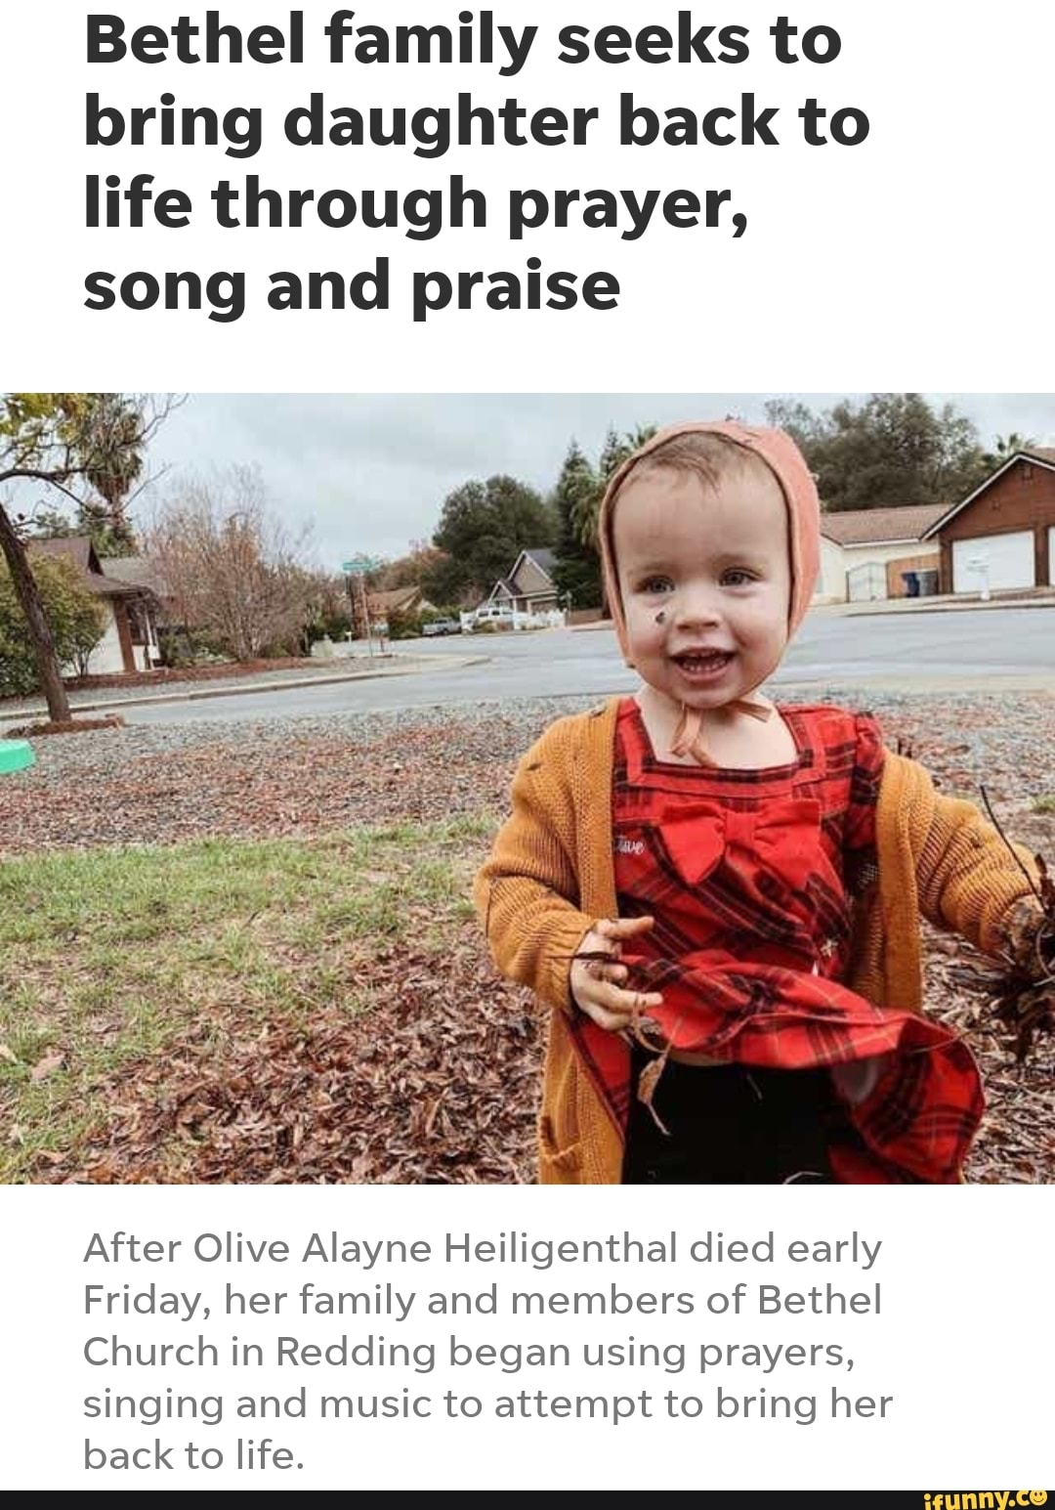

Slide 43
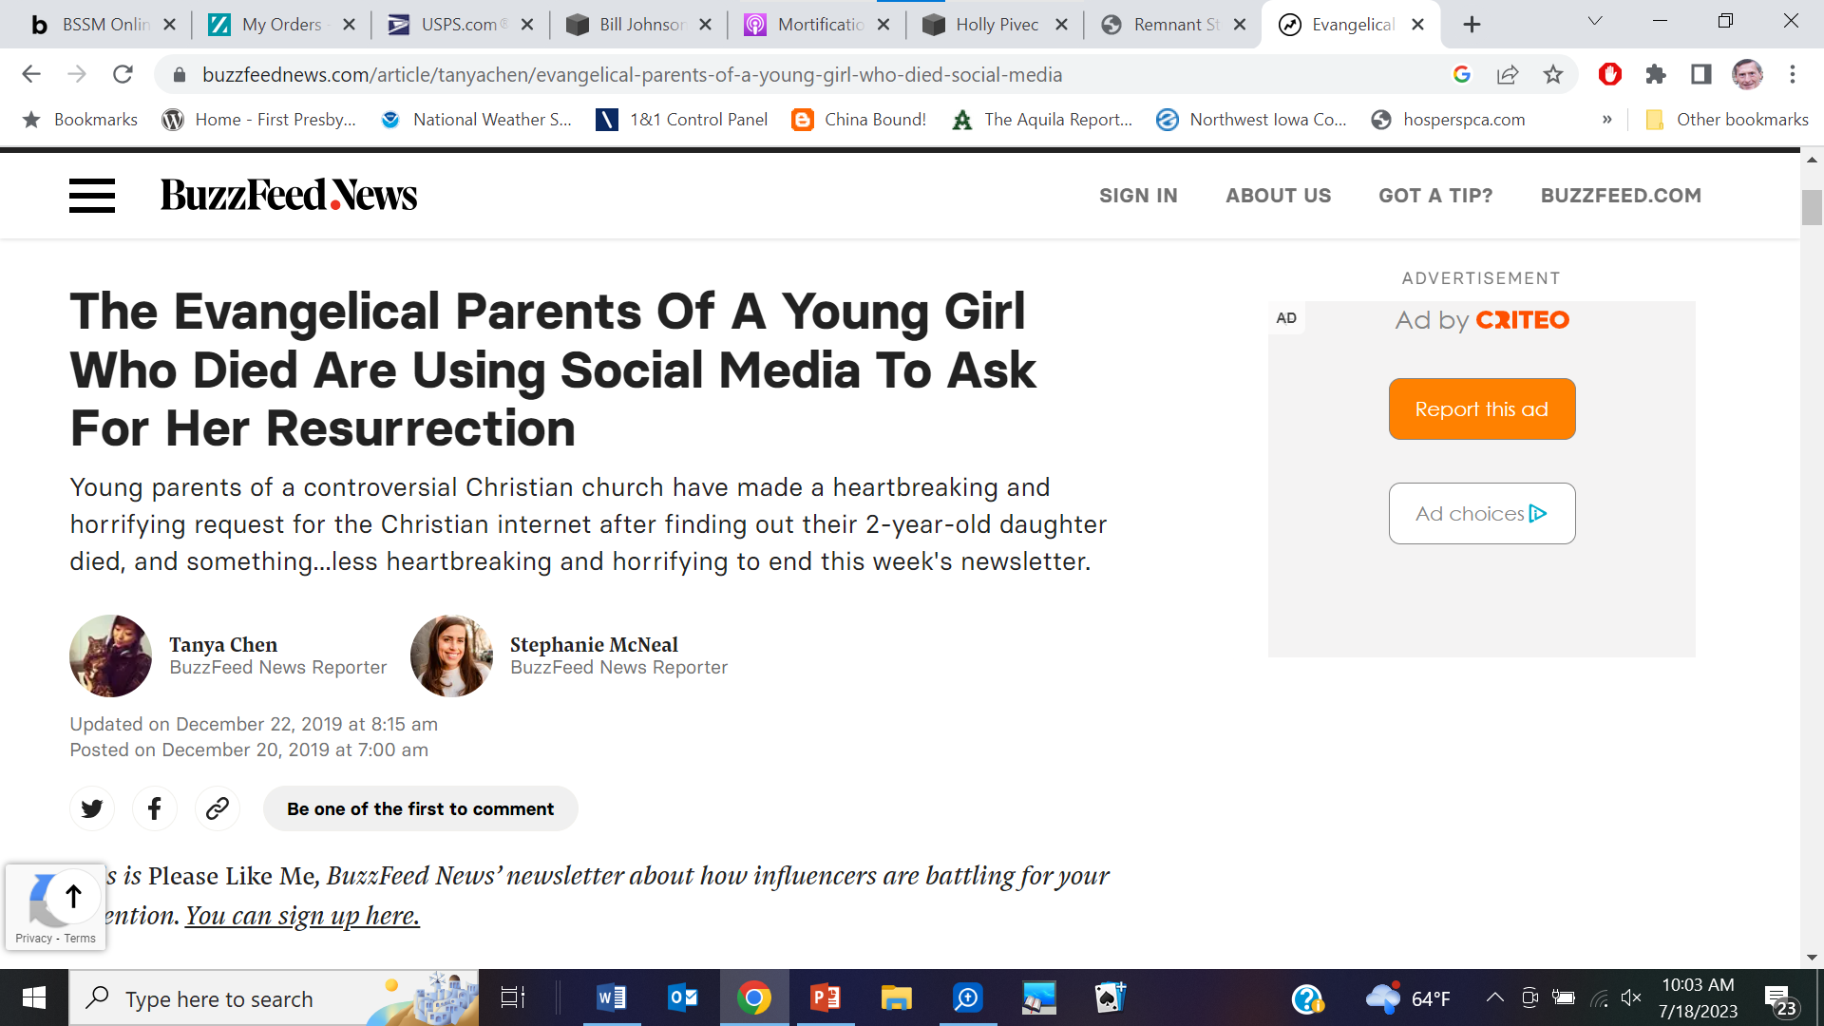
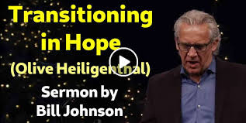
RIDICULOUS CLAIMS / STRANGE PRACTICES
They announced to the world that she would rise from the dead.
The secular media picked up on this and publicized it widely.
And then, after six days of no resurrection, they quietly planned a memorial service.
The world mocked them, and some tarred all Christians with the same skeptical brush.
Notes:
Now we can be glad that most probably do not cheat or lie or fake their conclusions. In fact, the scientific method has a safeguard built into it from the start. Reliable data can only be gleaned from experiments that can be replicated, repeated with the same results. Anyone should be able to conduct the same experiment under the same conditions and achieve the same outcome. If you perform an experiment a thousand times and get the same results a thousand times, then the data is probably correct, even well established. If you get multiple, conflicting outcomes, then the data is not confirmed and needs more work.

Slide 44
RIDICULOUS CLAIMS / STRANGE PRACTICES
And then there is the practice of “grave sucking” or “grave soaking.”
Students of Bethel’s School of Supernatural Ministry (BSSM) would visit the graves of Pentecostal leaders and faith healers like Smith Wigglesworth and Kathryn Kuhlman and attempt to suck up their spiritual powers.
The practice was based on a story from 2 Kings 13:21, where a dead body touched Elisha’s bones and came to life again.
When controversy regarding this practice arose, Bethel leaders denied that this was being taught in their BSSM.
But pictures and videos told a different story, as did many former BSSM students.
Even Beni Johnson, the wife of Pastor Bill Johnson, can be seen in different pictures lying on graves or hugging gravestones.
When she was questioned about it, her reply was: “Remember Elisha and his bones.”
Notes:
Now we can be glad that most probably do not cheat or lie or fake their conclusions. In fact, the scientific method has a safeguard built into it from the start. Reliable data can only be gleaned from experiments that can be replicated, repeated with the same results. Anyone should be able to conduct the same experiment under the same conditions and achieve the same outcome. If you perform an experiment a thousand times and get the same results a thousand times, then the data is probably correct, even well established. If you get multiple, conflicting outcomes, then the data is not confirmed and needs more work.

Slide 45
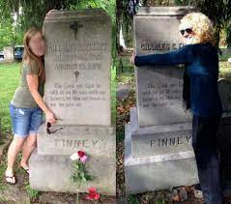
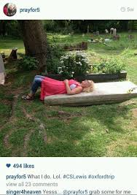

Slide 46
RIDICULOUS CLAIMS / STRANGE PRACTICES
Beni Johnson also frequently related the story of a student of the BSSM who, she claimed, was directed to go to Moriah Chapel in Wales and shout “Wakey, wakey!”
According to her story, nothing happened immediately, but when the student turned to leave, she felt the ground shake and heard a prodigious yawn.
“She looked back at the chapel, and a huge angel stepped out. All she could see was his feet because he was so large. She asked him who he was, and he turned to her and said, ‘I am the angel from the 1904 revival and you just woke me up.’ She asked him, ‘Why have you been sleeping?’ The angel answered and said, ‘Because no one has been calling out for revival anymore.’” (Counterfeit, 8)
Notes:
Now we can be glad that most probably do not cheat or lie or fake their conclusions. In fact, the scientific method has a safeguard built into it from the start. Reliable data can only be gleaned from experiments that can be replicated, repeated with the same results. Anyone should be able to conduct the same experiment under the same conditions and achieve the same outcome. If you perform an experiment a thousand times and get the same results a thousand times, then the data is probably correct, even well established. If you get multiple, conflicting outcomes, then the data is not confirmed and needs more work.

Slide 47
RIDICULOUS CLAIMS / STRANGE PRACTICES
Or we could talk about the supposed golden “glory cloud” that descended upon the Bethel congregation in 2011.
One eyewitness gave this description: “Up from the floor it rises up out of nowhere, out of thin air. Standing underneath the source you could feel it going through your body, touching your skin, or getting into your eyes. It would also stick onto anything. Those who had sickness and disease were told to go under the cloud, and some were healed within minutes.” (Kingdom, 12).
Others claimed it was merely gold colored glitter, purposely placed in the church’s air conditioning system. Other claimed phenomena included the descent of angel “feathers” or sudden gusts of wind. “Bill Johnson has defended the Glory Cloud—and the feathers and wind—against the critics, calling them ‘signs that make you wonder.’” (Kingdom, 12-13)
This is just the tip of the iceberg of controversial claims surrounding Bethel Church.
Notes:
Now we can be glad that most probably do not cheat or lie or fake their conclusions. In fact, the scientific method has a safeguard built into it from the start. Reliable data can only be gleaned from experiments that can be replicated, repeated with the same results. Anyone should be able to conduct the same experiment under the same conditions and achieve the same outcome. If you perform an experiment a thousand times and get the same results a thousand times, then the data is probably correct, even well established. If you get multiple, conflicting outcomes, then the data is not confirmed and needs more work.

Slide 48
A RESTORATION MOVEMENT?
But in our time together, I want to focus on the central claim of the NAR movement.
Supposedly, we are in the end times now, and God has restored the offices of apostles and prophets to the church, along with many miracles, miracles that all believers are to perform and will perform if they will submit to proper “activation.”
Every church including its pastors and elders must be under the authority of an apostle and must submit to new revelations through these prophets.
Those churches that refuse will only stand on the sidelines and will not share in the great blessings that are coming.
And those who criticize this movement, as I am doing right now, are from the enemy.
Notes:
Now we can be glad that most probably do not cheat or lie or fake their conclusions. In fact, the scientific method has a safeguard built into it from the start. Reliable data can only be gleaned from experiments that can be replicated, repeated with the same results. Anyone should be able to conduct the same experiment under the same conditions and achieve the same outcome. If you perform an experiment a thousand times and get the same results a thousand times, then the data is probably correct, even well established. If you get multiple, conflicting outcomes, then the data is not confirmed and needs more work.

Slide 49
A RESTORATION MOVEMENT?
My question is this: “Who says that this restoration has taken place?”
The answer is, “the new apostles and prophets say so.”
And this is a logical fallacy of the first order: circular logic.
It is like saying, “I am in charge because I am in charge.”
The claim is this: “new apostles and prophets have arisen in the church because these new apostles and prophets have arisen in the church.” The only evidence is that they have said so.
And why should we believe them? Because they are new apostles and prophets, so we have to believe them!
Notes:
Now we can be glad that most probably do not cheat or lie or fake their conclusions. In fact, the scientific method has a safeguard built into it from the start. Reliable data can only be gleaned from experiments that can be replicated, repeated with the same results. Anyone should be able to conduct the same experiment under the same conditions and achieve the same outcome. If you perform an experiment a thousand times and get the same results a thousand times, then the data is probably correct, even well established. If you get multiple, conflicting outcomes, then the data is not confirmed and needs more work.

Slide 50
A RESTORATION MOVEMENT?
Now I know that the Bible speaks for God because it is the Word of God. But I’m not so convinced that these new, self-proclaimed apostles and prophets speak for God, just because they say they do.
What we would expect is that the Bible, the true Word of God, would have given us some kind of heads up regarding a “new apostolic reformation” just before the return of Christ.
But I’ve read the Bible cover to cover many times. And the Bible gives us no indication that this would happen. And that is exceedingly odd, if what the NARs claim is true.
I trust the Bible and whatever it says as the Word of God. But I have no reason to trust these new self-proclaimed apostles and prophets, just because they say so, especially since the Bible does not support or even suggest their claims.
Notes:
Now we can be glad that most probably do not cheat or lie or fake their conclusions. In fact, the scientific method has a safeguard built into it from the start. Reliable data can only be gleaned from experiments that can be replicated, repeated with the same results. Anyone should be able to conduct the same experiment under the same conditions and achieve the same outcome. If you perform an experiment a thousand times and get the same results a thousand times, then the data is probably correct, even well established. If you get multiple, conflicting outcomes, then the data is not confirmed and needs more work.

Slide 52
ARE WE LIVING IN THE END TIMES?
Again, the main assertion we must accept is that these are now the end times and that the return of Christ is just around to corner.
Are we living in the end times?
Yes, beyond all doubt, we are living in the end times!
We are in the “last days.” So says the Word of God, the Bible. According to the New Testament, these are the “last days” even in the “last hour.”
I direct you to Hebrews 1:1-2 for example: “¹ Long ago, at many times and in many ways, God spoke to our fathers by the prophets, ² but in these last days he has spoken to us by his Son, whom he appointed the heir of all things, through whom also he created the world.” So we clearly are in the “last days.”
The “last days” began with the coming of Christ. In fact, we have been in the “last days” for nearly two thousand years. And we have been doing so without any new apostles and prophets.
Notes:
Now we can be glad that most probably do not cheat or lie or fake their conclusions. In fact, the scientific method has a safeguard built into it from the start. Reliable data can only be gleaned from experiments that can be replicated, repeated with the same results. Anyone should be able to conduct the same experiment under the same conditions and achieve the same outcome. If you perform an experiment a thousand times and get the same results a thousand times, then the data is probably correct, even well established. If you get multiple, conflicting outcomes, then the data is not confirmed and needs more work.

Slide 53
ARE WE LIVING IN THE END TIMES?
Even clearer and more precise is what John tells us in 1 John 2:18-19:
“¹⁸ Children, it is the last hour, and as you have heard that antichrist is coming, so now many antichrists have come. Therefore we know that it is the last hour. ¹⁹ They went out from us, but they were not of us; for if they had been of us, they would have continued with us. But they went out, that it might become plain that they all are not of us.”
Notes:
Now we can be glad that most probably do not cheat or lie or fake their conclusions. In fact, the scientific method has a safeguard built into it from the start. Reliable data can only be gleaned from experiments that can be replicated, repeated with the same results. Anyone should be able to conduct the same experiment under the same conditions and achieve the same outcome. If you perform an experiment a thousand times and get the same results a thousand times, then the data is probably correct, even well established. If you get multiple, conflicting outcomes, then the data is not confirmed and needs more work.

Slide 54
ARE WE LIVING IN THE END TIMES?
I want you to note two things.
First, John says that they were already living in the “last hour” in his day.
And second, this was obvious because of the rise of numerous “antichrists,” those who left the true church and started their own churches, based on their false claims.
So some new churches, despite their claims, have actually been started by antichrists, false teachers.
That should give us pause. The NAR movement has started new churches based on false claims.
Notes:
Now we can be glad that most probably do not cheat or lie or fake their conclusions. In fact, the scientific method has a safeguard built into it from the start. Reliable data can only be gleaned from experiments that can be replicated, repeated with the same results. Anyone should be able to conduct the same experiment under the same conditions and achieve the same outcome. If you perform an experiment a thousand times and get the same results a thousand times, then the data is probably correct, even well established. If you get multiple, conflicting outcomes, then the data is not confirmed and needs more work.

Slide 55
ARE WE LIVING IN THE END TIMES?
The Apostle Paul (a true apostle of Jesus Christ whom we know we can trust) agrees with this timetable.
He warns Timothy twice about false teachers arising in the later times or the last days. In 1 Timothy 4:1-2 Paul warns Timothy about a present threat: “Now the Spirit expressly says that in later times some will depart from the faith by devoting themselves to deceitful spirits and teachings of demons….”
But his concern was not for the distant future, thousands of years away. His point was that the departure from the faith was already happening, for they were already living in the “later times.”
Notes:
Now we can be glad that most probably do not cheat or lie or fake their conclusions. In fact, the scientific method has a safeguard built into it from the start. Reliable data can only be gleaned from experiments that can be replicated, repeated with the same results. Anyone should be able to conduct the same experiment under the same conditions and achieve the same outcome. If you perform an experiment a thousand times and get the same results a thousand times, then the data is probably correct, even well established. If you get multiple, conflicting outcomes, then the data is not confirmed and needs more work.

Slide 56
ARE WE LIVING IN THE END TIMES?
Or from 2 Timothy 3:1-5: “But understand this, that in the last days there will come times of difficulty. ² For people will be lovers of self, lovers of money, proud, arrogant, abusive, disobedient to their parents, ungrateful, unholy, ³ heartless, unappeasable, slanderous, without self-control, brutal, not loving good, ⁴ treacherous, reckless, swollen with conceit, lovers of pleasure rather than lovers of God, ⁵ having the appearance of godliness, but denying its power.”
So when would these people arise? The point is that they were already on the scene, for Paul tells Timothy: “Avoid such people.” They had already come.
And Paul further instructs Timothy on how to respond to this present threat which we will examine later.
Notes:
Now we can be glad that most probably do not cheat or lie or fake their conclusions. In fact, the scientific method has a safeguard built into it from the start. Reliable data can only be gleaned from experiments that can be replicated, repeated with the same results. Anyone should be able to conduct the same experiment under the same conditions and achieve the same outcome. If you perform an experiment a thousand times and get the same results a thousand times, then the data is probably correct, even well established. If you get multiple, conflicting outcomes, then the data is not confirmed and needs more work.

Slide 57
ARE WE LIVING IN THE END TIMES?
Another one of the real apostles, Peter, also speaks of the last days quoting the prophet Joel as he preached to the gathered crowd in Jerusalem in Acts 2, on the day of Pentecost, shortly after Jesus had ascended into heaven:
“¹⁴ But Peter, standing with the eleven, lifted up his voice and addressed them: “Men of Judea and all who dwell in Jerusalem, let this be known to you, and give ear to my words. ¹⁵ For these people are not drunk, as you suppose, since it is only the third hour of the day. ¹⁶ But this is what was uttered through the prophet Joel:
Notes:
Now we can be glad that most probably do not cheat or lie or fake their conclusions. In fact, the scientific method has a safeguard built into it from the start. Reliable data can only be gleaned from experiments that can be replicated, repeated with the same results. Anyone should be able to conduct the same experiment under the same conditions and achieve the same outcome. If you perform an experiment a thousand times and get the same results a thousand times, then the data is probably correct, even well established. If you get multiple, conflicting outcomes, then the data is not confirmed and needs more work.

Slide 58
ARE WE LIVING IN THE END TIMES?
¹⁷ “ ‘And in the last days it shall be, God declares, that I will pour out my Spirit on all flesh, and your sons and your daughters shall prophesy, And your young men shall see visions, and your old men shall dream dreams; ¹⁸ even on my male servants and female servants in those days I will pour out my Spirit, and they shall prophesy. ¹⁹ And I will show wonders in the heavens above and signs on the earth below, blood, and fire, and vapor of smoke; ²⁰ the sun shall be turned to darkness and the moon to blood, before the day of the Lord comes, the great and magnificent day. ²¹ And it shall come to pass that everyone who calls upon the name of the Lord shall be saved.’”
Notes:
Now we can be glad that most probably do not cheat or lie or fake their conclusions. In fact, the scientific method has a safeguard built into it from the start. Reliable data can only be gleaned from experiments that can be replicated, repeated with the same results. Anyone should be able to conduct the same experiment under the same conditions and achieve the same outcome. If you perform an experiment a thousand times and get the same results a thousand times, then the data is probably correct, even well established. If you get multiple, conflicting outcomes, then the data is not confirmed and needs more work.

Slide 59
ARE WE LIVING IN THE END TIMES?
The modern Pentecostal movement, which began in the early 1900s and which focuses on the miraculous sign gifts of speaking in tongues and performing miracles, had to explain why these gifts had disappeared from the church for so long, and why they then had suddenly reappeared, according to their claim.
Their answer was some kind of “restoration” before the end times.
God was restoring these miraculous gifts to the church.
And they would often cite Peter’s reference to Joel 2, that in the “last days” God said he would “pour out [his] Spirit” and then his people would “see visions” and “dream dreams.”
Notes:
Now we can be glad that most probably do not cheat or lie or fake their conclusions. In fact, the scientific method has a safeguard built into it from the start. Reliable data can only be gleaned from experiments that can be replicated, repeated with the same results. Anyone should be able to conduct the same experiment under the same conditions and achieve the same outcome. If you perform an experiment a thousand times and get the same results a thousand times, then the data is probably correct, even well established. If you get multiple, conflicting outcomes, then the data is not confirmed and needs more work.

Slide 60
ARE WE LIVING IN THE END TIMES?
What they missed, of course, was that Peter wasn’t foretelling some future fulfillment of this prophecy. He was pointing to his own day.
The apostles themselves had been speaking in tongues. It was proof that the “last days” had already commenced: two thousand years ago.
So there already has been an explosion of prophecy and miracles and it occurred in the ministry of our Lord Jesus Christ and in the days of his apostles.
Would those days return? Does the Bible anywhere suggest the restoration of the offices of apostles and prophets and all believers prophesying and working miracles if they only undergo the proper activation?
No, sorry, no. Not at all. Nothing like this.
Notes:
Now we can be glad that most probably do not cheat or lie or fake their conclusions. In fact, the scientific method has a safeguard built into it from the start. Reliable data can only be gleaned from experiments that can be replicated, repeated with the same results. Anyone should be able to conduct the same experiment under the same conditions and achieve the same outcome. If you perform an experiment a thousand times and get the same results a thousand times, then the data is probably correct, even well established. If you get multiple, conflicting outcomes, then the data is not confirmed and needs more work.

Slide 61
ARE WE LIVING IN THE END TIMES?
So, on the one hand, we have the Bible, and then, on the other hand, we have the claims of these self-styled apostles and prophets today.
And the Bible does not support their claims.
We really have to choose between the two, for they are incompatible, contradictory.
Notes:
Now we can be glad that most probably do not cheat or lie or fake their conclusions. In fact, the scientific method has a safeguard built into it from the start. Reliable data can only be gleaned from experiments that can be replicated, repeated with the same results. Anyone should be able to conduct the same experiment under the same conditions and achieve the same outcome. If you perform an experiment a thousand times and get the same results a thousand times, then the data is probably correct, even well established. If you get multiple, conflicting outcomes, then the data is not confirmed and needs more work.

Slide 62
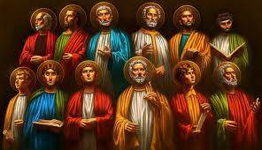
APOSTLES?
What is an apostle, anyhow? For the definition of “apostle” we do not turn to contemporary claims but to the Word of God.
And the New Testament offers two distinct definitions of “apostle,” one that is formal with a capital “A,” and one that is informal with a small “a.”
The capital “A” Apostles were those men specifically authorized by the incarnate Son of God to be his official witnesses and spokesmen, interpreting the meaning of his coming.
Notes:
Now we can be glad that most probably do not cheat or lie or fake their conclusions. In fact, the scientific method has a safeguard built into it from the start. Reliable data can only be gleaned from experiments that can be replicated, repeated with the same results. Anyone should be able to conduct the same experiment under the same conditions and achieve the same outcome. If you perform an experiment a thousand times and get the same results a thousand times, then the data is probably correct, even well established. If you get multiple, conflicting outcomes, then the data is not confirmed and needs more work.

Slide 63
APOSTLES?
Earlier we read 1 John 2:19: “They went out from us, but they were not of us; for if they had been of us, they would have continued with us. But they went out, that it might become plain that they all are not of us.”
Who is the “us”? John is speaking of himself and the other apostles commissioned by Jesus as his official spokesmen. Let me point you back to something John had written earlier in his gospel, words of Jesus in the upper room on the night he was betrayed.
Notes:
Now we can be glad that most probably do not cheat or lie or fake their conclusions. In fact, the scientific method has a safeguard built into it from the start. Reliable data can only be gleaned from experiments that can be replicated, repeated with the same results. Anyone should be able to conduct the same experiment under the same conditions and achieve the same outcome. If you perform an experiment a thousand times and get the same results a thousand times, then the data is probably correct, even well established. If you get multiple, conflicting outcomes, then the data is not confirmed and needs more work.

Slide 64
APOSTLES?
Jesus said (14:24-26): “²⁴ Whoever does not love me does not keep my words. And the word that you hear is not mine but the Father’s who sent me. ²⁵ “These things I have spoken to you while I am still with you. ²⁶ But the Helper, the Holy Spirit, whom the Father will send in my name, he will teach you all things and bring to your remembrance all that I have said to you.”
Jesus is not implying his continuing to speak or reveal new truth to all believers, but only the apostles for whom he would “bring to [their] remembrance all that [he had] spoken to [them].”
Notes:
Now we can be glad that most probably do not cheat or lie or fake their conclusions. In fact, the scientific method has a safeguard built into it from the start. Reliable data can only be gleaned from experiments that can be replicated, repeated with the same results. Anyone should be able to conduct the same experiment under the same conditions and achieve the same outcome. If you perform an experiment a thousand times and get the same results a thousand times, then the data is probably correct, even well established. If you get multiple, conflicting outcomes, then the data is not confirmed and needs more work.

Slide 65
APOSTLES?
Or in John 15:26-27: “²⁶ But when the Helper comes, whom I will send to you from the Father, the Spirit of truth, who proceeds from the Father, he will bear witness about me. ²⁷ And you also will bear witness, because you have been with me from the beginning.”
This, again, is not about us and our witness, but about the unique witness of the apostles who had been with Jesus “from the beginning.”
Notes:
Now we can be glad that most probably do not cheat or lie or fake their conclusions. In fact, the scientific method has a safeguard built into it from the start. Reliable data can only be gleaned from experiments that can be replicated, repeated with the same results. Anyone should be able to conduct the same experiment under the same conditions and achieve the same outcome. If you perform an experiment a thousand times and get the same results a thousand times, then the data is probably correct, even well established. If you get multiple, conflicting outcomes, then the data is not confirmed and needs more work.

Slide 66
APOSTLES?
And from John 16:12-14: “¹² I still have many things to say to you, but you cannot bear them now. ¹³ When the Spirit of truth comes, he will guide you into all the truth, for he will not speak on his own authority, but whatever he hears he will speak, and he will declare to you the things that are to come. ¹⁴ He will glorify me, for he will take what is mine and declare it to you.”
Again, this is not about the Spirit guiding ordinary Christians into all the truth, into new revelations and new truths in the distant future.
Jesus spoke this to his apostles.
Notes:
Now we can be glad that most probably do not cheat or lie or fake their conclusions. In fact, the scientific method has a safeguard built into it from the start. Reliable data can only be gleaned from experiments that can be replicated, repeated with the same results. Anyone should be able to conduct the same experiment under the same conditions and achieve the same outcome. If you perform an experiment a thousand times and get the same results a thousand times, then the data is probably correct, even well established. If you get multiple, conflicting outcomes, then the data is not confirmed and needs more work.

Slide 67
APOSTLES?
So Jesus authorized his apostles to be his official spokesmen, to be his approved interpreters of the true faith. And it is this that John was speaking of as “us” in 1 John 2:19: “¹⁹ They went out from us, but they were not of us; for if they had been of us, they would have continued with us. But they went out, that it might become plain that they all are not of us.”
Notice that when it came to the eleven apostles appointing a replacement for Judas, they had strict qualifications for who could serve as an “apostle.” (Acts 1:12-22)
Notes:
Now we can be glad that most probably do not cheat or lie or fake their conclusions. In fact, the scientific method has a safeguard built into it from the start. Reliable data can only be gleaned from experiments that can be replicated, repeated with the same results. Anyone should be able to conduct the same experiment under the same conditions and achieve the same outcome. If you perform an experiment a thousand times and get the same results a thousand times, then the data is probably correct, even well established. If you get multiple, conflicting outcomes, then the data is not confirmed and needs more work.

Slide 68
APOSTLES?
“¹² Then they returned to Jerusalem from the mount called Olivet, which is near Jerusalem, a Sabbath day’s journey away. ¹³ And when they had entered, they went up to the upper room, where they were staying, Peter and John and James and Andrew, Philip and Thomas, Bartholomew and Matthew, James the son of Alphaeus and Simon the Zealot and Judas the son of James. (That’s eleven, a precise number, those appointed by Jesus, the twelve minus Judas.) ¹⁴ All these with one accord were devoting themselves to prayer, together with the women and Mary the mother of Jesus, and his brothers.
Notes:
Now we can be glad that most probably do not cheat or lie or fake their conclusions. In fact, the scientific method has a safeguard built into it from the start. Reliable data can only be gleaned from experiments that can be replicated, repeated with the same results. Anyone should be able to conduct the same experiment under the same conditions and achieve the same outcome. If you perform an experiment a thousand times and get the same results a thousand times, then the data is probably correct, even well established. If you get multiple, conflicting outcomes, then the data is not confirmed and needs more work.

Slide 69
APOSTLES?
¹⁵ In those days Peter stood up among the brothers (the company of persons was in all about 120) and said, ¹⁶ "Brothers, the Scripture had to be fulfilled, which the Holy Spirit spoke beforehand by the mouth of David concerning Judas, who became a guide to those who arrested Jesus. ¹⁷ For he was numbered among us and was allotted his share in this ministry." ¹⁸ (Now this man acquired a field with the reward of his wickedness, and falling headlong he burst open in the middle and all his bowels gushed out. ¹⁹ And it became known to all the inhabitants of Jerusalem, so that the field was called in their own language Akeldama, that is, Field of Blood.) ²⁰ "For it is written in the Book of Psalms, "’May his camp become desolate, and let there be no one to dwell in it’; and "’Let another take his office.’ ²¹ So one of the men who have accompanied us during all the time that the Lord Jesus went in and out among us, ²² beginning from the baptism of John until the day when he was taken up from us— one of these men must become with us a witness to his resurrection.“ (Acts 1:15-22)
Notes:
Now we can be glad that most probably do not cheat or lie or fake their conclusions. In fact, the scientific method has a safeguard built into it from the start. Reliable data can only be gleaned from experiments that can be replicated, repeated with the same results. Anyone should be able to conduct the same experiment under the same conditions and achieve the same outcome. If you perform an experiment a thousand times and get the same results a thousand times, then the data is probably correct, even well established. If you get multiple, conflicting outcomes, then the data is not confirmed and needs more work.

Slide 70
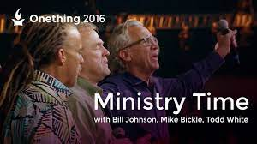
APOSTLES?
Do you see the specific requirements for the office of Apostle?
It had to be an eyewitness who accompanied them “during all the time that the Lord Jesus went in and out among us, beginning from the baptism of John until the day when he was taken up from us— one of these men must become with us a witness to his resurrection.”
And do you see why no one could lay claim to that office today?
Notes:
Now we can be glad that most probably do not cheat or lie or fake their conclusions. In fact, the scientific method has a safeguard built into it from the start. Reliable data can only be gleaned from experiments that can be replicated, repeated with the same results. Anyone should be able to conduct the same experiment under the same conditions and achieve the same outcome. If you perform an experiment a thousand times and get the same results a thousand times, then the data is probably correct, even well established. If you get multiple, conflicting outcomes, then the data is not confirmed and needs more work.

Slide 71
APOSTLES?
The one exception to this is that of the Apostle Paul. In most all of his letters he introduced himself as an apostle of Jesus Christ, except for the more personal letters of Philippians, 1 and 2 Thessalonians, and Philemon. And he explains the origin of his apostleship in 1 Corinthians 15:3-11
“³ For I delivered to you as of first importance what I also received: that Christ died for our sins in accordance with the Scriptures, ⁴ that he was buried, that he was raised on the third day in accordance with the Scriptures, ⁵ and that he appeared to Cephas, then to the twelve.”
Notes:
Now we can be glad that most probably do not cheat or lie or fake their conclusions. In fact, the scientific method has a safeguard built into it from the start. Reliable data can only be gleaned from experiments that can be replicated, repeated with the same results. Anyone should be able to conduct the same experiment under the same conditions and achieve the same outcome. If you perform an experiment a thousand times and get the same results a thousand times, then the data is probably correct, even well established. If you get multiple, conflicting outcomes, then the data is not confirmed and needs more work.

Slide 72
APOSTLES?
Notice that it was actually eleven, but that the apostleship of those few men was so established that they could simply be referred to as “the twelve.”
“⁶ Then he appeared to more than five hundred brothers at one time, most of whom are still alive, though some have fallen asleep. ⁷ Then he appeared to James, then to all the apostles. (Here is an indication of the other, generic use of the word “apostle,” with the small “a.”) ⁸ Last of all, as to one untimely born, he appeared also to me. ⁹ For I am the least of the apostles, unworthy to be called an apostle, because I persecuted the church of God. ¹⁰ But by the grace of God I am what I am, and his grace toward me was not in vain. On the contrary, I worked harder than any of them, though it was not I, but the grace of God that is with me. ¹¹ Whether then it was I or they, so we preach and so you believed.”
Notes:
Now we can be glad that most probably do not cheat or lie or fake their conclusions. In fact, the scientific method has a safeguard built into it from the start. Reliable data can only be gleaned from experiments that can be replicated, repeated with the same results. Anyone should be able to conduct the same experiment under the same conditions and achieve the same outcome. If you perform an experiment a thousand times and get the same results a thousand times, then the data is probably correct, even well established. If you get multiple, conflicting outcomes, then the data is not confirmed and needs more work.

Slide 73
APOSTLES?
Others beyond “the twelve,” and the special case of Paul are called “apostles,” but these instances were rare.
The word “apostle” simply means “one sent with a commission.” Any emissary could be called an “apostle” (small “a”).
And in 1 Thessalonians 2:5-6 we find Paul referring to himself and Silvanus and Timothy as “apostles.” “⁵ For we never came with words of flattery, as you know, nor with a pretext for greed— God is witness. ⁶ Nor did we seek glory from people, whether from you or from others, though we could have made demands as apostles of Christ.”
In what sense were Silvanus and Timothy “apostles”?
They had been sent by the church with a commission to preach Christ. They were “missionaries,” which is a good description of the secondary use of the word “apostle.”
Notes:
Now we can be glad that most probably do not cheat or lie or fake their conclusions. In fact, the scientific method has a safeguard built into it from the start. Reliable data can only be gleaned from experiments that can be replicated, repeated with the same results. Anyone should be able to conduct the same experiment under the same conditions and achieve the same outcome. If you perform an experiment a thousand times and get the same results a thousand times, then the data is probably correct, even well established. If you get multiple, conflicting outcomes, then the data is not confirmed and needs more work.

Slide 74
APOSTLES?
And Paul distinguished between the authority of apostles with a capital “A” and the generic apostles (small “a”) as mere missionaries. In 2 Timothy 2:1-2 he makes this clear distinction. “¹ You then, my child, be strengthened by the grace that is in Christ Jesus, ² and what you have heard from me in the presence of many witnesses entrust to faithful men who will be able to teach others also.”
Do you see what he’s saying?
“Timothy, take my teaching and entrust it to faithful men who will take it to the next generation.”
Notes:
Now we can be glad that most probably do not cheat or lie or fake their conclusions. In fact, the scientific method has a safeguard built into it from the start. Reliable data can only be gleaned from experiments that can be replicated, repeated with the same results. Anyone should be able to conduct the same experiment under the same conditions and achieve the same outcome. If you perform an experiment a thousand times and get the same results a thousand times, then the data is probably correct, even well established. If you get multiple, conflicting outcomes, then the data is not confirmed and needs more work.

Slide 75
APOSTLES?
What he does not say is this: “Timothy, you also are apostle in your own right, so you can add in some of your own teaching.” Nor does he say, “Those faithful men will also be apostles and prophets, so they can add some new revelations from God as well.”
Already, some apostles had died. Paul himself was anticipating his own “departure,” the end of an era. And what was vital was not some hoped-for spate of new teachings, but to hold fast to the apostolic body of truth.
Notes:
Now we can be glad that most probably do not cheat or lie or fake their conclusions. In fact, the scientific method has a safeguard built into it from the start. Reliable data can only be gleaned from experiments that can be replicated, repeated with the same results. Anyone should be able to conduct the same experiment under the same conditions and achieve the same outcome. If you perform an experiment a thousand times and get the same results a thousand times, then the data is probably correct, even well established. If you get multiple, conflicting outcomes, then the data is not confirmed and needs more work.

Slide 76
APOSTLES?
So “apostle” (capital “A”) formally means “one appointed by Christ himself” as his official witness and spokesman. And secondarily, generally-speaking, the term could also be applied (small “a”) to missionaries. Our church supports many missionaries. We could likewise call them “apostles.”
My question is which use of the word “apostle” are the NARs claiming as a restoration?
If it’s merely missionaries who spread the apostolic message from God’s Word, then no restoration would be necessary. That’s been happening all along. Nothing “new” here.
Notes:
Now we can be glad that most probably do not cheat or lie or fake their conclusions. In fact, the scientific method has a safeguard built into it from the start. Reliable data can only be gleaned from experiments that can be replicated, repeated with the same results. Anyone should be able to conduct the same experiment under the same conditions and achieve the same outcome. If you perform an experiment a thousand times and get the same results a thousand times, then the data is probably correct, even well established. If you get multiple, conflicting outcomes, then the data is not confirmed and needs more work.

Slide 77
APOSTLES?
But that’s not what the NARs are claiming for themselves.
And since none of them could be eyewitnesses of Jesus’ life and death and resurrection, none of them could be qualified to be (capital “A”) apostles.
The whole claim itself is offensive and even dangerous. Each one would then be made a little “pope,” a little “Thomas Muntzer.”
And, in fact, that’s what has happened in many instances.
Their claim to such high personal authority is really spiritual abuse waiting to happen.
Notes:
Now we can be glad that most probably do not cheat or lie or fake their conclusions. In fact, the scientific method has a safeguard built into it from the start. Reliable data can only be gleaned from experiments that can be replicated, repeated with the same results. Anyone should be able to conduct the same experiment under the same conditions and achieve the same outcome. If you perform an experiment a thousand times and get the same results a thousand times, then the data is probably correct, even well established. If you get multiple, conflicting outcomes, then the data is not confirmed and needs more work.

Slide 78
2023 SUMMER SEMINARS HOSPERS PCA
“Understanding the Popular Mind”
June 20 “Responding to the Social Imaginary”
June 27 “Restoring Biblical Marriage”
July 18 “Is the Church Witnessing a ‘New Apostolic Reformation’?”
Notes:
Now we can be glad that most probably do not cheat or lie or fake their conclusions. In fact, the scientific method has a safeguard built into it from the start. Reliable data can only be gleaned from experiments that can be replicated, repeated with the same results. Anyone should be able to conduct the same experiment under the same conditions and achieve the same outcome. If you perform an experiment a thousand times and get the same results a thousand times, then the data is probably correct, even well established. If you get multiple, conflicting outcomes, then the data is not confirmed and needs more work.

Slide 79
PROPHETS?
So has God restored prophets to the church delivering new essential revelation from God that the church needs to overcome in these end times?
Well, much like the term “apostle,” “prophet” and “prophecy” likewise has two meanings, one formal with a capital “P”, and the other informal with a small “p”.
Notes:
Now we can be glad that most probably do not cheat or lie or fake their conclusions. In fact, the scientific method has a safeguard built into it from the start. Reliable data can only be gleaned from experiments that can be replicated, repeated with the same results. Anyone should be able to conduct the same experiment under the same conditions and achieve the same outcome. If you perform an experiment a thousand times and get the same results a thousand times, then the data is probably correct, even well established. If you get multiple, conflicting outcomes, then the data is not confirmed and needs more work.

Slide 80
PROPHETS?
Unlike the exclusively New Testament phenomenon of “apostleship,” the concept of the prophet and prophecy stem from the earliest days of the Old Testament.
Abraham is the first to be called a prophet.
But the prophet par excellence was Moses, the one with whom God spoke face to face, to whom God gave the Law, written by the finger of God on tablets of stone.
Notes:
Now we can be glad that most probably do not cheat or lie or fake their conclusions. In fact, the scientific method has a safeguard built into it from the start. Reliable data can only be gleaned from experiments that can be replicated, repeated with the same results. Anyone should be able to conduct the same experiment under the same conditions and achieve the same outcome. If you perform an experiment a thousand times and get the same results a thousand times, then the data is probably correct, even well established. If you get multiple, conflicting outcomes, then the data is not confirmed and needs more work.

Slide 81
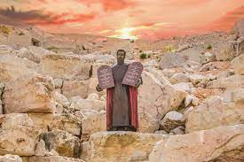

Slide 82
PROPHETS?
This office of prophet was to continue after Moses. Toward the end of his life the Prophet Moses foretold the coming of additional prophets after him who would speak the word of God.
A text from Deuteronomy 18 is very instructive and requires close examination.
Notes:
Now we can be glad that most probably do not cheat or lie or fake their conclusions. In fact, the scientific method has a safeguard built into it from the start. Reliable data can only be gleaned from experiments that can be replicated, repeated with the same results. Anyone should be able to conduct the same experiment under the same conditions and achieve the same outcome. If you perform an experiment a thousand times and get the same results a thousand times, then the data is probably correct, even well established. If you get multiple, conflicting outcomes, then the data is not confirmed and needs more work.

Slide 83
PROPHETS?
¹⁵ “The LORD your God will raise up for you a prophet like me from among you, from your brothers—it is to him you shall listen— ¹⁶ just as you desired of the LORD your God at Horeb on the day of the assembly, when you said, ‘Let me not hear again the voice of the LORD my God or see this great fire any more, lest I die.’ ¹⁷ And the LORD said to me, ‘They are right in what they have spoken. ¹⁸ I will raise up for them a prophet like you from among their brothers. And I will put my words in his mouth, and he shall speak to them all that I command him.”
Notes:
Now we can be glad that most probably do not cheat or lie or fake their conclusions. In fact, the scientific method has a safeguard built into it from the start. Reliable data can only be gleaned from experiments that can be replicated, repeated with the same results. Anyone should be able to conduct the same experiment under the same conditions and achieve the same outcome. If you perform an experiment a thousand times and get the same results a thousand times, then the data is probably correct, even well established. If you get multiple, conflicting outcomes, then the data is not confirmed and needs more work.

Slide 84
PROPHETS?
So this is the original concept and the central meaning of “prophecy.” The unveiled voice of God himself is so terrifying that the people begged not to hear it again. So God would speak to a prophet who would then relate his word to them.
And his word through his prophet was binding and must be obeyed upon pain of serious consequences:
“ ¹⁹ And whoever will not listen to my words that he shall speak in my name, I myself will require it of him.”
Notes:
Now we can be glad that most probably do not cheat or lie or fake their conclusions. In fact, the scientific method has a safeguard built into it from the start. Reliable data can only be gleaned from experiments that can be replicated, repeated with the same results. Anyone should be able to conduct the same experiment under the same conditions and achieve the same outcome. If you perform an experiment a thousand times and get the same results a thousand times, then the data is probably correct, even well established. If you get multiple, conflicting outcomes, then the data is not confirmed and needs more work.

Slide 85
PROPHETS?
But this presents a problem. What about false prophets who would claim to speak for God, but would be mistaken or lying? The severest penalty of all was reserved for those who merely pretended to speak for God.
“²⁰ But the prophet who presumes to speak a word in my name that I have not commanded him to speak, or who speaks in the name of other gods, that same prophet shall die.’”
Notes:
Now we can be glad that most probably do not cheat or lie or fake their conclusions. In fact, the scientific method has a safeguard built into it from the start. Reliable data can only be gleaned from experiments that can be replicated, repeated with the same results. Anyone should be able to conduct the same experiment under the same conditions and achieve the same outcome. If you perform an experiment a thousand times and get the same results a thousand times, then the data is probably correct, even well established. If you get multiple, conflicting outcomes, then the data is not confirmed and needs more work.

Slide 86
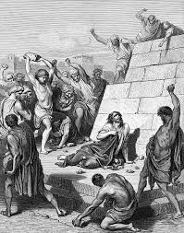

Slide 87
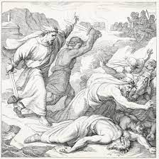
PROPHETS?
In the Old Testament, false prophets would be put to death.
When the Lord proved Elijah to be a true prophet on Mt. Carmel, he then rightly had the 400 false prophets of Baal rounded up and slaughtered on the spot, for God commanded it, no hesitation, no mercy, no reprieve, and no delay.
Notes:
Now we can be glad that most probably do not cheat or lie or fake their conclusions. In fact, the scientific method has a safeguard built into it from the start. Reliable data can only be gleaned from experiments that can be replicated, repeated with the same results. Anyone should be able to conduct the same experiment under the same conditions and achieve the same outcome. If you perform an experiment a thousand times and get the same results a thousand times, then the data is probably correct, even well established. If you get multiple, conflicting outcomes, then the data is not confirmed and needs more work.

Slide 88
PROPHETS?
But this creates a further problem. How can we know a true prophet from a false prophet?
“ ²¹ And if you say in your heart, ‘How may we know the word that the LORD has not spoken?’— ²² when a prophet speaks in the name of the LORD, if the word does not come to pass or come true, that is a word that the LORD has not spoken; the prophet has spoken it presumptuously. You need not be afraid of him.”
The Lord would provide proof of his true prophets through predictive prophecy, a miraculous sign. And notice that the rule was not “sometimes” or “getting one right occasionally,” but perfect consistency.
The rule for prophets was “one strike, you’re out,” permanently.
Notes:
Now we can be glad that most probably do not cheat or lie or fake their conclusions. In fact, the scientific method has a safeguard built into it from the start. Reliable data can only be gleaned from experiments that can be replicated, repeated with the same results. Anyone should be able to conduct the same experiment under the same conditions and achieve the same outcome. If you perform an experiment a thousand times and get the same results a thousand times, then the data is probably correct, even well established. If you get multiple, conflicting outcomes, then the data is not confirmed and needs more work.

Slide 89
PROPHETS?
But the Bible recognizes another form of “prophecy,” small “p” prophecy, those who would merely repeat what God had already said, no new revelation, but only proclaiming and applying God’s previously established Word. Some prophets engaged in “foretelling,” others only in “forthtelling.”
Ezra in the Old Testament was just such a “prophet.”
Nehemiah had Ezra read and explain the Word of God to the newly reconstituted people of God in Jerusalem. On the appointed day, Ezra stood with others on a platform in the hearing of the people. And Nehemiah 8:8 says, “They read from the book, from the Law of God, clearly, and they gave the sense, so that the people understood the reading.” They were prophesying. They were preaching God’s Law to the people.
Was there any need for miraculous signs to confirm what they were saying? No. Why not? Because they were only repeating what God had already said, what had already been confirmed by signs and miracles.
Notes:
Now we can be glad that most probably do not cheat or lie or fake their conclusions. In fact, the scientific method has a safeguard built into it from the start. Reliable data can only be gleaned from experiments that can be replicated, repeated with the same results. Anyone should be able to conduct the same experiment under the same conditions and achieve the same outcome. If you perform an experiment a thousand times and get the same results a thousand times, then the data is probably correct, even well established. If you get multiple, conflicting outcomes, then the data is not confirmed and needs more work.

Slide 90
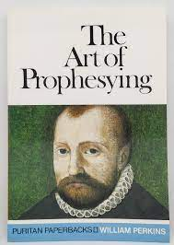
PROPHETS?
We need no new confirmation of Scripture today because it has already been attested by God through miraculous signs.
Preachers today are prophets in the general sense, prophets with a small “p.”
Faithful preachers are authorized when they stay true to the Scriptures, to the Word of God that has already been authorized.
This was the understanding of the Protestant Reformers and the early Puritans. One of the first “preaching manuals” by Puritan William Perkins was titled, “The Art of Prophesying.”
Notes:
Now we can be glad that most probably do not cheat or lie or fake their conclusions. In fact, the scientific method has a safeguard built into it from the start. Reliable data can only be gleaned from experiments that can be replicated, repeated with the same results. Anyone should be able to conduct the same experiment under the same conditions and achieve the same outcome. If you perform an experiment a thousand times and get the same results a thousand times, then the data is probably correct, even well established. If you get multiple, conflicting outcomes, then the data is not confirmed and needs more work.

Slide 91
PROPHETS?
I hope you see the inherent danger of claiming new revelation prophecies today.
How would you test these prophecies?
One could say, “Well, as long as it doesn’t contradict Scripture, we could accept it.”
But would that be sufficient?
Notes:
Now we can be glad that most probably do not cheat or lie or fake their conclusions. In fact, the scientific method has a safeguard built into it from the start. Reliable data can only be gleaned from experiments that can be replicated, repeated with the same results. Anyone should be able to conduct the same experiment under the same conditions and achieve the same outcome. If you perform an experiment a thousand times and get the same results a thousand times, then the data is probably correct, even well established. If you get multiple, conflicting outcomes, then the data is not confirmed and needs more work.

Slide 92
PROPHETS?
When I was in seminary, my friend Bob related a personal story. For a while he had been part of a Pentecostal church, open to new revelations and new “words from the Lord.” In fact, he was engaged to a girl who also belonged to that Pentecostal church.
One day a young man came up to Bob’s fiancée and said, “I have a word from the Lord for you.” When she asked what it was, he replied, “The Lord told me you were not to marry Bob.” So she obeyed “the Lord” and broke it off with Bob.
About a month later the same young man came back to her and said, “I have another word from the Lord for you.” Anybody want to guess what it was?
“The Lord told me you were to marry me.” (One might rightly suspect that it was not the Lord speaking but the man’s hormones.) She obeyed “the Lord” and married him!
But how would you defend against such clear abuse in the name of new revelations and new prophecies? Did his “words from the Lord” contradict any biblical truth? None that I can see. The fact is that once you open the door to such things there are no safeguards.
Notes:
Now we can be glad that most probably do not cheat or lie or fake their conclusions. In fact, the scientific method has a safeguard built into it from the start. Reliable data can only be gleaned from experiments that can be replicated, repeated with the same results. Anyone should be able to conduct the same experiment under the same conditions and achieve the same outcome. If you perform an experiment a thousand times and get the same results a thousand times, then the data is probably correct, even well established. If you get multiple, conflicting outcomes, then the data is not confirmed and needs more work.

Slide 93
PROPHETS?
And what of prophecies in the form of predictions?
Interestingly, many of the NAR prophets have gotten a lot of things things wrong.
They are aware of the Old Testament death penalty for false prophecy, and they simply ignore it.
In her research for her book, Counterfeit Kingdom, Holly Pivec joined a Bethel Church Sunday school class called “Firestarters.” There people were being taught how to “prophesy.” Here is an extended description of the class.
Notes:
Now we can be glad that most probably do not cheat or lie or fake their conclusions. In fact, the scientific method has a safeguard built into it from the start. Reliable data can only be gleaned from experiments that can be replicated, repeated with the same results. Anyone should be able to conduct the same experiment under the same conditions and achieve the same outcome. If you perform an experiment a thousand times and get the same results a thousand times, then the data is probably correct, even well established. If you get multiple, conflicting outcomes, then the data is not confirmed and needs more work.

Slide 94
PROPHETS?
“Four volunteers who had never publically prophesied before were called to the platform to be ‘activated.’ In churches like Bethel ‘activation exercises’ are used to trigger unused supernatural gifts that dwell deep within a Christian. Each volunteer was told to select from the people in the room anyone they did not know. They were then to prophesy to that person. All they had to do was to say whatever popped into their minds. ‘If you don’t know what to say, just start talking and you’ll get there,’ the teacher told them. During the exercise, students were assured that they need not be afraid of making mistakes when learning to prophesy. Missing it was part of the process. At one point, my table leader led a smaller group discussion. He told those seated at the table with me, ‘If you’re right, you’re right. If you’re wrong, who cares?’
Notes:
Now we can be glad that most probably do not cheat or lie or fake their conclusions. In fact, the scientific method has a safeguard built into it from the start. Reliable data can only be gleaned from experiments that can be replicated, repeated with the same results. Anyone should be able to conduct the same experiment under the same conditions and achieve the same outcome. If you perform an experiment a thousand times and get the same results a thousand times, then the data is probably correct, even well established. If you get multiple, conflicting outcomes, then the data is not confirmed and needs more work.

Slide 95
PROPHETS?
“Whoa! Wait a minute. What did he just say? That it doesn’t matter if they give a prophecy to someone and it turns out to be wrong? I wondered how that could possibly be so, given the many warnings in Scripture about false prophets and the importance of testing all prophecies to know whether they are truly from God.
“Eventually, one of the volunteers began her first-ever attempt to prophesy. She said she felt that God had given her two pieces of information that would identify the person God would have her prophesy to. He gave her the name ‘Anthony’ and the date ‘July 17.’ ‘Does that name mean anything to anybody?’ she said, looking around the room of about sixty or seventy people.
“Only awkward silence.
Notes:
Now we can be glad that most probably do not cheat or lie or fake their conclusions. In fact, the scientific method has a safeguard built into it from the start. Reliable data can only be gleaned from experiments that can be replicated, repeated with the same results. Anyone should be able to conduct the same experiment under the same conditions and achieve the same outcome. If you perform an experiment a thousand times and get the same results a thousand times, then the data is probably correct, even well established. If you get multiple, conflicting outcomes, then the data is not confirmed and needs more work.

Slide 96
PROPHETS?
“After a few moments, a young man spoke up. ‘My birthday is July 17.’
“From somewhere in the room someone called out the question we all were thinking. ‘Is your name Anthony?’
‘“No, it’s Xavier.’
“How many synonyms are there for ‘oops?’ His name wasn’t even close to Anthony.
“Undaunted by this ‘miss,’ the young woman said, ‘Let’s take July 17.’ She then gave Xavier a message that she had, so she believed, received from God.
Notes:
Now we can be glad that most probably do not cheat or lie or fake their conclusions. In fact, the scientific method has a safeguard built into it from the start. Reliable data can only be gleaned from experiments that can be replicated, repeated with the same results. Anyone should be able to conduct the same experiment under the same conditions and achieve the same outcome. If you perform an experiment a thousand times and get the same results a thousand times, then the data is probably correct, even well established. If you get multiple, conflicting outcomes, then the data is not confirmed and needs more work.

Slide 97
PROPHETS?
“I no longer recall the exact words she gave him. Here’s what I do remember: they were ‘positive’ and ‘life-affirming.’ The students had been instructed to give only such messages. No negative words, no judgmental words, no words of correction. The class notes we had been given stated: ‘True prophecy calls out the gold in people.’ In other words, don’t expose a person’s sin, or reveal any troubles that may lie ahead for them. Rather, it speaks of only uplifting and encouraging words.” (34-35)
Does that sound like biblical “prophecy” of the capital “P” variety?
Notes:
Now we can be glad that most probably do not cheat or lie or fake their conclusions. In fact, the scientific method has a safeguard built into it from the start. Reliable data can only be gleaned from experiments that can be replicated, repeated with the same results. Anyone should be able to conduct the same experiment under the same conditions and achieve the same outcome. If you perform an experiment a thousand times and get the same results a thousand times, then the data is probably correct, even well established. If you get multiple, conflicting outcomes, then the data is not confirmed and needs more work.

Slide 98
PROPHETS?
The NAR movement boasts of new prophets. But if you examine their “prophecies” you will find that they are often quite generic and non-specific, “fortune cookie prophecies” on a par with “you will meet a tall handsome stranger.”
For example, the Apostolic Council of Prophetic Elders produced these startling “revelations” in 2020:
“2020 is significant in that it is literally a new era. One of the words God has given is that we’re going to grow into our own skin….We’re going to grow into the purpose of God that He has for us.”
“And finally, for now, it is a year of reset. This is the day when we will be anointed for reset. This reset will bring a breakthrough for relations, for families, for the nation. God is going to turn impossible situations around.”
Notes:
Now we can be glad that most probably do not cheat or lie or fake their conclusions. In fact, the scientific method has a safeguard built into it from the start. Reliable data can only be gleaned from experiments that can be replicated, repeated with the same results. Anyone should be able to conduct the same experiment under the same conditions and achieve the same outcome. If you perform an experiment a thousand times and get the same results a thousand times, then the data is probably correct, even well established. If you get multiple, conflicting outcomes, then the data is not confirmed and needs more work.

Slide 99
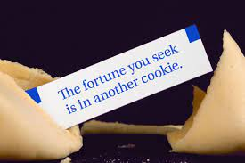
PROPHETS?
Pivec and Geivett observe:
“’Reset.’ ‘Breatkthrough.’ The reversal of ‘impossible situations.’ Any of those words could be found in a fortune cookie or a daily horoscope. But what do those things even mean? And how would anyone know if, when, or how the things they ‘predicted’ had occurred?” (62). They note that these prophecies are both unfalsifiable and untestable, which is convenient, to say the least.
Notes:
Now we can be glad that most probably do not cheat or lie or fake their conclusions. In fact, the scientific method has a safeguard built into it from the start. Reliable data can only be gleaned from experiments that can be replicated, repeated with the same results. Anyone should be able to conduct the same experiment under the same conditions and achieve the same outcome. If you perform an experiment a thousand times and get the same results a thousand times, then the data is probably correct, even well established. If you get multiple, conflicting outcomes, then the data is not confirmed and needs more work.

Slide 100
PROPHETS?
They also reference some “prophecies” made by Brian Carn, founder of Kingdom City Church in Charlotte, NC, Jackson, FL, and Houston, TX. Here’s one for 2020: “A famous 1980s star dies in 2020 who was a big name.”
First, People.com identified 210 celebrity deaths in 2020, so he probably got that one right.
But second, why was it important for the Lord to reveal this?
Notes:
Now we can be glad that most probably do not cheat or lie or fake their conclusions. In fact, the scientific method has a safeguard built into it from the start. Reliable data can only be gleaned from experiments that can be replicated, repeated with the same results. Anyone should be able to conduct the same experiment under the same conditions and achieve the same outcome. If you perform an experiment a thousand times and get the same results a thousand times, then the data is probably correct, even well established. If you get multiple, conflicting outcomes, then the data is not confirmed and needs more work.

Slide 101
PROPHETS?
Here’s more “astounding” predictions by Brian Carn for 2020:
“A shocking discovery by the end of August to reveal a great secret that will create a stir.”
“A famous preacher with heart problems in 2020 will take a break from ministry.”
“A rapid amount of children overdosing on prescriptions drugs.” (What is a “rapid amount”?)
“A New York City problem that will be found to reshape the way people view real estate.”
“A famous class action lawsuit begins in 2020.” (Probably several)
Again, Pivec and Geivett point out the obvious: “These headlines could be used year in and year out, with equal effectiveness time after time.” (65)
Notes:
Now we can be glad that most probably do not cheat or lie or fake their conclusions. In fact, the scientific method has a safeguard built into it from the start. Reliable data can only be gleaned from experiments that can be replicated, repeated with the same results. Anyone should be able to conduct the same experiment under the same conditions and achieve the same outcome. If you perform an experiment a thousand times and get the same results a thousand times, then the data is probably correct, even well established. If you get multiple, conflicting outcomes, then the data is not confirmed and needs more work.

Slide 102
PROPHETS?
Several “prophets” most famously predicted that Donald Trump would be reelected in 2020. The chief prophet at Bethel Church and Bill Johnson’s go-to guy for new revelations from God, Kris Vallotton declared this prophecy on December 8, 2019:
“I believe that the Lord’s gonna step into the impeachment process….This is decreed. The Lord is gonna step in sovereignly….And I believe the Lord’s gonna give him another term…because the Lord wants it.” (Wrong.)
Notes:
Now we can be glad that most probably do not cheat or lie or fake their conclusions. In fact, the scientific method has a safeguard built into it from the start. Reliable data can only be gleaned from experiments that can be replicated, repeated with the same results. Anyone should be able to conduct the same experiment under the same conditions and achieve the same outcome. If you perform an experiment a thousand times and get the same results a thousand times, then the data is probably correct, even well established. If you get multiple, conflicting outcomes, then the data is not confirmed and needs more work.

Slide 103
PROPHETS?
And on November 7, 2020—four days after the election—Vallotton posted a video to Facebook, admitting that he was wrong:
“I really want to apologize, sincerely apologize, for missing the prophecy about Donald Trump….I was completely wrong. I take full responsibility for being wrong. There’s no excuse for it. I think it doesn’t make me a false prophet, but it does create a credibility gap.”
The definition of a “false prophet” is someone who prophesies falsely, so, yes, it does make him a “false prophet.” But hold on, there’s more to the story.
“Vallotton’s eager followers advised him that this apology was premature, since the election results were still being contested. So he removed the apology. He then reposted it on January 8, 2021—the day following congressional certification of the election results.” (56)
Remember the Old Testament rule: “One strike-you’re out, permanently!”
Notes:
Now we can be glad that most probably do not cheat or lie or fake their conclusions. In fact, the scientific method has a safeguard built into it from the start. Reliable data can only be gleaned from experiments that can be replicated, repeated with the same results. Anyone should be able to conduct the same experiment under the same conditions and achieve the same outcome. If you perform an experiment a thousand times and get the same results a thousand times, then the data is probably correct, even well established. If you get multiple, conflicting outcomes, then the data is not confirmed and needs more work.

Slide 104
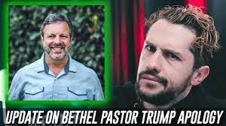

Slide 105
PROPHETS?
And the New Testament declares that the offices of apostle and prophet were “foundational” offices. Ephesians 2:19-20 tells us as much: “¹⁹ So then you are no longer strangers and aliens, but you are fellow citizens with the saints and members of the household of God, ²⁰ built on the foundation of the apostles and prophets, Christ Jesus himself being the cornerstone….”
Arguably “prophets” here refers to the Old Testament and “apostles” refers to the New Testament.
Notes:
Now we can be glad that most probably do not cheat or lie or fake their conclusions. In fact, the scientific method has a safeguard built into it from the start. Reliable data can only be gleaned from experiments that can be replicated, repeated with the same results. Anyone should be able to conduct the same experiment under the same conditions and achieve the same outcome. If you perform an experiment a thousand times and get the same results a thousand times, then the data is probably correct, even well established. If you get multiple, conflicting outcomes, then the data is not confirmed and needs more work.

Slide 106
PROPHETS?
At any rate these are foundational offices.
The apostles and prophets have already laid the foundation for the church, and once they did so, their office was no longer required. For as we read in 1 Corinthians 3:10-11: “¹⁰ According to the grace of God given to me, like a skilled master builder I laid a foundation, and someone else is building upon it. Let each one take care how he builds upon it. ¹¹ For no one can lay a foundation other than that which is laid, which is Jesus Christ….”
Notes:
Now we can be glad that most probably do not cheat or lie or fake their conclusions. In fact, the scientific method has a safeguard built into it from the start. Reliable data can only be gleaned from experiments that can be replicated, repeated with the same results. Anyone should be able to conduct the same experiment under the same conditions and achieve the same outcome. If you perform an experiment a thousand times and get the same results a thousand times, then the data is probably correct, even well established. If you get multiple, conflicting outcomes, then the data is not confirmed and needs more work.

Slide 107
OCCULT / NEW AGE PRACTICES
The definition of “ridiculous” is “worthy of ridicule.” And let’s be honest, these claims are ridiculous on their face.
But some claims are even more serious.
Some techniques like “grave sucking” or “grave soaking” have no biblical warrant and arise from the occult or the new age rather than from Scripture. Here are some examples:
Notes:
Now we can be glad that most probably do not cheat or lie or fake their conclusions. In fact, the scientific method has a safeguard built into it from the start. Reliable data can only be gleaned from experiments that can be replicated, repeated with the same results. Anyone should be able to conduct the same experiment under the same conditions and achieve the same outcome. If you perform an experiment a thousand times and get the same results a thousand times, then the data is probably correct, even well established. If you get multiple, conflicting outcomes, then the data is not confirmed and needs more work.

Slide 108
OCCULT / NEW AGE PRACTICES
BSSM students have attempted to levitate small objects or walk through walls. (They did not succeed.)
After training at BSSM, students are sent out into the Redding community to offer “dream interpretations” and “spirit readings.”
Some students have utilized “destiny cards,” a Christian version of tarot cards to aid in their readings.
Others have attempted mind reading or mental telepathy. One Bethel associate, Seth Dahl, claimed that his one and a half year old son who, could not fall asleep, had messaged him telepathically and asked him to stay near his crib and rub his back. According to Dahl, his son fell asleep within minutes.
Notes:
Now we can be glad that most probably do not cheat or lie or fake their conclusions. In fact, the scientific method has a safeguard built into it from the start. Reliable data can only be gleaned from experiments that can be replicated, repeated with the same results. Anyone should be able to conduct the same experiment under the same conditions and achieve the same outcome. If you perform an experiment a thousand times and get the same results a thousand times, then the data is probably correct, even well established. If you get multiple, conflicting outcomes, then the data is not confirmed and needs more work.

Slide 109
OCCULT / NEW AGE PRACTICES
Why didn’t Dahl just telepathically message back to his son and tell him to go to sleep? And what parent doesn’t know that standing by a crib and rubbing a sleepy child’s back will help them go to sleep faster?
And others claimed to receive messages from deceased spiritual leaders, a practice the Bible describes as “necromancy,” and, oh, also utterly condemns it, always. Again, these are all recognized occult practices.
Notes:
Now we can be glad that most probably do not cheat or lie or fake their conclusions. In fact, the scientific method has a safeguard built into it from the start. Reliable data can only be gleaned from experiments that can be replicated, repeated with the same results. Anyone should be able to conduct the same experiment under the same conditions and achieve the same outcome. If you perform an experiment a thousand times and get the same results a thousand times, then the data is probably correct, even well established. If you get multiple, conflicting outcomes, then the data is not confirmed and needs more work.

Slide 110
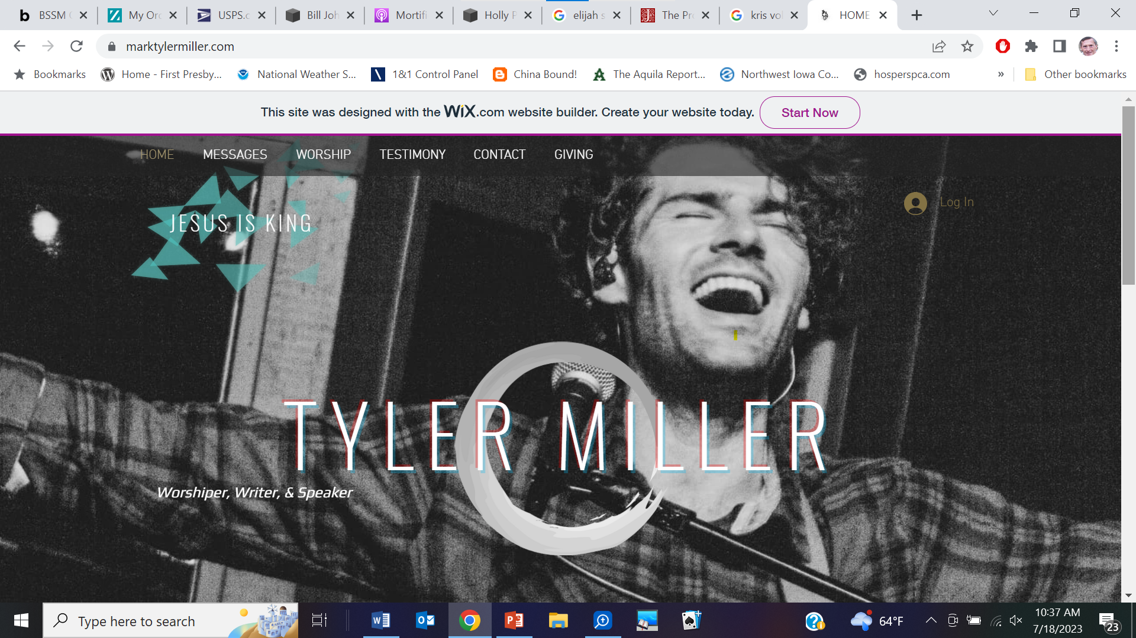
OCCULT / NEW AGE PRACTICES
Here’s one not mentioned by Pivec and Geivett.
Someone named Mark Tyler Miller describes his experience as a part of his testimony on his personal website:
Notes:
Now we can be glad that most probably do not cheat or lie or fake their conclusions. In fact, the scientific method has a safeguard built into it from the start. Reliable data can only be gleaned from experiments that can be replicated, repeated with the same results. Anyone should be able to conduct the same experiment under the same conditions and achieve the same outcome. If you perform an experiment a thousand times and get the same results a thousand times, then the data is probably correct, even well established. If you get multiple, conflicting outcomes, then the data is not confirmed and needs more work.

Slide 112
OCCULT / NEW AGE PRACTICES
“I got down on my bedroom floor and started feverishly free-writing in my journal when suddenly a line came out of my pen and onto the paper which read:
‘I KNEW WHAT YOU’D STRUGGLE WITH WHEN I CREATED YOU, AND I DECIDED TO CREATE YOU ANYWAY.’
“I stared at my paper knowing that I had not written that sentence, and that it was a direct word from the Lord.”
Notes:
Now we can be glad that most probably do not cheat or lie or fake their conclusions. In fact, the scientific method has a safeguard built into it from the start. Reliable data can only be gleaned from experiments that can be replicated, repeated with the same results. Anyone should be able to conduct the same experiment under the same conditions and achieve the same outcome. If you perform an experiment a thousand times and get the same results a thousand times, then the data is probably correct, even well established. If you get multiple, conflicting outcomes, then the data is not confirmed and needs more work.

Slide 113
OCCULT / NEW AGE PRACTICES
Okay, that is called “automatic writing.” Do you know which characters in the Bible practiced automatic writing like this?
Neither do I. Nobody in the Bible did anything like this.
Rather, this is a recognized occult and new age practice. This is not a Christian practice whatsoever.
So if this is the source of these “prophets,” I think we can safely conclude that these messages are either delusions or something worse.
Notes:
Now we can be glad that most probably do not cheat or lie or fake their conclusions. In fact, the scientific method has a safeguard built into it from the start. Reliable data can only be gleaned from experiments that can be replicated, repeated with the same results. Anyone should be able to conduct the same experiment under the same conditions and achieve the same outcome. If you perform an experiment a thousand times and get the same results a thousand times, then the data is probably correct, even well established. If you get multiple, conflicting outcomes, then the data is not confirmed and needs more work.

Slide 115
OCCULT / NEW AGE PRACTICES
How does the NAR movement answer these objections to their employing occult and new age techniques? Quite ingeniously. One approved writer, Jonathan Welton lists certain practices that “actually belong to the church, but were stolen and cleverly repackaged,” including “spirit guide, trances, meditation, auras, power objects, clairvoyance, clairaudience, and more.”
“In short, many NAR leaders believe many occult practices must be redeemed and reclaimed by Christians because they are important tools for advancing God’s kingdom.” (Counterfeit, 40-41)
What’s interesting is that similar practices were labeled “divination” in the Old Testament, and were condemned as witchcraft or sorcery and warranted the death penalty in every instance. None of God’s people used these demonic means. I’m afraid that this places the NAR movement a different light and its proponents in a difficult position.
Notes:
Now we can be glad that most probably do not cheat or lie or fake their conclusions. In fact, the scientific method has a safeguard built into it from the start. Reliable data can only be gleaned from experiments that can be replicated, repeated with the same results. Anyone should be able to conduct the same experiment under the same conditions and achieve the same outcome. If you perform an experiment a thousand times and get the same results a thousand times, then the data is probably correct, even well established. If you get multiple, conflicting outcomes, then the data is not confirmed and needs more work.

Slide 116
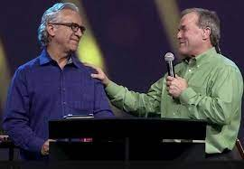
GOD’S WORD WARNS AGAINST FALSE TEACHERS
Keep these obviously spurious apostles and clearly false prophets in mind as I read from what is most likely the last letter that the true Apostle Paul wrote in this life (2 Timothy 3:1-4:5):
Notes:
Now we can be glad that most probably do not cheat or lie or fake their conclusions. In fact, the scientific method has a safeguard built into it from the start. Reliable data can only be gleaned from experiments that can be replicated, repeated with the same results. Anyone should be able to conduct the same experiment under the same conditions and achieve the same outcome. If you perform an experiment a thousand times and get the same results a thousand times, then the data is probably correct, even well established. If you get multiple, conflicting outcomes, then the data is not confirmed and needs more work.

Slide 117
GOD’S WORD WARNS AGAINST FALSE TEACHERS
“But understand this, that in the last days there will come times of difficulty. ² For people will be lovers of self, lovers of money, proud, arrogant, abusive, disobedient to their parents, ungrateful, unholy, ³ heartless, unappeasable, slanderous, without self-control, brutal, not loving good, ⁴ treacherous, reckless, swollen with conceit, lovers of pleasure rather than lovers of God, ⁵ having the appearance of godliness, but denying its power. Avoid such people. ⁶ For among them are those who creep into households and capture weak women, burdened with sins and led astray by various passions, ⁷ always learning and never able to arrive at a knowledge of the truth. ⁸ Just as Jannes and Jambres opposed Moses, so these men also oppose the truth, men corrupted in mind and disqualified regarding the faith. ⁹ But they will not get very far, for their folly will be plain to all, as was that of those two men.”
Notes:
Now we can be glad that most probably do not cheat or lie or fake their conclusions. In fact, the scientific method has a safeguard built into it from the start. Reliable data can only be gleaned from experiments that can be replicated, repeated with the same results. Anyone should be able to conduct the same experiment under the same conditions and achieve the same outcome. If you perform an experiment a thousand times and get the same results a thousand times, then the data is probably correct, even well established. If you get multiple, conflicting outcomes, then the data is not confirmed and needs more work.

Slide 118
GOD’S WORD WARNS AGAINST FALSE TEACHERS
So if you cannot trust these false prophets, who can you trust? Paul continues:
“¹⁰ You, however, have followed my teaching, my conduct, my aim in life, my faith, my patience, my love, my steadfastness, ¹¹ my persecutions and sufferings that happened to me at Antioch, at Iconium, and at Lystra—which persecutions I endured; yet from them all the Lord rescued me. ¹² Indeed, all who desire to live a godly life in Christ Jesus will be persecuted, ¹³ while evil people and impostors will go on from bad to worse, deceiving and being deceived.”
Notes:
Now we can be glad that most probably do not cheat or lie or fake their conclusions. In fact, the scientific method has a safeguard built into it from the start. Reliable data can only be gleaned from experiments that can be replicated, repeated with the same results. Anyone should be able to conduct the same experiment under the same conditions and achieve the same outcome. If you perform an experiment a thousand times and get the same results a thousand times, then the data is probably correct, even well established. If you get multiple, conflicting outcomes, then the data is not confirmed and needs more work.

Slide 119
GOD’S WORD WARNS AGAINST FALSE TEACHERS
Paul sounds like the real deal to me. I think we can trust him to speak clearly for the Lord. And what does he counsel in those terrible times?
“¹⁴ But as for you, continue in what you have learned and have firmly believed, knowing from whom you learned it ¹⁵ and how from childhood you have been acquainted with the sacred writings, which are able to make you wise for salvation through faith in Christ Jesus. ¹⁶ All Scripture is breathed out by God and profitable for teaching, for reproof, for correction, and for training in righteousness, ¹⁷ that the man of God may be complete, equipped for every good work.”
Notes:
Now we can be glad that most probably do not cheat or lie or fake their conclusions. In fact, the scientific method has a safeguard built into it from the start. Reliable data can only be gleaned from experiments that can be replicated, repeated with the same results. Anyone should be able to conduct the same experiment under the same conditions and achieve the same outcome. If you perform an experiment a thousand times and get the same results a thousand times, then the data is probably correct, even well established. If you get multiple, conflicting outcomes, then the data is not confirmed and needs more work.

Slide 120
GOD’S WORD WARNS AGAINST FALSE TEACHERS
The Scriptures, the Word of God written is fully sufficient. With these the man of God “is complete, equipped for every good work.”
So what should we do in response to this? Paul continues:
“^{4:1} I charge you in the presence of God and of Christ Jesus, who is to judge the living and the dead, and by his appearing and his kingdom: ² preach the word; be ready in season and out of season; reprove, rebuke, and exhort, with complete patience and teaching.”
Notes:
Now we can be glad that most probably do not cheat or lie or fake their conclusions. In fact, the scientific method has a safeguard built into it from the start. Reliable data can only be gleaned from experiments that can be replicated, repeated with the same results. Anyone should be able to conduct the same experiment under the same conditions and achieve the same outcome. If you perform an experiment a thousand times and get the same results a thousand times, then the data is probably correct, even well established. If you get multiple, conflicting outcomes, then the data is not confirmed and needs more work.

Slide 121
GOD’S WORD WARNS AGAINST FALSE TEACHERS
Do you know what that is?
That is prophecy with a small “p!”
We already have the complete and fully sufficient Word of God. All we have to do is prayerfully proclaim it, and let the same Spirit who inspired the Word sovereignly apply it to the elect. But we must be careful. Why? Perhaps this is the most direct word in Scripture that we can aim at the purveyors of the supposed New Apostolic Reformation:
“³ For the time is coming when people will not endure sound teaching, but having itching ears they will accumulate for themselves teachers to suit their own passions, ⁴ and will turn away from listening to the truth and wander off into myths.”
These “myths” might include the delusional fantasy that we are now living in the end times and that God has restored the offices of apostles and prophets to the church, for which there is no biblical warrant to believe and a lot of good evidence for doubting.
Notes:
Now we can be glad that most probably do not cheat or lie or fake their conclusions. In fact, the scientific method has a safeguard built into it from the start. Reliable data can only be gleaned from experiments that can be replicated, repeated with the same results. Anyone should be able to conduct the same experiment under the same conditions and achieve the same outcome. If you perform an experiment a thousand times and get the same results a thousand times, then the data is probably correct, even well established. If you get multiple, conflicting outcomes, then the data is not confirmed and needs more work.

Slide 123
GOD’S WORD WARNS AGAINST FALSE TEACHERS
And so here’s a word for those who would stand firm on the truth: “⁵ As for you, always be sober-minded, endure suffering, do the work of an evangelist, fulfill your ministry.”
And those words can be trusted, for those are the apostolic words of God.
Notes:
Now we can be glad that most probably do not cheat or lie or fake their conclusions. In fact, the scientific method has a safeguard built into it from the start. Reliable data can only be gleaned from experiments that can be replicated, repeated with the same results. Anyone should be able to conduct the same experiment under the same conditions and achieve the same outcome. If you perform an experiment a thousand times and get the same results a thousand times, then the data is probably correct, even well established. If you get multiple, conflicting outcomes, then the data is not confirmed and needs more work.

Slide 124
GOD’S WORD WARNS AGAINST FALSE TEACHERS
So let me state it plainly.
I can understand the longing for something more, something exciting and glamorous, something magical and mystifying and super-supernatural. Most every age has seen its own claims like these. Remember Luther and Calvin and their conflict with the false prophet, Thomas Muntzer, and others. But none of this is real. None of this is from the Lord.
There is no New Apostolic Reformation. God has not restored the offices of apostles and prophets to the church. The claims of those who affirm this do not match the criteria of God’s Word and utterly fail the test.
Notes:
Now we can be glad that most probably do not cheat or lie or fake their conclusions. In fact, the scientific method has a safeguard built into it from the start. Reliable data can only be gleaned from experiments that can be replicated, repeated with the same results. Anyone should be able to conduct the same experiment under the same conditions and achieve the same outcome. If you perform an experiment a thousand times and get the same results a thousand times, then the data is probably correct, even well established. If you get multiple, conflicting outcomes, then the data is not confirmed and needs more work.

Slide 125
GOD’S WORD WARNS AGAINST FALSE TEACHERS
So I would say this to those caught up in NAR churches today:
There are no new apostles. You are not prophets prophesying new revelations from God. You are not working miracles. You are utterly wasting your time. You are following false teachers who have clearly been exposed by their admitted errors. Even more serious, though, by these occult and new age practices you are opening yourselves, your families, and those who follow you to dynamics and forces that God has always condemned, and for good reason. I urge you to repudiate these false claims and to repent of this nonsense…and to repent of some something perhaps more dangerous than nonsense, for you soul’s sake, and for the sake of the souls who look to you for leadership.
Notes:
Now we can be glad that most probably do not cheat or lie or fake their conclusions. In fact, the scientific method has a safeguard built into it from the start. Reliable data can only be gleaned from experiments that can be replicated, repeated with the same results. Anyone should be able to conduct the same experiment under the same conditions and achieve the same outcome. If you perform an experiment a thousand times and get the same results a thousand times, then the data is probably correct, even well established. If you get multiple, conflicting outcomes, then the data is not confirmed and needs more work.

Slide 126
2023 SUMMER SEMINARS HOSPERS PCA
“Understanding the Popular Mind”
June 20 “Responding to the Social Imaginary”
June 27 “Restoring Biblical Marriage”
July 18 “Is the Church Witnessing a ‘New Apostolic Reformation’?”
Notes:
Now we can be glad that most probably do not cheat or lie or fake their conclusions. In fact, the scientific method has a safeguard built into it from the start. Reliable data can only be gleaned from experiments that can be replicated, repeated with the same results. Anyone should be able to conduct the same experiment under the same conditions and achieve the same outcome. If you perform an experiment a thousand times and get the same results a thousand times, then the data is probably correct, even well established. If you get multiple, conflicting outcomes, then the data is not confirmed and needs more work.

