Slide 1
“Understanding the popular mind”
1. responding to the social imaginary

Slide 2
2023 SUMMER SEMINARS HOSPERS PCA
“Understanding the Popular Mind”
June 20 “Responding to the Social Imaginary”
June 27 “Restoring Biblical Marriage”
July 18 “Is the Church Witnessing a ‘New Apostolic Reformation’?”
Notes:
Now we can be glad that most probably do not cheat or lie or fake their conclusions. In fact, the scientific method has a safeguard built into it from the start. Reliable data can only be gleaned from experiments that can be replicated, repeated with the same results. Anyone should be able to conduct the same experiment under the same conditions and achieve the same outcome. If you perform an experiment a thousand times and get the same results a thousand times, then the data is probably correct, even well established. If you get multiple, conflicting outcomes, then the data is not confirmed and needs more work.

Slide 3
“Understanding the popular mind”
1. responding to the social imaginary

Slide 4
INTRODUCTION: WHAT IN THE WORLD IS HAPPENING?
What in the world is happening?
If someone awakened from a “Rip Van Winkle” nap of only twenty years, he would encounter today a world that was largely unrecognizable.
In 2003, just two decades ago, only the state of Massachusetts permitted gay marriage, and the first gay weddings would not take place there until the following year.
California (California!) still had a statutory ban on gay marriage. (California!)
Three states, Alaska, Nebraska, and Nevada had bans on gay marriage written into their state constitutions!
And in 2003, the Federal Marriage Amendment that would have added language to the US Constitution banning same-sex marriage nationwide was introduced into the U.S. Congress.
Notes:
Now we can be glad that most probably do not cheat or lie or fake their conclusions. In fact, the scientific method has a safeguard built into it from the start. Reliable data can only be gleaned from experiments that can be replicated, repeated with the same results. Anyone should be able to conduct the same experiment under the same conditions and achieve the same outcome. If you perform an experiment a thousand times and get the same results a thousand times, then the data is probably correct, even well established. If you get multiple, conflicting outcomes, then the data is not confirmed and needs more work.

Slide 5
INTRODUCTION: WHAT IN THE WORLD IS HAPPENING?
But, today, twenty brief years later, same-sex marriage is the law of the land by judicial decree, and nobody is protesting this loudly or expects a serious challenge to be mounted against it any time soon.
The US House and Senate have affirmed same-sex marriage, by passing the infamously named “Respect for Marriage Act,” with bi-partisan support, and the president has signed it into law.
Notes:
Now we can be glad that most probably do not cheat or lie or fake their conclusions. In fact, the scientific method has a safeguard built into it from the start. Reliable data can only be gleaned from experiments that can be replicated, repeated with the same results. Anyone should be able to conduct the same experiment under the same conditions and achieve the same outcome. If you perform an experiment a thousand times and get the same results a thousand times, then the data is probably correct, even well established. If you get multiple, conflicting outcomes, then the data is not confirmed and needs more work.

Slide 6
INTRODUCTION: WHAT IN THE WORLD IS HAPPENING?
Today tens of thousands of teenagers are declaring themselves to be “trans,” many of them receiving off-label, unapproved hormone treatment, effectively, permanently sterilizing them, and a large number has undergone surgeries producing irreversible changes to their body structures, “top” and “bottom” surgeries, some in their early teens, with or without parental consent.
What in the world is happening? Or in the words of a bewildered Theoden of Rohan at the battle of Helm’s Deep in the film adaptation of Tolkien’s The Two Towers:
Notes:
Now we can be glad that most probably do not cheat or lie or fake their conclusions. In fact, the scientific method has a safeguard built into it from the start. Reliable data can only be gleaned from experiments that can be replicated, repeated with the same results. Anyone should be able to conduct the same experiment under the same conditions and achieve the same outcome. If you perform an experiment a thousand times and get the same results a thousand times, then the data is probably correct, even well established. If you get multiple, conflicting outcomes, then the data is not confirmed and needs more work.

Slide 8
INTRODUCTION: WHAT IN THE WORLD IS HAPPENING?
I noticed the rapid shift taking place shortly after the Obergefell US Supreme Court ruling requiring gay marriage was handed down June 26, 2015.
If you recall, that very night President Obama ordered the White House to become the “Rainbow House,” bathed in rainbow colors celebrating the LGBTQIA+ victory.
Notes:
Now we can be glad that most probably do not cheat or lie or fake their conclusions. In fact, the scientific method has a safeguard built into it from the start. Reliable data can only be gleaned from experiments that can be replicated, repeated with the same results. Anyone should be able to conduct the same experiment under the same conditions and achieve the same outcome. If you perform an experiment a thousand times and get the same results a thousand times, then the data is probably correct, even well established. If you get multiple, conflicting outcomes, then the data is not confirmed and needs more work.

Slide 10
INTRODUCTION: WHAT IN THE WORLD IS HAPPENING?
But it seemed like a matter of mere weeks, less than a month, I think, when the celebration gave way to the next crusade, and President Obama began talking about the need to secure “trans rights,” even as the ink on Obergefell was still drying.
Notes:
Now we can be glad that most probably do not cheat or lie or fake their conclusions. In fact, the scientific method has a safeguard built into it from the start. Reliable data can only be gleaned from experiments that can be replicated, repeated with the same results. Anyone should be able to conduct the same experiment under the same conditions and achieve the same outcome. If you perform an experiment a thousand times and get the same results a thousand times, then the data is probably correct, even well established. If you get multiple, conflicting outcomes, then the data is not confirmed and needs more work.

Slide 11
INTRODUCTION: WHAT IN THE WORLD IS HAPPENING?
Since that time there has been a nonstop discussion, no, check that, lectures and diatribes, on the vital necessity of trans rights, and the exponential explosion of young people suddenly discovering and declaring they were trans.
Women’s sports have been thrown into turmoil as more and more biological men have taken scholarships, won championships, and wrested records away from actual women, biological women, to the consternation of many feminists and, well, a lot of just ordinary people as well.
Women’s sports may just be the first casualty, now having been placed on the endangered species list, soon likely to suffer extinction.
Notes:
Now we can be glad that most probably do not cheat or lie or fake their conclusions. In fact, the scientific method has a safeguard built into it from the start. Reliable data can only be gleaned from experiments that can be replicated, repeated with the same results. Anyone should be able to conduct the same experiment under the same conditions and achieve the same outcome. If you perform an experiment a thousand times and get the same results a thousand times, then the data is probably correct, even well established. If you get multiple, conflicting outcomes, then the data is not confirmed and needs more work.

Slide 14
INTRODUCTION: WHAT IN THE WORLD IS HAPPENING?
But even more seriously, this rapid shift of morality, truth, reality, and ultimately stability is likely at the root of the unprecedented, dangerously high rates of depression and suicidal tendencies among young people.
Notes:
Now we can be glad that most probably do not cheat or lie or fake their conclusions. In fact, the scientific method has a safeguard built into it from the start. Reliable data can only be gleaned from experiments that can be replicated, repeated with the same results. Anyone should be able to conduct the same experiment under the same conditions and achieve the same outcome. If you perform an experiment a thousand times and get the same results a thousand times, then the data is probably correct, even well established. If you get multiple, conflicting outcomes, then the data is not confirmed and needs more work.

Slide 15
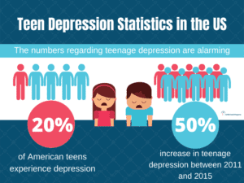

Slide 16
INTRODUCTION: WHAT IN THE WORLD IS HAPPENING?
The LGBTQIA+ “Pride Month” (June) has followed on the heels of “Mental Health Awareness Month” (May), and many of us would suggest that the second one has in large part created the need for the first one.
If you have not noticed, young people, teenagers are not thriving today.
Bewildering moral confusion regarding their sexual “identity,” ramped up by ubiquitous social media posts daring others to plunge into the next, toxic, reality-defying bit of mental insanity and moral depravity surely seem to be the culprits lurking in the shadows.
One could well argue that this is clearly a matter of causation and not mere correlation.
Notes:
Now we can be glad that most probably do not cheat or lie or fake their conclusions. In fact, the scientific method has a safeguard built into it from the start. Reliable data can only be gleaned from experiments that can be replicated, repeated with the same results. Anyone should be able to conduct the same experiment under the same conditions and achieve the same outcome. If you perform an experiment a thousand times and get the same results a thousand times, then the data is probably correct, even well established. If you get multiple, conflicting outcomes, then the data is not confirmed and needs more work.

Slide 17
INTRODUCTION: WHAT IN THE WORLD IS HAPPENING?
And most serious of all is to consider how the church is to respond to these formidable challenges to our calling to “make disciples of all nations.”
How does one proclaim the gospel message, the most sobering, universal truth claim, in a time and in a philosophical context where every truth claim is considered dangerous, manipulative, and exploitative, an assault, a “micro-aggression”?
Notes:
Now we can be glad that most probably do not cheat or lie or fake their conclusions. In fact, the scientific method has a safeguard built into it from the start. Reliable data can only be gleaned from experiments that can be replicated, repeated with the same results. Anyone should be able to conduct the same experiment under the same conditions and achieve the same outcome. If you perform an experiment a thousand times and get the same results a thousand times, then the data is probably correct, even well established. If you get multiple, conflicting outcomes, then the data is not confirmed and needs more work.

Slide 18
INTRODUCTION: WHAT IN THE WORLD IS HAPPENING?
Thankfully, Reformed theologian Carl Trueman has written a pair of books that enable us to understand how this tsunami of confusion and moral upheaval has come about.
Notes:
Now we can be glad that most probably do not cheat or lie or fake their conclusions. In fact, the scientific method has a safeguard built into it from the start. Reliable data can only be gleaned from experiments that can be replicated, repeated with the same results. Anyone should be able to conduct the same experiment under the same conditions and achieve the same outcome. If you perform an experiment a thousand times and get the same results a thousand times, then the data is probably correct, even well established. If you get multiple, conflicting outcomes, then the data is not confirmed and needs more work.

Slide 19
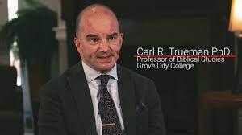

Slide 20
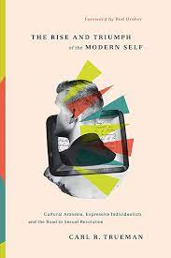
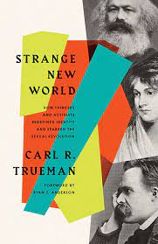

Slide 21
INTRODUCTION: WHAT IN THE WORLD IS HAPPENING?
The first book, The Rise and Triumph of the Modern Self: Cultural Amnesia, Expressive Individualism, and the Road to Sexual Revolution, (2019) is ponderously deep (407 pages).
Without a bit of background in philosophy it is a difficult, but not an impossible read.
But his second book, Strange New World: How Thinkers and Activists Redefined Identity and Sparked the Sexual Revolution (2022), which covers much of the same ground is a far more accessible (and shorter, 192 pages) read, complete with a helpful glossary of important terms.
I read the first book (three weeks) and was stunned.
I read the second book twice (a couple of days each time) and gained greater understanding each time (and became even more concerned).
Notes:
Now we can be glad that most probably do not cheat or lie or fake their conclusions. In fact, the scientific method has a safeguard built into it from the start. Reliable data can only be gleaned from experiments that can be replicated, repeated with the same results. Anyone should be able to conduct the same experiment under the same conditions and achieve the same outcome. If you perform an experiment a thousand times and get the same results a thousand times, then the data is probably correct, even well established. If you get multiple, conflicting outcomes, then the data is not confirmed and needs more work.

Slide 22
INTRODUCTION: WHAT IN THE WORLD IS HAPPENING?
So my plan for our time is to offer an overview of the second book, through my own grid, of course, and then, after the break touch on ways that the church must necessarily respond to these disturbing developments.
I will point out unhelpful forms of response, some that are being tried and will likely do more harm than good.
This is not simply a concern for church leaders alone, nor, perhaps even primarily for church leaders.
The lofty, toxic ideas that have created the current cultural crisis were first presented by intellectuals that almost none of us have read.
But due to the work of popularizers, mostly in the arts and the media, these lethal lies have filtered down to the popular mind and are widely accepted as unassailable, absolute truth, even as the existence of any such absolutes is loudly denied.
Notes:
Now we can be glad that most probably do not cheat or lie or fake their conclusions. In fact, the scientific method has a safeguard built into it from the start. Reliable data can only be gleaned from experiments that can be replicated, repeated with the same results. Anyone should be able to conduct the same experiment under the same conditions and achieve the same outcome. If you perform an experiment a thousand times and get the same results a thousand times, then the data is probably correct, even well established. If you get multiple, conflicting outcomes, then the data is not confirmed and needs more work.

Slide 23
INTRODUCTION: WHAT IN THE WORLD IS HAPPENING?
As Dr. Trueman explains, “To respond to our times, we must first understand our times. That is the goal.” (p. 29. All Trueman quotations are from Strange New World unless otherwise noted.)
Notes:
Now we can be glad that most probably do not cheat or lie or fake their conclusions. In fact, the scientific method has a safeguard built into it from the start. Reliable data can only be gleaned from experiments that can be replicated, repeated with the same results. Anyone should be able to conduct the same experiment under the same conditions and achieve the same outcome. If you perform an experiment a thousand times and get the same results a thousand times, then the data is probably correct, even well established. If you get multiple, conflicting outcomes, then the data is not confirmed and needs more work.

Slide 24
I. THE IDEA OF THE SOCIAL IMAGINARY
An important concept to master goes to the way people think and respond to their surroundings. How does someone come to form his or her opinions and intuitions about the way things are and how they should be?
The answer lies in a helpful concept introduced by Canadian philosopher Charles Taylor called the “social imaginary,” basically how people think or sense things are and ought to be.
We might call it their “worldview,” their general conception of the universe.
Notes:
Now we can be glad that most probably do not cheat or lie or fake their conclusions. In fact, the scientific method has a safeguard built into it from the start. Reliable data can only be gleaned from experiments that can be replicated, repeated with the same results. Anyone should be able to conduct the same experiment under the same conditions and achieve the same outcome. If you perform an experiment a thousand times and get the same results a thousand times, then the data is probably correct, even well established. If you get multiple, conflicting outcomes, then the data is not confirmed and needs more work.

Slide 25
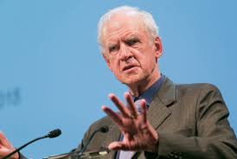

Slide 26
I. THE IDEA OF THE SOCIAL IMAGINARY
Trueman’s helpful glossary defines the “social imaginary” as “the set of socially conditioned intuitions by which a person relates to the world in a nonreflective way.” (191)
Thought, reason, linear logic do not so much determine our preferences or loyalties as do subtle social conditioning.
Social rewards and punishments tend to shape our beliefs, and even more, our emotional, instinctual “gut reactions” to ideas, expressions, or actions.
Notes:
Now we can be glad that most probably do not cheat or lie or fake their conclusions. In fact, the scientific method has a safeguard built into it from the start. Reliable data can only be gleaned from experiments that can be replicated, repeated with the same results. Anyone should be able to conduct the same experiment under the same conditions and achieve the same outcome. If you perform an experiment a thousand times and get the same results a thousand times, then the data is probably correct, even well established. If you get multiple, conflicting outcomes, then the data is not confirmed and needs more work.

Slide 28
I. THE IDEA OF THE SOCIAL IMAGINARY
I want to dwell on this concept of the social imaginary because it helps to explain much of the rapid change in moral views and the utterly strange developments in our time.
Notes:
Now we can be glad that most probably do not cheat or lie or fake their conclusions. In fact, the scientific method has a safeguard built into it from the start. Reliable data can only be gleaned from experiments that can be replicated, repeated with the same results. Anyone should be able to conduct the same experiment under the same conditions and achieve the same outcome. If you perform an experiment a thousand times and get the same results a thousand times, then the data is probably correct, even well established. If you get multiple, conflicting outcomes, then the data is not confirmed and needs more work.

Slide 29
I. THE IDEA OF THE SOCIAL IMAGINARY
Charles Taylor defines it this way:
“I speak of ‘imaginary’ (i) because I’m talking about the way ordinary people ‘imagine’ their social surroundings, and this is often not expressed in theoretical terms, it is carried in images, stories, legends, etc. But it is also the case that (ii) theory is often the possession of a small minority, whereas what is interesting in the social imaginary is that it is shared by large groups of people, if not the whole society. Which leads to a third difference: (iii) the social imaginary is that common understanding which makes possible common practices, and a widely shared sense of legitimacy.”
Notes:
Now we can be glad that most probably do not cheat or lie or fake their conclusions. In fact, the scientific method has a safeguard built into it from the start. Reliable data can only be gleaned from experiments that can be replicated, repeated with the same results. Anyone should be able to conduct the same experiment under the same conditions and achieve the same outcome. If you perform an experiment a thousand times and get the same results a thousand times, then the data is probably correct, even well established. If you get multiple, conflicting outcomes, then the data is not confirmed and needs more work.

Slide 30
I. THE IDEA OF THE SOCIAL IMAGINARY
And Trueman adds, “What Taylor is pointing to here is the fact that human beings do not typically think about themselves and the world they inhabit in consistently self-conscious terms. Rather, we imagine it to be in certain ways—physically and indeed morally.” (27)
Notes:
Now we can be glad that most probably do not cheat or lie or fake their conclusions. In fact, the scientific method has a safeguard built into it from the start. Reliable data can only be gleaned from experiments that can be replicated, repeated with the same results. Anyone should be able to conduct the same experiment under the same conditions and achieve the same outcome. If you perform an experiment a thousand times and get the same results a thousand times, then the data is probably correct, even well established. If you get multiple, conflicting outcomes, then the data is not confirmed and needs more work.

Slide 31
I. THE IDEA OF THE SOCIAL IMAGINARY
This is not really something new.
People always have a certain perspective or worldview out of which they respond or act, not necessarily in cognitive or deliberative ways but rather by mere preference or sentiment.
The real question involves the content of this “social imaginary,” (how people imagine that things are and how they should be) and the various ways people acquire this set of intuitions.
It includes the often subtle social pressures that create and reinforce this widespread or even universal social sense.
Notes:
Now we can be glad that most probably do not cheat or lie or fake their conclusions. In fact, the scientific method has a safeguard built into it from the start. Reliable data can only be gleaned from experiments that can be replicated, repeated with the same results. Anyone should be able to conduct the same experiment under the same conditions and achieve the same outcome. If you perform an experiment a thousand times and get the same results a thousand times, then the data is probably correct, even well established. If you get multiple, conflicting outcomes, then the data is not confirmed and needs more work.

Slide 32
I. THE IDEA OF THE SOCIAL IMAGINARY
In the early 1900s, for example, the consensus was that using any form of birth control was frowned upon or condemned outright, even for married couples.
Fifty years later, NOT using some form of birth control was widely considered irresponsible, and today, it is unthinkable.
But what has sparked the change? How could the “social imaginary,” the widespread consensus of sentiment have swung in the opposite direction?
Notes:
Now we can be glad that most probably do not cheat or lie or fake their conclusions. In fact, the scientific method has a safeguard built into it from the start. Reliable data can only be gleaned from experiments that can be replicated, repeated with the same results. Anyone should be able to conduct the same experiment under the same conditions and achieve the same outcome. If you perform an experiment a thousand times and get the same results a thousand times, then the data is probably correct, even well established. If you get multiple, conflicting outcomes, then the data is not confirmed and needs more work.

Slide 34
II. “EXPRESSIVE INDIVIDUALISM”: THE CURRENT SOCIAL IMAGINARY
Dr. Trueman describes the current, dominant social imaginary in terms of “expressive individualism.” And this is the second important concept for us to comprehend if we are to understand our times and the blistering pace of moral decline.
The phrase “expressive individualism” was coined by American sociologist of religion Robert Bellah.
Notes:
Now we can be glad that most probably do not cheat or lie or fake their conclusions. In fact, the scientific method has a safeguard built into it from the start. Reliable data can only be gleaned from experiments that can be replicated, repeated with the same results. Anyone should be able to conduct the same experiment under the same conditions and achieve the same outcome. If you perform an experiment a thousand times and get the same results a thousand times, then the data is probably correct, even well established. If you get multiple, conflicting outcomes, then the data is not confirmed and needs more work.

Slide 35
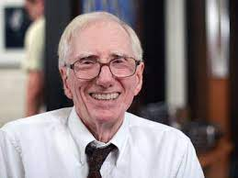

Slide 36
II. “EXPRESSIVE INDIVIDUALISM”: THE CURRENT SOCIAL IMAGINARY
He defines it:
“Expressive individualism holds that each person has a unique core of feeling and intuition that should unfold or be expressed if individuality is to be realized.”
But it’s more than simply a statement of fact. It implies an obligation. Each person is tasked with a duty to fully explore and to express their “unique core of feeling and intuition.”
In reality, it becomes the highest calling, the most pressing obligation, the self’s justification for her existence, the “chief end,” if you will: to develop and display the unique wonders of the unique self to the adoration and applause of the watching world.
Notes:
Now we can be glad that most probably do not cheat or lie or fake their conclusions. In fact, the scientific method has a safeguard built into it from the start. Reliable data can only be gleaned from experiments that can be replicated, repeated with the same results. Anyone should be able to conduct the same experiment under the same conditions and achieve the same outcome. If you perform an experiment a thousand times and get the same results a thousand times, then the data is probably correct, even well established. If you get multiple, conflicting outcomes, then the data is not confirmed and needs more work.

Slide 37
II. “EXPRESSIVE INDIVIDUALISM”: THE CURRENT SOCIAL IMAGINARY
In the glossary, Carl Trueman defines expressive individualism as “the belief that each person must act based on expressing his or her core feelings and intuition.”
Now, to be fair, when someone acts in a way that does not reflect their true thoughts or sentiments we often refer to this negatively as hypocrisy.
But the key difference in expressive individualism is that the inner life, the unique core feelings are never to be subject to any assessment or correction, but must be embraced and affirmed in every instance.
One’s inner life is beyond critique and never wrong.
Notes:
Now we can be glad that most probably do not cheat or lie or fake their conclusions. In fact, the scientific method has a safeguard built into it from the start. Reliable data can only be gleaned from experiments that can be replicated, repeated with the same results. Anyone should be able to conduct the same experiment under the same conditions and achieve the same outcome. If you perform an experiment a thousand times and get the same results a thousand times, then the data is probably correct, even well established. If you get multiple, conflicting outcomes, then the data is not confirmed and needs more work.

Slide 38
II. “EXPRESSIVE INDIVIDUALISM”: THE CURRENT SOCIAL IMAGINARY
In plain English, previously our general commitment was to something outside of ourselves: family, religion, country, our company, or neighborhood.
Now, under expressive individualism, our only loyalty is internal, to the self.
Notes:
Now we can be glad that most probably do not cheat or lie or fake their conclusions. In fact, the scientific method has a safeguard built into it from the start. Reliable data can only be gleaned from experiments that can be replicated, repeated with the same results. Anyone should be able to conduct the same experiment under the same conditions and achieve the same outcome. If you perform an experiment a thousand times and get the same results a thousand times, then the data is probably correct, even well established. If you get multiple, conflicting outcomes, then the data is not confirmed and needs more work.

Slide 39
II. “EXPRESSIVE INDIVIDUALISM”: THE CURRENT SOCIAL IMAGINARY
This shift involves the move of “granting decisive authority” to the inner feelings.
Fifty or sixty years ago, if a patient came to a doctor with the complaint "I feel like a woman trapped in man’s body,” the doctor would have instinctively seen this as a problem of the mind.
The doctor “was working within a social imaginary that granted normative authority to the physical body. The body was decisive for answering the question of whether a person was a man or a woman.” (32)
In this case the body was obviously that of a man, so the mind, the feelings must be the problem and would require some kind of treatment to bring them in line with the body.
Notes:
Now we can be glad that most probably do not cheat or lie or fake their conclusions. In fact, the scientific method has a safeguard built into it from the start. Reliable data can only be gleaned from experiments that can be replicated, repeated with the same results. Anyone should be able to conduct the same experiment under the same conditions and achieve the same outcome. If you perform an experiment a thousand times and get the same results a thousand times, then the data is probably correct, even well established. If you get multiple, conflicting outcomes, then the data is not confirmed and needs more work.

Slide 40
II. “EXPRESSIVE INDIVIDUALISM”: THE CURRENT SOCIAL IMAGINARY
The situation, the social imaginary, has now changed:
“Doctors today, however, grant normative authority in such cases to inner feelings or psychological convictions. We should note that this is not a ‘scientific’ move. It is not the result of ‘following the science.’ Science can study the body and the mind and can describe and analyze how the two connect; but how the relationship between the two is constructed in terms of which [the body or the mind] has normative authority rests upon evaluative judgments shaped by wider philosophical or cultural commitments. The question for us therefore is: Where do these commitments originate?” (32)
Notes:
Now we can be glad that most probably do not cheat or lie or fake their conclusions. In fact, the scientific method has a safeguard built into it from the start. Reliable data can only be gleaned from experiments that can be replicated, repeated with the same results. Anyone should be able to conduct the same experiment under the same conditions and achieve the same outcome. If you perform an experiment a thousand times and get the same results a thousand times, then the data is probably correct, even well established. If you get multiple, conflicting outcomes, then the data is not confirmed and needs more work.

Slide 41
II. “EXPRESSIVE INDIVIDUALISM”: THE CURRENT SOCIAL IMAGINARY
Another way to get at this: the aforementioned Charles Taylor considers this “expressive individualism” as “the normative modern notion of selfhood in the West.” (22) He likens it to what he calls “the culture of authenticity.”
“[The culture of authenticity is where] each one of us has his/her own way of realizing our humanity, and that it is important to find and live out one’s own [way], as against surrendering to conformity with a model imposed on us from outside, by society, or the previous generation, or religious or political authority." (23)
“Express yourself!” “Get real!” “Live your truth!” “Religion as ‘buffet Buddhism.’”
Notes:
Now we can be glad that most probably do not cheat or lie or fake their conclusions. In fact, the scientific method has a safeguard built into it from the start. Reliable data can only be gleaned from experiments that can be replicated, repeated with the same results. Anyone should be able to conduct the same experiment under the same conditions and achieve the same outcome. If you perform an experiment a thousand times and get the same results a thousand times, then the data is probably correct, even well established. If you get multiple, conflicting outcomes, then the data is not confirmed and needs more work.

Slide 42
II. “EXPRESSIVE INDIVIDUALISM”: THE CURRENT SOCIAL IMAGINARY
“In short, the modern self is one where authenticity is achieved by acting outwardly in accordance with one’s inner feelings….[T]his notion is now very deep in modern culture and helps to explain a host of interesting phenomena. For example, the increasing social sensitivity to criticizing anyone for their personal lifestyle choice reflects a view of the world where each person is free to perform life in whatever way they choose; and any attempt to express disapproval is therefore a blow not simply against particular ways of behaving but against the right of that person to be whoever they wish to be. Indeed, we might even say that the very notion of ‘personal lifestyle choice’ is a symptom of a society where expressive individualism is the normative way of thinking about self and its place in the world.” (23)
Notes:
Now we can be glad that most probably do not cheat or lie or fake their conclusions. In fact, the scientific method has a safeguard built into it from the start. Reliable data can only be gleaned from experiments that can be replicated, repeated with the same results. Anyone should be able to conduct the same experiment under the same conditions and achieve the same outcome. If you perform an experiment a thousand times and get the same results a thousand times, then the data is probably correct, even well established. If you get multiple, conflicting outcomes, then the data is not confirmed and needs more work.

Slide 43
II. “EXPRESSIVE INDIVIDUALISM”: THE CURRENT SOCIAL IMAGINARY
In other words, by our own intuitively thinking that there is something right about people making “personal lifestyle choices,” and our reluctance to criticize any such choice whatever it may be, by this we show that we have incorporated this expressive individualism into our own social imaginary.
We accept it.
We do not question it, because we are expressive individualists as well.
Notes:
Now we can be glad that most probably do not cheat or lie or fake their conclusions. In fact, the scientific method has a safeguard built into it from the start. Reliable data can only be gleaned from experiments that can be replicated, repeated with the same results. Anyone should be able to conduct the same experiment under the same conditions and achieve the same outcome. If you perform an experiment a thousand times and get the same results a thousand times, then the data is probably correct, even well established. If you get multiple, conflicting outcomes, then the data is not confirmed and needs more work.

Slide 44
II. “EXPRESSIVE INDIVIDUALISM”: THE CURRENT SOCIAL IMAGINARY
This sorry development, this ubiquitous expectation is revealed in the now commonly accepted purpose of education, for example.
“[I]nstitutions cease to be places for the formation of individuals via their schooling in the various practices and disciplines that allow them to take their place in society. Instead they become platforms for performances, where individuals are allowed to be their authentic selves precisely because they are able to give expression to who they are on the ‘inside.’….For such selves in such a world, institutions such as schools and churches are places where one goes to perform, not to be formed—or, perhaps better, where one goes to be formed by performing.” (Rise and Triumph, p. 49)
Notes:
Now we can be glad that most probably do not cheat or lie or fake their conclusions. In fact, the scientific method has a safeguard built into it from the start. Reliable data can only be gleaned from experiments that can be replicated, repeated with the same results. Anyone should be able to conduct the same experiment under the same conditions and achieve the same outcome. If you perform an experiment a thousand times and get the same results a thousand times, then the data is probably correct, even well established. If you get multiple, conflicting outcomes, then the data is not confirmed and needs more work.

Slide 46
II. “EXPRESSIVE INDIVIDUALISM”: THE CURRENT SOCIAL IMAGINARY
Schools and churches are no longer considered places to learn, to conform our lives according to a standard that will enable us to contribute to society and do something useful out of a sense of obligation to others.
Now they are considered places where the self is displayed to others, for the adoration of others.
In many churches today, the pulpit and table where God speaks, commands, and blesses has now become the “stage.”
Notes:
Now we can be glad that most probably do not cheat or lie or fake their conclusions. In fact, the scientific method has a safeguard built into it from the start. Reliable data can only be gleaned from experiments that can be replicated, repeated with the same results. Anyone should be able to conduct the same experiment under the same conditions and achieve the same outcome. If you perform an experiment a thousand times and get the same results a thousand times, then the data is probably correct, even well established. If you get multiple, conflicting outcomes, then the data is not confirmed and needs more work.

Slide 47
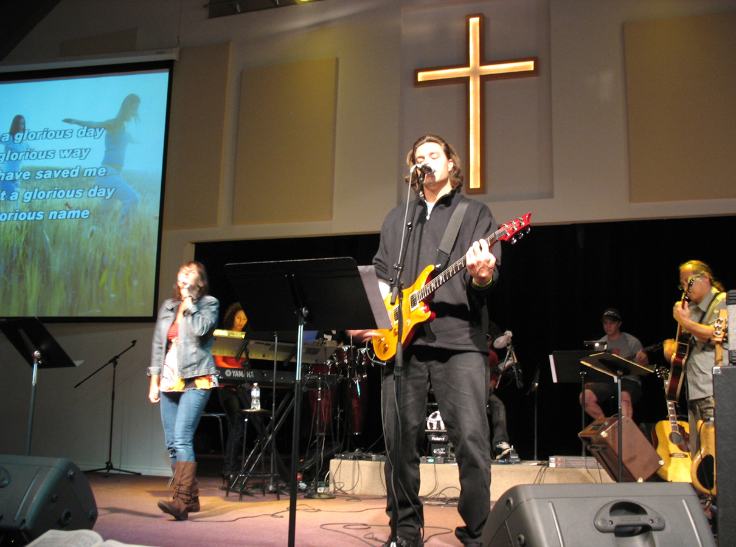

Slide 48
II. “EXPRESSIVE INDIVIDUALISM”: THE CURRENT SOCIAL IMAGINARY
So, to put it simply, the inner self is always good and our life’s purpose and goal is to pattern our external lives after our internal preferences, and even to express the internal life for the adulation and affirmation of others.
And others must affirm, adore, and applaud—celebrate, or else.
Notes:
Now we can be glad that most probably do not cheat or lie or fake their conclusions. In fact, the scientific method has a safeguard built into it from the start. Reliable data can only be gleaned from experiments that can be replicated, repeated with the same results. Anyone should be able to conduct the same experiment under the same conditions and achieve the same outcome. If you perform an experiment a thousand times and get the same results a thousand times, then the data is probably correct, even well established. If you get multiple, conflicting outcomes, then the data is not confirmed and needs more work.

Slide 49
II. “EXPRESSIVE INDIVIDUALISM”: THE CURRENT SOCIAL IMAGINARY
And now you can perhaps see how an internal feeling of the self as having this or that sexual preference or this or that (or no) gender must not only be expressed outwardly as my solemn duty to myself, but it must also be acknowledged, accepted, affirmed, and celebrated by all others—everyone, no exceptions. Period.
Hence the sexual revolution, and the rapid pace of the growth of the divine, holy acronym: LGBTQIA+ (no end in sight), “May it live forever!”
Notes:
Now we can be glad that most probably do not cheat or lie or fake their conclusions. In fact, the scientific method has a safeguard built into it from the start. Reliable data can only be gleaned from experiments that can be replicated, repeated with the same results. Anyone should be able to conduct the same experiment under the same conditions and achieve the same outcome. If you perform an experiment a thousand times and get the same results a thousand times, then the data is probably correct, even well established. If you get multiple, conflicting outcomes, then the data is not confirmed and needs more work.

Slide 50
II. “EXPRESSIVE INDIVIDUALISM”: THE CURRENT SOCIAL IMAGINARY
“[T]he sexual revolution does not simply represent a growth in the routine transgression of traditional sexual codes or even a modest expansion of the boundaries of what is and is not acceptable sexual behavior. Not at all. Rather, it is the repudiation of the very idea of such codes in their entirety. More than that, it has come in certain areas, such as that of homosexuality and transgenderism, to require the positive repudiation of traditional sexual mores to the point where belief in, or maintenance of, such views has come to be seen as ridiculous and even a sign of serious mental or moral deficiency. And to understand this, we need to see the sexual revolution as a particularly sharp manifestation of the characteristics of expressive individualism. If the individual’s identity is defined by sexual desire, then he or she must be allowed to act out on that desire in order to be an authentic person.” (25)
Notes:
Now we can be glad that most probably do not cheat or lie or fake their conclusions. In fact, the scientific method has a safeguard built into it from the start. Reliable data can only be gleaned from experiments that can be replicated, repeated with the same results. Anyone should be able to conduct the same experiment under the same conditions and achieve the same outcome. If you perform an experiment a thousand times and get the same results a thousand times, then the data is probably correct, even well established. If you get multiple, conflicting outcomes, then the data is not confirmed and needs more work.

Slide 51
II. “EXPRESSIVE INDIVIDUALISM”: THE CURRENT SOCIAL IMAGINARY
Ironically, while everyone must act out of their unique inner self, the only exception to this is if your unique inner self does not want to affirm and celebrate the choices of others.
The unique inner self that refuses to acknowledge the choices of other unique inner selves is neither affirmed nor celebrated but must be disqualified and must be marginalized, reeducated, or cancelled.
This form of expressive individualism alone is disqualified.
Notes:
Now we can be glad that most probably do not cheat or lie or fake their conclusions. In fact, the scientific method has a safeguard built into it from the start. Reliable data can only be gleaned from experiments that can be replicated, repeated with the same results. Anyone should be able to conduct the same experiment under the same conditions and achieve the same outcome. If you perform an experiment a thousand times and get the same results a thousand times, then the data is probably correct, even well established. If you get multiple, conflicting outcomes, then the data is not confirmed and needs more work.

Slide 52
III. THE SOURCES OF THIS SOCIAL IMAGINARY
Again, as King Theoden asked:
Notes:
Now we can be glad that most probably do not cheat or lie or fake their conclusions. In fact, the scientific method has a safeguard built into it from the start. Reliable data can only be gleaned from experiments that can be replicated, repeated with the same results. Anyone should be able to conduct the same experiment under the same conditions and achieve the same outcome. If you perform an experiment a thousand times and get the same results a thousand times, then the data is probably correct, even well established. If you get multiple, conflicting outcomes, then the data is not confirmed and needs more work.

Slide 54
III. THE SOURCES OF THIS SOCIAL IMAGINARY
And here’s where Trueman starts to explore the ideas of key philosophers, mostly unknown to most of us, ideas that enflamed the imaginations of others and touched off the current storm of moral decline.
Notes:
Now we can be glad that most probably do not cheat or lie or fake their conclusions. In fact, the scientific method has a safeguard built into it from the start. Reliable data can only be gleaned from experiments that can be replicated, repeated with the same results. Anyone should be able to conduct the same experiment under the same conditions and achieve the same outcome. If you perform an experiment a thousand times and get the same results a thousand times, then the data is probably correct, even well established. If you get multiple, conflicting outcomes, then the data is not confirmed and needs more work.

Slide 55
III. THE SOURCES OF THIS SOCIAL IMAGINARY
If I may digress for a moment and approach this from a biblical and theological perspective, the Bible, of course, teaches the very opposite of what expressive individualism asserts about the inner person or the self.
According to the Bible, the self is fallen into sin. We are born, hard wired, utterly devoted and enslaved to sin and self and have become the enemies of God.
So the sinful self does not need a lot of coaxing when it comes to swallowing nonsensical excuses that will enable it to keep God at a distance and keep self and its degrading, dehumanizing cravings in the forefront.
Notes:
Now we can be glad that most probably do not cheat or lie or fake their conclusions. In fact, the scientific method has a safeguard built into it from the start. Reliable data can only be gleaned from experiments that can be replicated, repeated with the same results. Anyone should be able to conduct the same experiment under the same conditions and achieve the same outcome. If you perform an experiment a thousand times and get the same results a thousand times, then the data is probably correct, even well established. If you get multiple, conflicting outcomes, then the data is not confirmed and needs more work.

Slide 56
III. THE SOURCES OF THIS SOCIAL IMAGINARY
The philosophers Trueman cites as a group, one and all, were all highly intelligent, thorough atheists who hated the Christian faith more than anything else and, each in their own way, judged Christianity to be the root of all human misery.
So it’s not surprising that other fallen sinners would welcome their silly, toxic declarations as profound truths and seek to make them the foundation of a new civilization.
Notes:
Now we can be glad that most probably do not cheat or lie or fake their conclusions. In fact, the scientific method has a safeguard built into it from the start. Reliable data can only be gleaned from experiments that can be replicated, repeated with the same results. Anyone should be able to conduct the same experiment under the same conditions and achieve the same outcome. If you perform an experiment a thousand times and get the same results a thousand times, then the data is probably correct, even well established. If you get multiple, conflicting outcomes, then the data is not confirmed and needs more work.

Slide 57
III. THE SOURCES OF THIS SOCIAL IMAGINARY
What virtually all of these thinkers held in common, then, was the notion that the inner life, the self, is that which is truly good, god-like even (if there was such a thing as “God”).
They also all agreed that all problems arose from the outside, from the various taboos and moral restrictions placed on the naturally good self by external, societal forces. We will see these themes echoed in each of the philosophers under review even as we devote only a minute or two to their key contributions.
Notes:
Now we can be glad that most probably do not cheat or lie or fake their conclusions. In fact, the scientific method has a safeguard built into it from the start. Reliable data can only be gleaned from experiments that can be replicated, repeated with the same results. Anyone should be able to conduct the same experiment under the same conditions and achieve the same outcome. If you perform an experiment a thousand times and get the same results a thousand times, then the data is probably correct, even well established. If you get multiple, conflicting outcomes, then the data is not confirmed and needs more work.

Slide 59
III. THE SOURCES OF THIS SOCIAL IMAGINARY—ROUSSEAU
JEAN-JACQUES ROUSSEAU (1712-1778)
“Rousseau is particularly significant to our story because he offers a compelling and influential articulation of two ideas that help us understand the modern notion of the self. First, he locates identity in the inner psychological life of the individual. Feelings for Rousseau are central to who we are. And second, he sees society (or perhaps better, culture) as exerting a corrupting influence on the self. To the extent that society prevents us from acting consistently with our feelings, to that extent it prevents us from being who we really are. In short, society makes us inauthentic.” (40-41)
Notes:
Now we can be glad that most probably do not cheat or lie or fake their conclusions. In fact, the scientific method has a safeguard built into it from the start. Reliable data can only be gleaned from experiments that can be replicated, repeated with the same results. Anyone should be able to conduct the same experiment under the same conditions and achieve the same outcome. If you perform an experiment a thousand times and get the same results a thousand times, then the data is probably correct, even well established. If you get multiple, conflicting outcomes, then the data is not confirmed and needs more work.

Slide 60
III. THE SOURCES OF THIS SOCIAL IMAGINARY—ROUSSEAU
Rousseau’s most famous quotation is this:
“Man is born free, yet everywhere he is in chains.”
Trueman’s response? “This is, of course, complete nonsense. Of all creatures on the face of the earth, human beings are born remarkably dependent on others, and that for a remarkably long period of time.”
He revises Rousseau’s statement in a more accurate way, “Man is born utterly dependent on others but everywhere tries to persuade himself that such an obvious fact is not actually true.” (41)
Later writers spoke of his notion of the free and good self as Rousseau’s “noble savage.” And Trueman notes: “That is the modern myth of selfhood that now dominates the Western imagination and that underlies the sexual revolution.” (42)
But we must hurry on.
Notes:
Now we can be glad that most probably do not cheat or lie or fake their conclusions. In fact, the scientific method has a safeguard built into it from the start. Reliable data can only be gleaned from experiments that can be replicated, repeated with the same results. Anyone should be able to conduct the same experiment under the same conditions and achieve the same outcome. If you perform an experiment a thousand times and get the same results a thousand times, then the data is probably correct, even well established. If you get multiple, conflicting outcomes, then the data is not confirmed and needs more work.

Slide 61
III. THE SOURCES OF THIS SOCIAL IMAGINARY—ROMANTICISM
ROMANTICISM
This philosophical innovation is not associated with only one thinker but with a cadre of writers, poets, painters, and composers such as William Wordsworth (1770-1850), Samuel Taylor Coleridge (1772-1834), Percy Bysshe Shelly (1772-1822), Lord Byron (1788-1824) and Franz Schubert (1797-1828).
Notes:
Now we can be glad that most probably do not cheat or lie or fake their conclusions. In fact, the scientific method has a safeguard built into it from the start. Reliable data can only be gleaned from experiments that can be replicated, repeated with the same results. Anyone should be able to conduct the same experiment under the same conditions and achieve the same outcome. If you perform an experiment a thousand times and get the same results a thousand times, then the data is probably correct, even well established. If you get multiple, conflicting outcomes, then the data is not confirmed and needs more work.

Slide 62
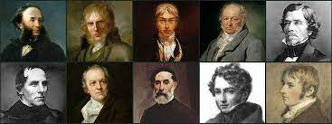

Slide 63
III. THE SOURCES OF THIS SOCIAL IMAGINARY—ROMANTICISM
In Romanticism the lingering emphasis is on the purity and simplicity of the “natural,” especially rural life, as opposed to the complications and restrictions of the city.
Trueman writes: “At its heart, Romanticism sought to find authentic humanity in an acknowledgement of, and connection to, the power of nature.”
While many of us nature lovers and “rural” folks might rise to cheer in agreement, the point is that the “natural” is the pure, inward self, unspoiled by the external forces of “civilization” with its rules and restrictions.
So this merely represents enthusiastic fans of Rousseau developing his core (atheistic, anti-Christian, humanistic) ideas in various art forms, especially poetry, literature, and music.
Notes:
Now we can be glad that most probably do not cheat or lie or fake their conclusions. In fact, the scientific method has a safeguard built into it from the start. Reliable data can only be gleaned from experiments that can be replicated, repeated with the same results. Anyone should be able to conduct the same experiment under the same conditions and achieve the same outcome. If you perform an experiment a thousand times and get the same results a thousand times, then the data is probably correct, even well established. If you get multiple, conflicting outcomes, then the data is not confirmed and needs more work.

Slide 64
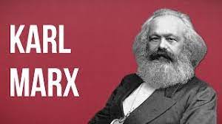

Slide 65
III. THE SOURCES OF THIS SOCIAL IMAGINARY—MARX
KARL MARX (1818-1883)
Marx injected the dynamic of “exploitation” into the continuing conversation. His concern was in class exploitation, how the owners separated the workers from the fruits of their labor. Religion was complicit in this, favoring the owners and seeking to soothe the workers with the claim that the circumstances were only God’s will, and that God would reward their subservience in the world to come. Marx hated religion, particularly the Christian faith, and called it “the opium of the masses.”
Notes:
Now we can be glad that most probably do not cheat or lie or fake their conclusions. In fact, the scientific method has a safeguard built into it from the start. Reliable data can only be gleaned from experiments that can be replicated, repeated with the same results. Anyone should be able to conduct the same experiment under the same conditions and achieve the same outcome. If you perform an experiment a thousand times and get the same results a thousand times, then the data is probably correct, even well established. If you get multiple, conflicting outcomes, then the data is not confirmed and needs more work.

Slide 66
III. THE SOURCES OF THIS SOCIAL IMAGINARY—MARX
What’s more, all forms of human community necessarily become political, including opposition and the striving for supremacy.
Those in charge create laws and structures to keep them in their positions of power.
“In short, Marx lays the groundwork for some of the most basic of our culture’s contemporary intuitions [the “social imaginary”]: Religion is a sign of intellectual weakness in its adherents and a means of social oppression for its proponents. Further, freedom can be achieved only by the abolition of religion. Above all, the idea that human nature is to be morally framed by theological claims such as the notion that men and women are made in the image of God is to be repudiated. Of course, few today have read Marx himself, but these ideas have in many ways infiltrated the cultural imagination in which religion is instinctively regarded as both childish and oppressive.”
Notes:
Now we can be glad that most probably do not cheat or lie or fake their conclusions. In fact, the scientific method has a safeguard built into it from the start. Reliable data can only be gleaned from experiments that can be replicated, repeated with the same results. Anyone should be able to conduct the same experiment under the same conditions and achieve the same outcome. If you perform an experiment a thousand times and get the same results a thousand times, then the data is probably correct, even well established. If you get multiple, conflicting outcomes, then the data is not confirmed and needs more work.

Slide 67
III. THE SOURCES OF THIS SOCIAL IMAGINARY—MARX
“We should also notice…that Marx’s claim that all social relations are economic relations has one more significant result: all human social relations must therefore be political because they all serve the status quo. Whether we are talking about the Boy Scouts or the local golf club, in Marx’s world all have political significance. If society is to be transformed, then these too must be arenas of political conflict. That sounds very familiar in a world where the last decade has seen cake baking, flower arranging, and school bathroom policies subjected to acrimonious legal wrangling….There is nothing in this world where human beings can relate to each other that is not a potential arena of political conflict, because all areas of life connect to the overall economic structure of society and thus to society’s inequalities and inequities; and Marx should be given much of the credit of laying the theoretical foundations of that.” (59)
Notes:
Now we can be glad that most probably do not cheat or lie or fake their conclusions. In fact, the scientific method has a safeguard built into it from the start. Reliable data can only be gleaned from experiments that can be replicated, repeated with the same results. Anyone should be able to conduct the same experiment under the same conditions and achieve the same outcome. If you perform an experiment a thousand times and get the same results a thousand times, then the data is probably correct, even well established. If you get multiple, conflicting outcomes, then the data is not confirmed and needs more work.

Slide 68
SUMMARY SO FAR
We are attempting to locate the roots of ideas that have taken hold in the current social imaginary and has shaped the common sentiment in a direction that is so opposite of and hostile to the biblical worldview.
Rousseau declared that the inner self is good and all external rules are stifling to inner goodness.
The Romantics ran with his ideas vaunting the unspoiled natural, authentic human nature kept free from the meddling rules of civilization.
Marx hated and ridiculed religion as the root of the problem and urged resistance to all authority since it was necessarily an exercise of power to keep the powerful in power.
We have three more thinkers to consider: Friedrich Nietzsche, Sigmund Freud, and Wilhelm Reich.
Notes:
Now we can be glad that most probably do not cheat or lie or fake their conclusions. In fact, the scientific method has a safeguard built into it from the start. Reliable data can only be gleaned from experiments that can be replicated, repeated with the same results. Anyone should be able to conduct the same experiment under the same conditions and achieve the same outcome. If you perform an experiment a thousand times and get the same results a thousand times, then the data is probably correct, even well established. If you get multiple, conflicting outcomes, then the data is not confirmed and needs more work.

Slide 70
III. THE SOURCES OF THIS SOCIAL IMAGINARY—NIETZSCHE
FRIEDRICH NIETZSCHE (1844-1900)
German Philosopher Friedrich Nietzsche, known for his declaration that “God is dead,” agreed with Marx that religion, especially Christianity was the enemy.
But Nietzsche did so for different reasons. He founded that many philosophers denied the existence of God but refused to make a clean break, and he noted how many common people continued to cling to their now discredited belief in God.
“This persistence of belief in God fulfills two functions: it is a crutch or an excuse by which the weak can avoid the challenge of creating their own meaning in an otherwise meaningless universe; and it is a means by which the weak can demonize and manipulate the strong.” (63)
Notes:
Now we can be glad that most probably do not cheat or lie or fake their conclusions. In fact, the scientific method has a safeguard built into it from the start. Reliable data can only be gleaned from experiments that can be replicated, repeated with the same results. Anyone should be able to conduct the same experiment under the same conditions and achieve the same outcome. If you perform an experiment a thousand times and get the same results a thousand times, then the data is probably correct, even well established. If you get multiple, conflicting outcomes, then the data is not confirmed and needs more work.

Slide 71
III. THE SOURCES OF THIS SOCIAL IMAGINARY—NIETZSCHE
Religion represents nonsensical myths and moral demands that hold us back from becoming fully human.
“For Nietzsche, then the great task facing human beings is to break free of the metaphysical myths that religion weaves and to shatter the moral codes that hinder individuals from being strong. We might express Nietzsche’s thoughts this way: freed from the burden of being creatures of God, human beings must rise to the challenge of self-creation, of being whoever they choose to be. Put perhaps even more bluntly: be whoever or whatever works for you. You should feel no obligation to conform to the standards and criteria of anybody else.” (63)
Notes:
Now we can be glad that most probably do not cheat or lie or fake their conclusions. In fact, the scientific method has a safeguard built into it from the start. Reliable data can only be gleaned from experiments that can be replicated, repeated with the same results. Anyone should be able to conduct the same experiment under the same conditions and achieve the same outcome. If you perform an experiment a thousand times and get the same results a thousand times, then the data is probably correct, even well established. If you get multiple, conflicting outcomes, then the data is not confirmed and needs more work.

Slide 72
III. THE SOURCES OF THIS SOCIAL IMAGINARY—NIETZSCHE
Nietzsche was fond of the image of the “ubermensch” or “superman,” (not the DC Comics creation) who rises above the pitiful existence of ordinary people, the “herd mentality” to assert himself in his “will to power.”
“The superman is the one who engages in dramatic, transgressive self-creation.” (65)
So Nietzsche despises the conformer and praises the one who breaks all rules and puts himself first, above all.
As we said earlier, the sinful self needs little excuse to rebel against God’s authority and revel in sin and self.
Nietzsche delivered not simply an excuse, but a positive imperative to do so.
Notes:
Now we can be glad that most probably do not cheat or lie or fake their conclusions. In fact, the scientific method has a safeguard built into it from the start. Reliable data can only be gleaned from experiments that can be replicated, repeated with the same results. Anyone should be able to conduct the same experiment under the same conditions and achieve the same outcome. If you perform an experiment a thousand times and get the same results a thousand times, then the data is probably correct, even well established. If you get multiple, conflicting outcomes, then the data is not confirmed and needs more work.

Slide 73
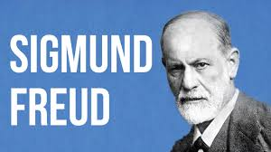

Slide 74
III. THE SOURCES OF THIS SOCIAL IMAGINARY—FREUD
SIGMUND FREUD (1856-1939)
Freud is widely known as “the father of modern psychology.”
And while most of his theories have been discredited, what has been eagerly embraced is Freud’s notion that sex is foundational to human happiness.
After Marx and Nietzsche abolished the thought that human nature has an external, objective moral structure, the importance of human happiness became paramount.
Freud agreed that to be human was not a matter of behaving morally, but what then became the foundation of human happiness?
Freud accepted the modern notion of happiness as enjoying pleasure and avoiding pain.
And for Freud, the fundamental source of human happiness was sexual pleasure.
Notes:
Now we can be glad that most probably do not cheat or lie or fake their conclusions. In fact, the scientific method has a safeguard built into it from the start. Reliable data can only be gleaned from experiments that can be replicated, repeated with the same results. Anyone should be able to conduct the same experiment under the same conditions and achieve the same outcome. If you perform an experiment a thousand times and get the same results a thousand times, then the data is probably correct, even well established. If you get multiple, conflicting outcomes, then the data is not confirmed and needs more work.

Slide 75
III. THE SOURCES OF THIS SOCIAL IMAGINARY—FREUD
In Freud’s words:
“Man’s discovery that sexual (genital) love afforded him the strongest experiences of satisfaction and in fact provided him with the prototype of all happiness, must have suggested to him that he should continue to seek the satisfaction of happiness in his life along the path of sexual relations and that he should make genital eroticism the central point of his life.” (73, emphasis added)
Notes:
Now we can be glad that most probably do not cheat or lie or fake their conclusions. In fact, the scientific method has a safeguard built into it from the start. Reliable data can only be gleaned from experiments that can be replicated, repeated with the same results. Anyone should be able to conduct the same experiment under the same conditions and achieve the same outcome. If you perform an experiment a thousand times and get the same results a thousand times, then the data is probably correct, even well established. If you get multiple, conflicting outcomes, then the data is not confirmed and needs more work.

Slide 76
III. THE SOURCES OF THIS SOCIAL IMAGINARY—FREUD
Now the sinful self has even more ammunition in his defense of sinful self-seeking. Dr. Freud has declared that uninhibited sexual pleasure is now to be the goal of our existence.
Freud did allow that society had to put some curbs on sexual behavior for the sake of its own survival.
He considered the impact this trade off to be the basis of all mental illness. All mental illness arose because some sexual desire was considered unacceptable and so was left unfulfilled.
But there is one more necessary component in reaching our current psychological state. It is the combination of Marxism and Freudianism under the direction of Wilhelm Reich.
Notes:
Now we can be glad that most probably do not cheat or lie or fake their conclusions. In fact, the scientific method has a safeguard built into it from the start. Reliable data can only be gleaned from experiments that can be replicated, repeated with the same results. Anyone should be able to conduct the same experiment under the same conditions and achieve the same outcome. If you perform an experiment a thousand times and get the same results a thousand times, then the data is probably correct, even well established. If you get multiple, conflicting outcomes, then the data is not confirmed and needs more work.

Slide 77
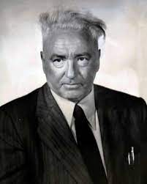
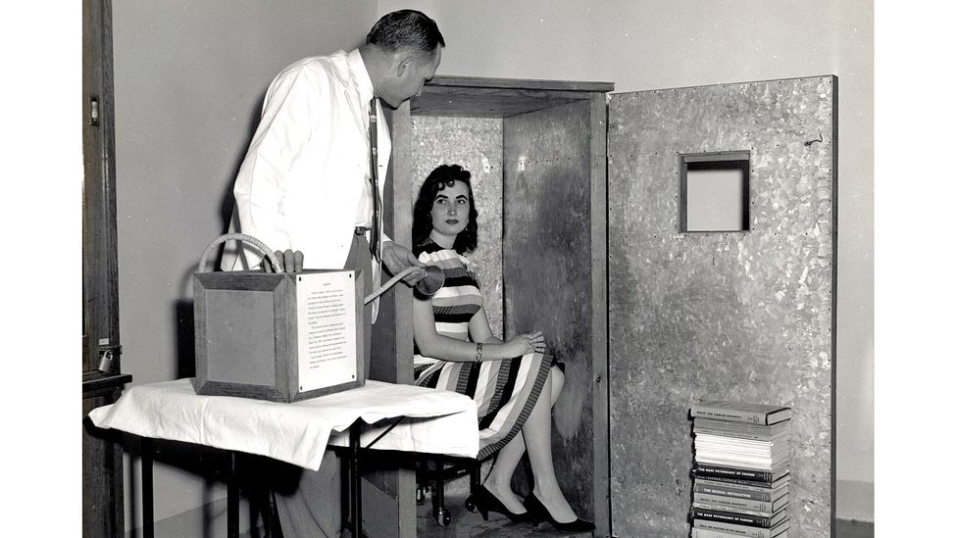

Slide 78
III. THE SOURCES OF THIS SOCIAL IMAGINARY—REICH
WILHELM REICH (1897-1957)
Reich was a colleague of Freud, whom Freud eventually dismissed as too extreme. He also died in prison.
If you recall, Marx’s point was that those holding the reins of power in society wrote laws and structured society for the singular purpose of retaining their authority and keeping their positions of control.
Reich applied this to traditional sexual morality.
Notes:
Now we can be glad that most probably do not cheat or lie or fake their conclusions. In fact, the scientific method has a safeguard built into it from the start. Reliable data can only be gleaned from experiments that can be replicated, repeated with the same results. Anyone should be able to conduct the same experiment under the same conditions and achieve the same outcome. If you perform an experiment a thousand times and get the same results a thousand times, then the data is probably correct, even well established. If you get multiple, conflicting outcomes, then the data is not confirmed and needs more work.

Slide 79
III. THE SOURCES OF THIS SOCIAL IMAGINARY—REICH
Freud had argued that the imposition of sexual morality was the necessary trade-off for maintaining a measure of stability in society.
Reich’s contention was that the traditional code of sexual morality was not good for maintaining civilization, but only a certain form of civilization, and that was the middle-class, capitalist culture of the German people.
But Reich argued that this kind of civilization was created to reinforce the structure and authority of the traditional family.
And Reich, among other progressives, was highly suspicious or critical of the traditional family. He considered the traditional family and the sexual morality that sustained it to be coercive and manipulative.
This, by the way, helps to explain that the Marxist Black Lives Matter movement was stridently anti-traditional family.
Notes:
Now we can be glad that most probably do not cheat or lie or fake their conclusions. In fact, the scientific method has a safeguard built into it from the start. Reliable data can only be gleaned from experiments that can be replicated, repeated with the same results. Anyone should be able to conduct the same experiment under the same conditions and achieve the same outcome. If you perform an experiment a thousand times and get the same results a thousand times, then the data is probably correct, even well established. If you get multiple, conflicting outcomes, then the data is not confirmed and needs more work.

Slide 80
III. THE SOURCES OF THIS SOCIAL IMAGINARY—REICH
“The point is clear: sexual codes must be shattered if human beings are to be truly free. Those things that inhibit the free sexual expression, even of young children, are oppressive and prevent individuals from truly being themselves.” (83)
Reich was a Marxist. And if the only solution to overthrowing such illegitimate power structures was violent revolution, so be it.
Notes:
Now we can be glad that most probably do not cheat or lie or fake their conclusions. In fact, the scientific method has a safeguard built into it from the start. Reliable data can only be gleaned from experiments that can be replicated, repeated with the same results. Anyone should be able to conduct the same experiment under the same conditions and achieve the same outcome. If you perform an experiment a thousand times and get the same results a thousand times, then the data is probably correct, even well established. If you get multiple, conflicting outcomes, then the data is not confirmed and needs more work.

Slide 81
III. THE SOURCES OF THIS SOCIAL IMAGINARY—REICH
So who is going to facilitate this sexual revolution?
“[S]ociety will do so, by promoting sexual freedom and dealing severely with those who oppose it. In short, sex must become a pressing political issue in which the State takes a proactive interest.”
So we’ve reached our destination, our explanation of how it came to this:
The State must take charge of abolishing every restriction or taboo regarding sex, whether it be legal, religious, or personal.
Notes:
Now we can be glad that most probably do not cheat or lie or fake their conclusions. In fact, the scientific method has a safeguard built into it from the start. Reliable data can only be gleaned from experiments that can be replicated, repeated with the same results. Anyone should be able to conduct the same experiment under the same conditions and achieve the same outcome. If you perform an experiment a thousand times and get the same results a thousand times, then the data is probably correct, even well established. If you get multiple, conflicting outcomes, then the data is not confirmed and needs more work.

Slide 82
III. THE SOURCES OF THIS SOCIAL IMAGINARY—REICH
In his foreword to Trueman’s shorter book, Ryan T. Anderson explains the outline:
“At the risk of oversimplifying what Trueman accomplishes, I would summarize the broad arc of his work as an account of how
the person became a self,
the self became sexualized,
and sex became politicized.”
And we have connected the dots or traced the stepping stones on this pathway from Rousseau to the Romantics (the self) to Marx and Nietzsche (the political), and on to Freud and Reich (the sexual).
Notes:
Now we can be glad that most probably do not cheat or lie or fake their conclusions. In fact, the scientific method has a safeguard built into it from the start. Reliable data can only be gleaned from experiments that can be replicated, repeated with the same results. Anyone should be able to conduct the same experiment under the same conditions and achieve the same outcome. If you perform an experiment a thousand times and get the same results a thousand times, then the data is probably correct, even well established. If you get multiple, conflicting outcomes, then the data is not confirmed and needs more work.

Slide 83
IV. THE POPULAR TRANSMISSION OF THIS SOCIAL IMAGINARY
But the question remains: how did the little-known ideas of these ivory tower thinkers become so widely accepted and eventually entrenched in the social imaginary of our day?
Few of us have read deeply in their writings.
The answer must lie in their popularizers, those who became enamored of their ideas and translated them into the wider consciousness, mostly through the arts: literature, painting and sculpting, popular music, and especially plays and film.
To delve deeply into these is beyond the scope of our brief study.
Suffice it to say that all art declares a message, reflecting a worldview, preaching and expecting a response.
Notes:
Now we can be glad that most probably do not cheat or lie or fake their conclusions. In fact, the scientific method has a safeguard built into it from the start. Reliable data can only be gleaned from experiments that can be replicated, repeated with the same results. Anyone should be able to conduct the same experiment under the same conditions and achieve the same outcome. If you perform an experiment a thousand times and get the same results a thousand times, then the data is probably correct, even well established. If you get multiple, conflicting outcomes, then the data is not confirmed and needs more work.

Slide 84
IV. THE POPULAR TRANSMISSION OF THIS SOCIAL IMAGINARY
Do you watch movies? You should be aware that the film writer, director, and actors are trying to convey a message and convince you of that message, and if you do not realize that they are doing so, they will likely succeed in shaping your social imaginary.
I recall many years ago speaking with a group of volunteer youth leaders. They were discussing a popular teen film that I had not seen.
I said, “Let me ask a question. In the film, was there any adult character who was trying to prevent young people from doing something they enjoyed?”
Several lit up, “Oh, yes, there was this cranky old religious guy who hated the fact they were having fun and did all that he could to stop it!”
Notes:
Now we can be glad that most probably do not cheat or lie or fake their conclusions. In fact, the scientific method has a safeguard built into it from the start. Reliable data can only be gleaned from experiments that can be replicated, repeated with the same results. Anyone should be able to conduct the same experiment under the same conditions and achieve the same outcome. If you perform an experiment a thousand times and get the same results a thousand times, then the data is probably correct, even well established. If you get multiple, conflicting outcomes, then the data is not confirmed and needs more work.

Slide 85
IV. THE POPULAR TRANSMISSION OF THIS SOCIAL IMAGINARY
I pointed out that none of those characters were real, and that this was only a message that the writer and director were trying to convey.
There were some sudden looks of awareness.
One man, however, protested and said, “Yeah, but that guy really WAS a jerk!”
So his social imaginary had been subtly shaped by this make-believe message, and he was utterly unaware of it.
(The movie, which I still have not seen, was Footloose.)
Notes:
Now we can be glad that most probably do not cheat or lie or fake their conclusions. In fact, the scientific method has a safeguard built into it from the start. Reliable data can only be gleaned from experiments that can be replicated, repeated with the same results. Anyone should be able to conduct the same experiment under the same conditions and achieve the same outcome. If you perform an experiment a thousand times and get the same results a thousand times, then the data is probably correct, even well established. If you get multiple, conflicting outcomes, then the data is not confirmed and needs more work.

Slide 87
IV. THE POPULAR TRANSMISSION OF THIS SOCIAL IMAGINARY
And what we must realize is that we are all expressive individualists now.
For all of our life we have been molded and massaged, shaped and squeezed into a certain way of thinking, a worldview, a social imaginary that seeks to convince us that our unique inner life, how we feel or what we decide, our inner self-improvement and outward self-expression are the most important things of all—the only thing.
And one of the biggest culprits and conveyors of this ideology is humanistic psychology, the psychology of the self.
One of the familiar images that is still commonly referenced today is the pyramid figure of “Maslow’s Hierarchy of Needs” as a supposed explanation of human motivation.
It’s diabolically clever with a little truth and a lot of error.
Notes:
Now we can be glad that most probably do not cheat or lie or fake their conclusions. In fact, the scientific method has a safeguard built into it from the start. Reliable data can only be gleaned from experiments that can be replicated, repeated with the same results. Anyone should be able to conduct the same experiment under the same conditions and achieve the same outcome. If you perform an experiment a thousand times and get the same results a thousand times, then the data is probably correct, even well established. If you get multiple, conflicting outcomes, then the data is not confirmed and needs more work.

Slide 88
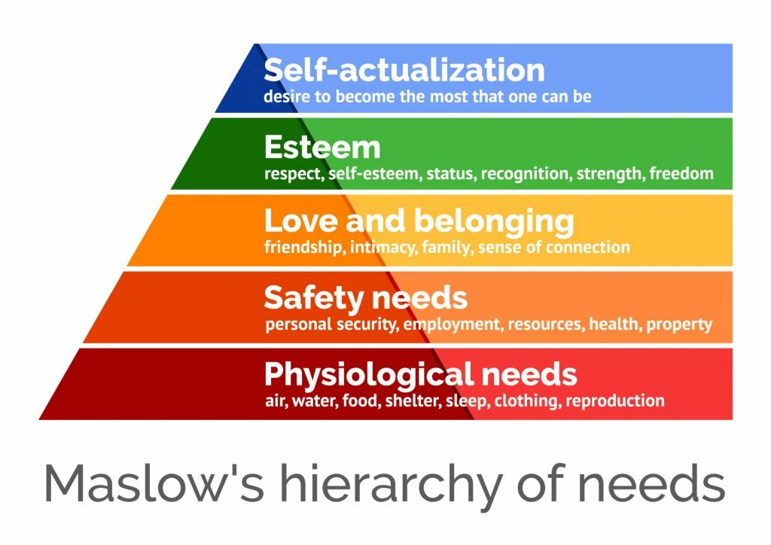

Slide 89
IV. THE POPULAR TRANSMISSION OF THIS SOCIAL IMAGINARY
In Maslow’s social imaginary, the human is defined primarily, or perhaps exclusively as a set of needs seeking fulfillment.
Notice, the human is not a moral agent tasked by God or society with any duties or obligations.
No, a human is entirely motivated by satisfying his or her needs.
Notes:
Now we can be glad that most probably do not cheat or lie or fake their conclusions. In fact, the scientific method has a safeguard built into it from the start. Reliable data can only be gleaned from experiments that can be replicated, repeated with the same results. Anyone should be able to conduct the same experiment under the same conditions and achieve the same outcome. If you perform an experiment a thousand times and get the same results a thousand times, then the data is probably correct, even well established. If you get multiple, conflicting outcomes, then the data is not confirmed and needs more work.

Slide 90
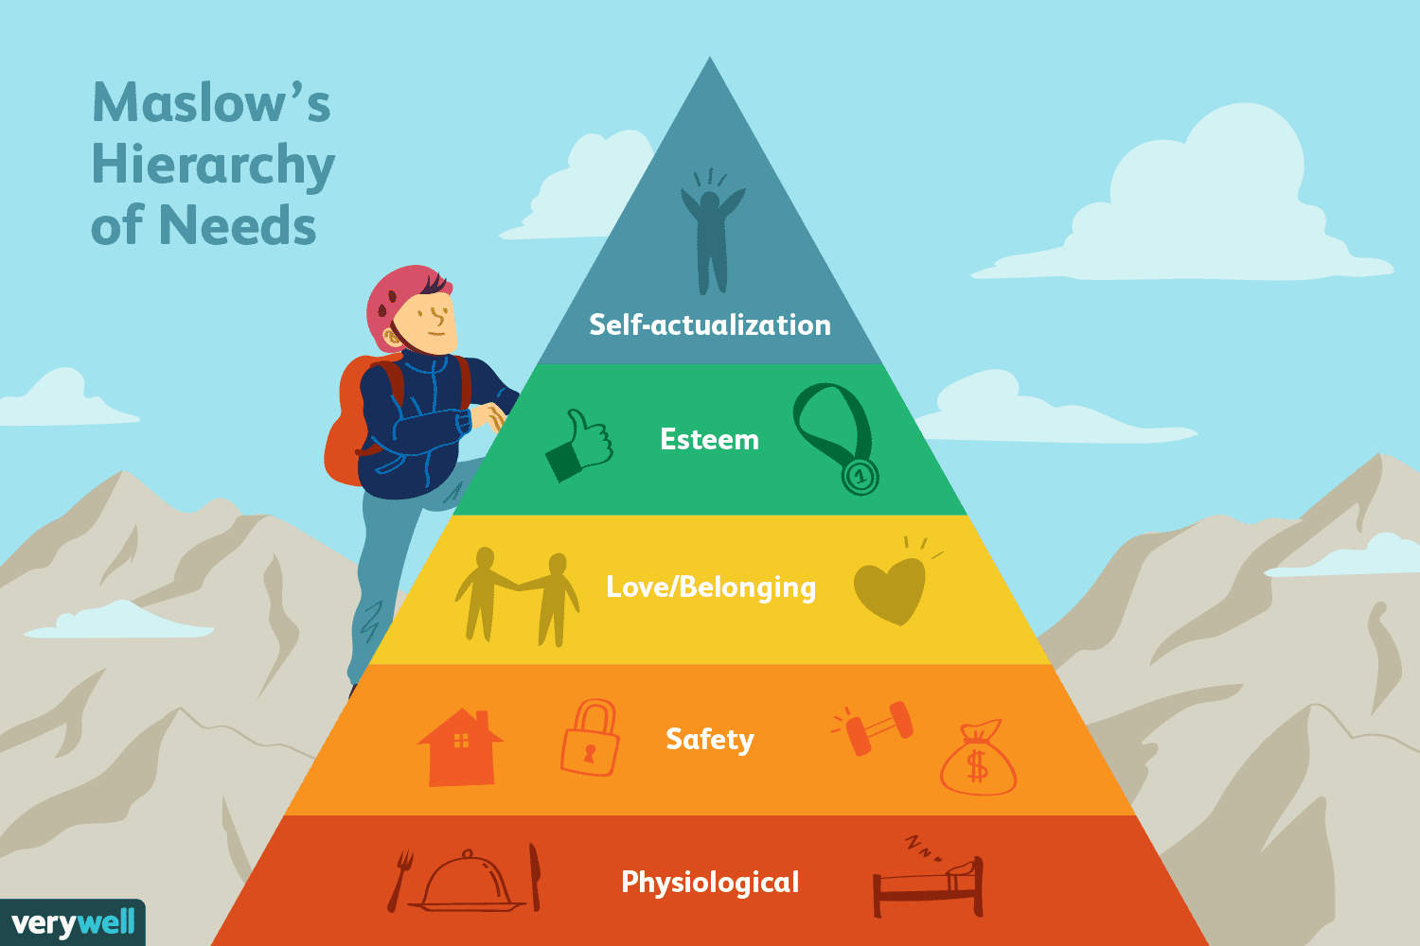

Slide 91
IV. THE POPULAR TRANSMISSION OF THIS SOCIAL IMAGINARY
The first levels are in regards to the most basic needs for survival. At the bottom the need for food and water, the basics of life.
Notes:
Now we can be glad that most probably do not cheat or lie or fake their conclusions. In fact, the scientific method has a safeguard built into it from the start. Reliable data can only be gleaned from experiments that can be replicated, repeated with the same results. Anyone should be able to conduct the same experiment under the same conditions and achieve the same outcome. If you perform an experiment a thousand times and get the same results a thousand times, then the data is probably correct, even well established. If you get multiple, conflicting outcomes, then the data is not confirmed and needs more work.

Slide 93
IV. THE POPULAR TRANSMISSION OF THIS SOCIAL IMAGINARY
Next up is the need for security, to feel safe. Until these needs are fully met, the human will not reach any higher to fulfill more seemingly noble needs.
Notes:
Now we can be glad that most probably do not cheat or lie or fake their conclusions. In fact, the scientific method has a safeguard built into it from the start. Reliable data can only be gleaned from experiments that can be replicated, repeated with the same results. Anyone should be able to conduct the same experiment under the same conditions and achieve the same outcome. If you perform an experiment a thousand times and get the same results a thousand times, then the data is probably correct, even well established. If you get multiple, conflicting outcomes, then the data is not confirmed and needs more work.

Slide 95
IV. THE POPULAR TRANSMISSION OF THIS SOCIAL IMAGINARY
The next level is for love and belonging, but not really to love others but to be loved. Above that is the quest for self-esteem. You see the influence of expressive individualism.
Notes:
Now we can be glad that most probably do not cheat or lie or fake their conclusions. In fact, the scientific method has a safeguard built into it from the start. Reliable data can only be gleaned from experiments that can be replicated, repeated with the same results. Anyone should be able to conduct the same experiment under the same conditions and achieve the same outcome. If you perform an experiment a thousand times and get the same results a thousand times, then the data is probably correct, even well established. If you get multiple, conflicting outcomes, then the data is not confirmed and needs more work.

Slide 97
IV. THE POPULAR TRANSMISSION OF THIS SOCIAL IMAGINARY
And then there is a subtle shift as we move to the top, the “need” for self-actualization. Since the unique self is a true marvel, a wonder to behold, it suddenly becomes one’s duty to make this self as wonderful as possible and display that wonder before all.
Notes:
Now we can be glad that most probably do not cheat or lie or fake their conclusions. In fact, the scientific method has a safeguard built into it from the start. Reliable data can only be gleaned from experiments that can be replicated, repeated with the same results. Anyone should be able to conduct the same experiment under the same conditions and achieve the same outcome. If you perform an experiment a thousand times and get the same results a thousand times, then the data is probably correct, even well established. If you get multiple, conflicting outcomes, then the data is not confirmed and needs more work.

Slide 99
IV. THE POPULAR TRANSMISSION OF THIS SOCIAL IMAGINARY
In response, we should note a few things.
1. First, this is a pretty accurate description of the unbeliever, enslaved to sin and self.
2. You will notice that this hierarchy shows zero concern for duty to others or to society in general.
3. This scheme is unsustainable. If everyone is seeking to get their needs met, who does the need- meeting?
4. The changing emphasis at the top to “self-actualization,” the development of the inner life then performing for others reveals that this model is simply an expression of expressive individualism. And this is the apex of all our striving. This is the “chief end of man” in this secular worldview.
Notes:
Now we can be glad that most probably do not cheat or lie or fake their conclusions. In fact, the scientific method has a safeguard built into it from the start. Reliable data can only be gleaned from experiments that can be replicated, repeated with the same results. Anyone should be able to conduct the same experiment under the same conditions and achieve the same outcome. If you perform an experiment a thousand times and get the same results a thousand times, then the data is probably correct, even well established. If you get multiple, conflicting outcomes, then the data is not confirmed and needs more work.

Slide 101
IV. THE POPULAR TRANSMISSION OF THIS SOCIAL IMAGINARY
And this scheme is common is psychology and educational theory, public schools.
It is a nearly perfect model of expressive individualism.
We mentioned earlier the transformation of schools and churches, no longer as a place to be formed but to perform.
Several years ago some proposed government action was likely to force many into unemployment. The then speaker of the US House of Representatives, Nancy Pelosi was not worried in the least. She thought it might give some people the opportunity to take up painting.
Through its social welfare programs, the government would support the unemployed at a subsistence level so that they could have the free time to pursue “self-actualization” and develop the hidden talents of their inner self for purposes of performance and display.
She was appealing to “expressive individualism.”
Notes:
Now we can be glad that most probably do not cheat or lie or fake their conclusions. In fact, the scientific method has a safeguard built into it from the start. Reliable data can only be gleaned from experiments that can be replicated, repeated with the same results. Anyone should be able to conduct the same experiment under the same conditions and achieve the same outcome. If you perform an experiment a thousand times and get the same results a thousand times, then the data is probably correct, even well established. If you get multiple, conflicting outcomes, then the data is not confirmed and needs more work.

Slide 102
IV. THE POPULAR TRANSMISSION OF THIS SOCIAL IMAGINARY
The US Military has adopted the same strategy in recent years seeking to entice new recruits. Think of the various slogans that we have heard repeatedly.
Notes:
Now we can be glad that most probably do not cheat or lie or fake their conclusions. In fact, the scientific method has a safeguard built into it from the start. Reliable data can only be gleaned from experiments that can be replicated, repeated with the same results. Anyone should be able to conduct the same experiment under the same conditions and achieve the same outcome. If you perform an experiment a thousand times and get the same results a thousand times, then the data is probably correct, even well established. If you get multiple, conflicting outcomes, then the data is not confirmed and needs more work.

Slide 104
IV. THE POPULAR TRANSMISSION OF THIS SOCIAL IMAGINARY
Already from 1980 the motto was “Be All that You can Be.”
That was quite a departure from the longstanding “Today’s Army Wants You to Join,” from the group to the individual.
Notice the focus on joining the army for purposes of personal development, and not in any sense of a duty to defend the country, for example.
Notes:
Now we can be glad that most probably do not cheat or lie or fake their conclusions. In fact, the scientific method has a safeguard built into it from the start. Reliable data can only be gleaned from experiments that can be replicated, repeated with the same results. Anyone should be able to conduct the same experiment under the same conditions and achieve the same outcome. If you perform an experiment a thousand times and get the same results a thousand times, then the data is probably correct, even well established. If you get multiple, conflicting outcomes, then the data is not confirmed and needs more work.

Slide 106
IV. THE POPULAR TRANSMISSION OF THIS SOCIAL IMAGINARY
From 2001-2006 we saw the short-lived emphasis on “Army of One,” even more individualistic and focused on self.
Currently, the motto is “Army Strong,” a rather ambivalent message meaning either “a strong army” or you personally will become “army strong.” Read it any way you want to.
Notes:
Now we can be glad that most probably do not cheat or lie or fake their conclusions. In fact, the scientific method has a safeguard built into it from the start. Reliable data can only be gleaned from experiments that can be replicated, repeated with the same results. Anyone should be able to conduct the same experiment under the same conditions and achieve the same outcome. If you perform an experiment a thousand times and get the same results a thousand times, then the data is probably correct, even well established. If you get multiple, conflicting outcomes, then the data is not confirmed and needs more work.

Slide 108
IV. THE POPULAR TRANSMISSION OF THIS SOCIAL IMAGINARY
The Marines launched a campaign in 2017 with the tagline: “Battles are Won Within.”
Again, the emphasis is on joining the Marines for the purpose of internal challenge and development.
Notes:
Now we can be glad that most probably do not cheat or lie or fake their conclusions. In fact, the scientific method has a safeguard built into it from the start. Reliable data can only be gleaned from experiments that can be replicated, repeated with the same results. Anyone should be able to conduct the same experiment under the same conditions and achieve the same outcome. If you perform an experiment a thousand times and get the same results a thousand times, then the data is probably correct, even well established. If you get multiple, conflicting outcomes, then the data is not confirmed and needs more work.

Slide 110
IV. THE POPULAR TRANSMISSION OF THIS SOCIAL IMAGINARY
But some religious people have followed the same playbook.
The wildly popular religious life-coach Joel Osteen has done the same, shamelessly appealing to expressive individualism to sell his books.
Here are the titles:
“Your Best Life Now” (2004)
“Become a Better You” (2007)
“It’s Your Time” (2009)
“I Declare” (2012)
“You Can, You Will” (2014)
“The Power of ‘I Am’” (2015)
Notes:
Now we can be glad that most probably do not cheat or lie or fake their conclusions. In fact, the scientific method has a safeguard built into it from the start. Reliable data can only be gleaned from experiments that can be replicated, repeated with the same results. Anyone should be able to conduct the same experiment under the same conditions and achieve the same outcome. If you perform an experiment a thousand times and get the same results a thousand times, then the data is probably correct, even well established. If you get multiple, conflicting outcomes, then the data is not confirmed and needs more work.

Slide 111
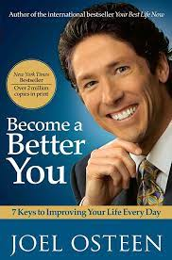

Slide 112
IV. THE POPULAR TRANSMISSION OF THIS SOCIAL IMAGINARY
Christians know that the covenant name of God given at Mt. Sinai is “Yahweh” or “I AM.”
Osteen is not talking about the power of God, but the internal power of one who will stand defiantly and declare “I Am.”
This is one of the most astonishing examples of blasphemy that the world has ever known.
Notes:
Now we can be glad that most probably do not cheat or lie or fake their conclusions. In fact, the scientific method has a safeguard built into it from the start. Reliable data can only be gleaned from experiments that can be replicated, repeated with the same results. Anyone should be able to conduct the same experiment under the same conditions and achieve the same outcome. If you perform an experiment a thousand times and get the same results a thousand times, then the data is probably correct, even well established. If you get multiple, conflicting outcomes, then the data is not confirmed and needs more work.

Slide 113
IV. THE POPULAR TRANSMISSION OF THIS SOCIAL IMAGINARY
And many churches have struck a compromise with expressive individualism.
Expressive individualists love the stage, and many churches work hard to provide that stage where these expressive individualists can perform for the congregation (and now globally on Livestream or YouTube!).
But how, then, is that same church going to be able to challenge the errors of expressive individualism and rescue the same people from their addiction to self?
Notes:
Now we can be glad that most probably do not cheat or lie or fake their conclusions. In fact, the scientific method has a safeguard built into it from the start. Reliable data can only be gleaned from experiments that can be replicated, repeated with the same results. Anyone should be able to conduct the same experiment under the same conditions and achieve the same outcome. If you perform an experiment a thousand times and get the same results a thousand times, then the data is probably correct, even well established. If you get multiple, conflicting outcomes, then the data is not confirmed and needs more work.

Slide 114
2023 SUMMER SEMINARS HOSPERS PCA
“Understanding the Popular Mind”
June 20 “Responding to the Social Imaginary”
June 27 “Restoring Biblical Marriage”
July 18 “Is the Church Witnessing a ‘New Apostolic Reformation’?”
Notes:
Now we can be glad that most probably do not cheat or lie or fake their conclusions. In fact, the scientific method has a safeguard built into it from the start. Reliable data can only be gleaned from experiments that can be replicated, repeated with the same results. Anyone should be able to conduct the same experiment under the same conditions and achieve the same outcome. If you perform an experiment a thousand times and get the same results a thousand times, then the data is probably correct, even well established. If you get multiple, conflicting outcomes, then the data is not confirmed and needs more work.

Slide 115
V. THE BIBLICAL RESPONSE TO THIS SOCIAL IMAGINARY
So the current social imaginary of the vast majority of those in and out of the church has been carefully crafted.
And it is that of expressive individualism: “the belief that each person must act based on expressing his or her [unique] core feelings and intuition.”
This does not bode well for the fabric of the republic, the society at large, or the health and wellbeing of the church. Trueman puts it succinctly:
“For traditional Christians, the narrative of this book is inevitably a somewhat depressing one, as it points both to past transformations of the notion of selfhood that challenge our views at every level and indicates that the world in which we live is hostile to expression of our beliefs on these matters.” (169)
So how to respond to this current social imaginary?
Notes:
Now we can be glad that most probably do not cheat or lie or fake their conclusions. In fact, the scientific method has a safeguard built into it from the start. Reliable data can only be gleaned from experiments that can be replicated, repeated with the same results. Anyone should be able to conduct the same experiment under the same conditions and achieve the same outcome. If you perform an experiment a thousand times and get the same results a thousand times, then the data is probably correct, even well established. If you get multiple, conflicting outcomes, then the data is not confirmed and needs more work.

Slide 116
V. THE BIBLICAL RESPONSE TO THIS SOCIAL IMAGINARY
1. Be prepared.
This is going to get worse before it gets better.
Currently “To object to same-sex marriage, for example, is in the moral register of the day not substantially different from being a racist. The era when Christians could disagree with the broader convictions of the secular world and yet find themselves respected as decent members of society at large is coming to an end, if indeed it has not ended already.” (169)
Notes:
Now we can be glad that most probably do not cheat or lie or fake their conclusions. In fact, the scientific method has a safeguard built into it from the start. Reliable data can only be gleaned from experiments that can be replicated, repeated with the same results. Anyone should be able to conduct the same experiment under the same conditions and achieve the same outcome. If you perform an experiment a thousand times and get the same results a thousand times, then the data is probably correct, even well established. If you get multiple, conflicting outcomes, then the data is not confirmed and needs more work.

Slide 117
V. THE BIBLICAL RESPONSE TO THIS SOCIAL IMAGINARY
2. Understand our complicity.
There are some aspects of expressive individualism that are right. The Psalms, for example, remind us that our response to God is not simply a matter of outward conformity, but of inward, psychological response with the fullness of our affections, the whole person. And coming to Christ is an exercise of personal faith in him.
But because the church in the western world has become a religious marketplace angling for its market share of consumers/adherents, many churches have sought to appeal to the felt needs of the psychologized self, and to promise that which is the only universal goal of the current social imaginary: psychological happiness.
Notes:
Now we can be glad that most probably do not cheat or lie or fake their conclusions. In fact, the scientific method has a safeguard built into it from the start. Reliable data can only be gleaned from experiments that can be replicated, repeated with the same results. Anyone should be able to conduct the same experiment under the same conditions and achieve the same outcome. If you perform an experiment a thousand times and get the same results a thousand times, then the data is probably correct, even well established. If you get multiple, conflicting outcomes, then the data is not confirmed and needs more work.

Slide 118
V. THE BIBLICAL RESPONSE TO THIS SOCIAL IMAGINARY
Trueman quotes an observation by American sociologist Philip Rieff:
“Formerly, if men were miserable, they went to church, so as to find the rationale for their misery; they did not expect to be happy, this idea is Greek, not Christian our Jewish.” (171)
To this Trueman adds:
“Such a notion is incomprehensible today: we as Christians intuitively go to church to feel good—perhaps to meet friends or to sing uplifting songs (whether traditional or contemporary) or to have our minds stimulated by a good sermon or our ears edified by beautiful music. Prayers, personal and corporate, tend to focus on the alleviation of misery, not being enabled to understand it. We tend to go to—to choose!—the church that fits with what makes us personally feel good.”
Notes:
Now we can be glad that most probably do not cheat or lie or fake their conclusions. In fact, the scientific method has a safeguard built into it from the start. Reliable data can only be gleaned from experiments that can be replicated, repeated with the same results. Anyone should be able to conduct the same experiment under the same conditions and achieve the same outcome. If you perform an experiment a thousand times and get the same results a thousand times, then the data is probably correct, even well established. If you get multiple, conflicting outcomes, then the data is not confirmed and needs more work.

Slide 119
V. THE BIBLICAL RESPONSE TO THIS SOCIAL IMAGINARY
Why should personal happiness be normal, expected, or even possible in a fallen world?
Is personal happiness in this world a worthy goal endorsed in Scripture?
Did the godly men and women of the Bible set personal happiness as their main goal in life?
So we need to examine ourselves “to see in what ways we have compromised the gospel with the spirit of this age. Then, we need to repent, call out to the Lord for grace, and seek to reform our beliefs, attitudes, intuitions, and practices accordingly. Nothing less is required for a true reformation at this point.”
Notes:
Now we can be glad that most probably do not cheat or lie or fake their conclusions. In fact, the scientific method has a safeguard built into it from the start. Reliable data can only be gleaned from experiments that can be replicated, repeated with the same results. Anyone should be able to conduct the same experiment under the same conditions and achieve the same outcome. If you perform an experiment a thousand times and get the same results a thousand times, then the data is probably correct, even well established. If you get multiple, conflicting outcomes, then the data is not confirmed and needs more work.

Slide 120
V. THE BIBLICAL RESPONSE TO THIS SOCIAL IMAGINARY
3. Learn from the ancient church.
We are not the first Christians to face the hostility of the wider culture.
Trueman points to the model of the second century church which he describes as “a little-understood, despised, marginal sect.” This is not defeatist, but realistic. For decades now, we have lived in a “post-Christian” era.
Perhaps you do not remember, but in the mid- and late-1900s, news organizations felt an obligation to get the perspective of mainline protestant churches on the significant issues of the day.
Now most of the sound bites from Christians are held up for ridicule and contempt.
Notes:
Now we can be glad that most probably do not cheat or lie or fake their conclusions. In fact, the scientific method has a safeguard built into it from the start. Reliable data can only be gleaned from experiments that can be replicated, repeated with the same results. Anyone should be able to conduct the same experiment under the same conditions and achieve the same outcome. If you perform an experiment a thousand times and get the same results a thousand times, then the data is probably correct, even well established. If you get multiple, conflicting outcomes, then the data is not confirmed and needs more work.

Slide 121
V. THE BIBLICAL RESPONSE TO THIS SOCIAL IMAGINARY
And what do we learn from the hard-pressed, second-century church?
(1) We learn the importance of community. Our identity and character is largely shaped by the community to which we belong.
(2) We learn that worship and fellowship are the key common elements of these vital Christian communities. “Gathering together on the Lord’s Day, praying, singing God’s praise, hearing the word read and preached, celebrating baptism and the Lord’s Supper, giving materially to the church’s work—these are things all Christians should do when gathered together.” (176)
Notes:
Now we can be glad that most probably do not cheat or lie or fake their conclusions. In fact, the scientific method has a safeguard built into it from the start. Reliable data can only be gleaned from experiments that can be replicated, repeated with the same results. Anyone should be able to conduct the same experiment under the same conditions and achieve the same outcome. If you perform an experiment a thousand times and get the same results a thousand times, then the data is probably correct, even well established. If you get multiple, conflicting outcomes, then the data is not confirmed and needs more work.

Slide 122
V. THE BIBLICAL RESPONSE TO THIS SOCIAL IMAGINARY
(3) We learn to demonstrate a better alternative to the culture around us.
Trueman notes: “Many Christians talk of engaging the culture. In fact, the culture is most dramatically engaged by the church presenting it with another culture, another form of community rooted in her liturgical worship practices and manifested in the loving community that exists both in and beyond the worship service.” (176)
Notes:
Now we can be glad that most probably do not cheat or lie or fake their conclusions. In fact, the scientific method has a safeguard built into it from the start. Reliable data can only be gleaned from experiments that can be replicated, repeated with the same results. Anyone should be able to conduct the same experiment under the same conditions and achieve the same outcome. If you perform an experiment a thousand times and get the same results a thousand times, then the data is probably correct, even well established. If you get multiple, conflicting outcomes, then the data is not confirmed and needs more work.

Slide 123
V. THE BIBLICAL RESPONSE TO THIS SOCIAL IMAGINARY
(4) And we learn to unashamedly teach the whole counsel of God. We dare not simply be reactionary, trying to put out fires of false teaching as they arise. Instead, we must carefully, systematically, faithfully, and continually teaching the entirety of the biblical message.
Notes:
Now we can be glad that most probably do not cheat or lie or fake their conclusions. In fact, the scientific method has a safeguard built into it from the start. Reliable data can only be gleaned from experiments that can be replicated, repeated with the same results. Anyone should be able to conduct the same experiment under the same conditions and achieve the same outcome. If you perform an experiment a thousand times and get the same results a thousand times, then the data is probably correct, even well established. If you get multiple, conflicting outcomes, then the data is not confirmed and needs more work.

Slide 124
V. THE BIBLICAL RESPONSE TO THIS SOCIAL IMAGINARY
“…Christian truth is not a set of isolated and unconnected claims but rather stands as a coherent whole. The church’s teaching on gender, marriage, and sex is a function of her teaching on what it means to be human. The doctrines of creation, fall, redemption, and consummation are important foundations for addressing the specific challenges of our time. If, as I have argued in this book, modern sexual and identity politics are functions of deeper notions of selfhood, then we need first to know what the Christian view of the self is in order to address them. And as the Bible teaches that the human self is made in the image of God, we need a good grasp on the doctrine of God. In short, we can stand strong at this cultural moment and address the specific challenges we face only if our foundations in God’s truth are broad and deep.” (178)
Notes:
Now we can be glad that most probably do not cheat or lie or fake their conclusions. In fact, the scientific method has a safeguard built into it from the start. Reliable data can only be gleaned from experiments that can be replicated, repeated with the same results. Anyone should be able to conduct the same experiment under the same conditions and achieve the same outcome. If you perform an experiment a thousand times and get the same results a thousand times, then the data is probably correct, even well established. If you get multiple, conflicting outcomes, then the data is not confirmed and needs more work.

Slide 125
V. THE BIBLICAL RESPONSE TO THIS SOCIAL IMAGINARY
4. Shape Intuitions through Biblical Worship.
Our own social imaginaries, our non-reflective intuitions need to be re-formed through the rhythm of biblical worship: adoration of God, confession and forgiveness of sin, instruction and formation in Christian truth and worldview, and recommitment to God and to our Christian family.
Notes:
Now we can be glad that most probably do not cheat or lie or fake their conclusions. In fact, the scientific method has a safeguard built into it from the start. Reliable data can only be gleaned from experiments that can be replicated, repeated with the same results. Anyone should be able to conduct the same experiment under the same conditions and achieve the same outcome. If you perform an experiment a thousand times and get the same results a thousand times, then the data is probably correct, even well established. If you get multiple, conflicting outcomes, then the data is not confirmed and needs more work.

Slide 126
V. THE BIBLICAL RESPONSE TO THIS SOCIAL IMAGINARY
5. Natural Law and the Theology of the Body
God through natures teaches us much about the way human life and communities flourish. It’s pretty hard to dispute that humans come in two varieties, male and female, and that it takes one of each to form families. We have much to learn and to declare from the goodness of God’s creation, even of God’s design for humans reflected by our bodies, “fearfully and wonderfully made.”
Notes:
Now we can be glad that most probably do not cheat or lie or fake their conclusions. In fact, the scientific method has a safeguard built into it from the start. Reliable data can only be gleaned from experiments that can be replicated, repeated with the same results. Anyone should be able to conduct the same experiment under the same conditions and achieve the same outcome. If you perform an experiment a thousand times and get the same results a thousand times, then the data is probably correct, even well established. If you get multiple, conflicting outcomes, then the data is not confirmed and needs more work.

Slide 127
V. THE BIBLICAL RESPONSE TO THIS SOCIAL IMAGINARY
6. Choose Neither Despair nor Optimism.
“To fall into the former [despair] would be to fail to take seriously the promise that the church will win in the end because the gates of hell shall not prevail against her. To engage in the latter [optimism] is simply to prepare the stage for deeper despair later. And both will feed inaction, one out of a sense of impotence, another out of naiveté.”
Notes:
Now we can be glad that most probably do not cheat or lie or fake their conclusions. In fact, the scientific method has a safeguard built into it from the start. Reliable data can only be gleaned from experiments that can be replicated, repeated with the same results. Anyone should be able to conduct the same experiment under the same conditions and achieve the same outcome. If you perform an experiment a thousand times and get the same results a thousand times, then the data is probably correct, even well established. If you get multiple, conflicting outcomes, then the data is not confirmed and needs more work.

Slide 128
V. THE BIBLICAL RESPONSE TO THIS SOCIAL IMAGINARY
Trueman wisely counsels hope.
“Christian hope…is optimistic. It understands that this world is a vale of tears, that things are not as they should be….This world is not the Christian’s home, and so we should not expect it to provide us with home comforts.”
We can and should be thankful for the comforts we do enjoy, the remaining blessings of freedom even as they seem to be shrinking.
Notes:
Now we can be glad that most probably do not cheat or lie or fake their conclusions. In fact, the scientific method has a safeguard built into it from the start. Reliable data can only be gleaned from experiments that can be replicated, repeated with the same results. Anyone should be able to conduct the same experiment under the same conditions and achieve the same outcome. If you perform an experiment a thousand times and get the same results a thousand times, then the data is probably correct, even well established. If you get multiple, conflicting outcomes, then the data is not confirmed and needs more work.

Slide 129
V. THE BIBLICAL RESPONSE TO THIS SOCIAL IMAGINARY
“But I am also aware that the world is fallen, that the gospel does not promise me necessarily the life of ease and comfort I currently have, and that my calling, as that of all Christians, is to live faithfully in the time and place I have been set. And that means that when things go awry, or when I am faced with changes that bring suffering to me or to my loved ones or to society at large, I must not despair. I must work to the best of my ability to right such wrongs, and I must also remember that the real meaning of my life and that of others is not found in the here and now but in the hereafter. Suffering here and now may at times be terrible, even unbearable, but it is never meaningless. No, it finds its meaning in the life, death, resurrection, ascension, and return of the Lord Jesus Christ.” (186)
Notes:
Now we can be glad that most probably do not cheat or lie or fake their conclusions. In fact, the scientific method has a safeguard built into it from the start. Reliable data can only be gleaned from experiments that can be replicated, repeated with the same results. Anyone should be able to conduct the same experiment under the same conditions and achieve the same outcome. If you perform an experiment a thousand times and get the same results a thousand times, then the data is probably correct, even well established. If you get multiple, conflicting outcomes, then the data is not confirmed and needs more work.

Slide 130
2023 SUMMER SEMINARS HOSPERS PCA
“Understanding the Popular Mind”
June 20 “Responding to the Social Imaginary”
June 27 “Restoring Biblical Marriage”
July 18 “Is the Church Witnessing a ‘New Apostolic Reformation’?”
Notes:
Now we can be glad that most probably do not cheat or lie or fake their conclusions. In fact, the scientific method has a safeguard built into it from the start. Reliable data can only be gleaned from experiments that can be replicated, repeated with the same results. Anyone should be able to conduct the same experiment under the same conditions and achieve the same outcome. If you perform an experiment a thousand times and get the same results a thousand times, then the data is probably correct, even well established. If you get multiple, conflicting outcomes, then the data is not confirmed and needs more work.

